Slide 1
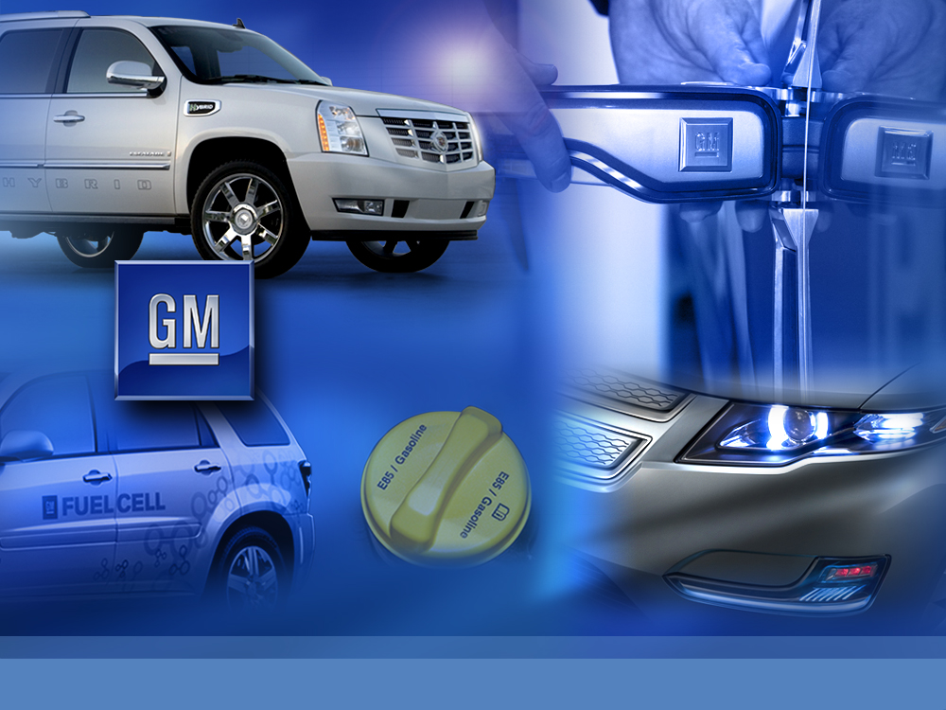
The Future of the Automobile
Converging on a Sustainability
Bob Kruse
Executive Director, Global Vehicle Engineering
Hybrids, Electric Vehicles & Batteries
Missouri Energy Summit
April 22, 2009

Slide 2
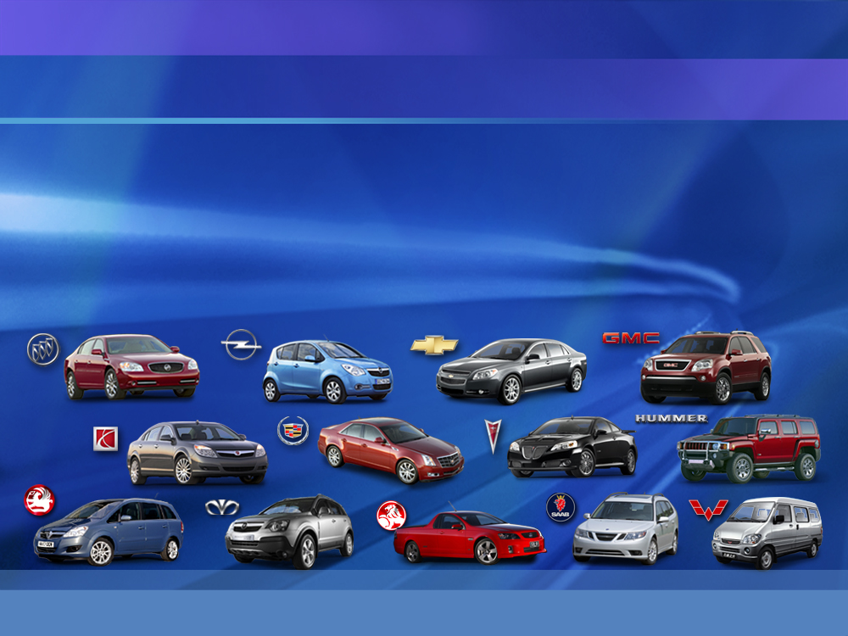

General Motors Corporation
  Founded in 1908
  Worldwide employment: 252,000
  2008 worldwide vehicle sales: 8.35M
  12.4% of global vehicle market
Notes:
RAK_ARA02

Slide 3
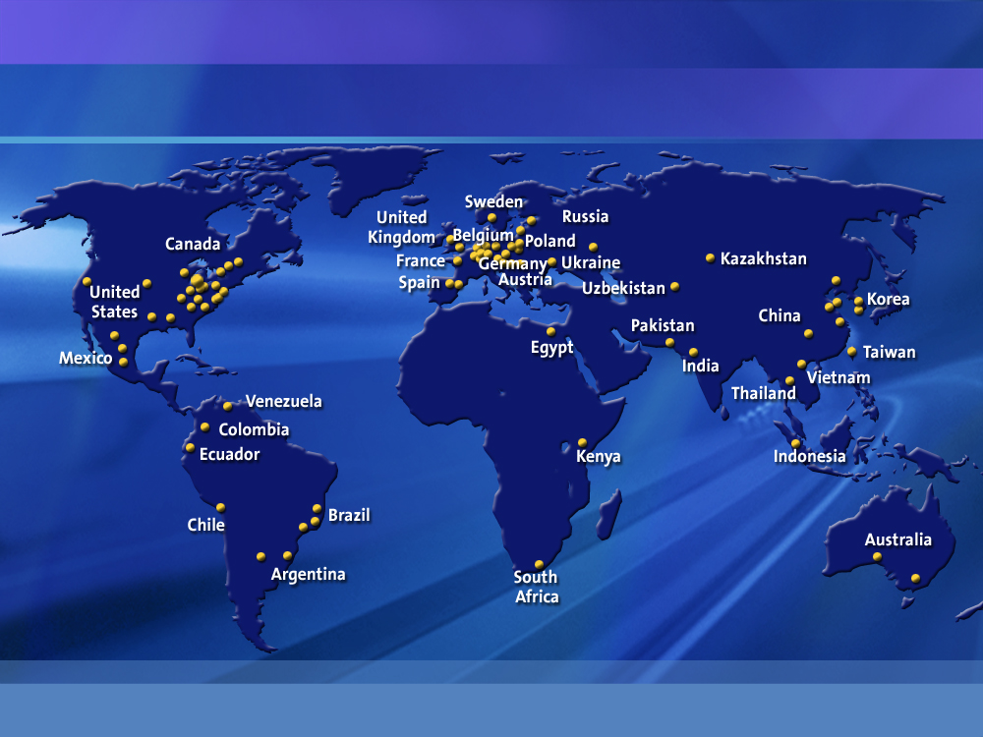
GM’s Global Manufacturing Footprint
Notes:
RAK_ARA03

Slide 4







































The General Motors Network
WULING
Engineering JVs
Manufacturing JVs
Powertrain JVs
Mini Vehicles Factory 15.812%
Wuling Auto Co., Ltd. .022
Yili Machinery Co., Ltd. .022
Guolian Transportation Co., Ltd. .022
Changhong Machinery Mfg. Co. .022
General Motors Acceptance
Corporation
40%
15.9%
GMAC - SAIC
Automotive Finance Co., LTD
40%
50.1%
Liuzhou, Guangxi, China
SAIC - GM - Wuling
Liuzhou, Guangxi,
QingDao, Shandong
China
Shanghai,
China
25%
Yulon - GM
Motor Co., LTD.
Vehicle Distribution Aftermarket Sales
51%
Shanghai Automotive Industry Corp
Shanghai,
China
formerly
Jinbei GM
South Korean
Creditor
Banks
25%
Shanghai-GM
DongYue
Automotive
Powertrain
Co., LTD.
Taipei, Taiwan, ROC
Taipei, Taiwan, ROC
50%
Shanghai-GM Norsom Motors Co., LTD
Yantai, Shandong,
China
Shenyang, Liaoning,
China
Light
Commercial Vehicle
LCV Platform
Engineering Corp.
Next Gen Small Truck
Fujisawa,
Japan
27.97%
9.89%
50%
25%
20%
50%
50%
49%
34%
50%
Shanghai-GM
DongYue
Motors Co., LTD
Shanghai, China
25%
40%
Pan Asia Technical Automotive Center
Shanghai,
China
50%
25%
Incheon, South Korea
Vehicle Assembly
Yantai, Shandong,
China
50%
50%
GM-Isuzu Diesel Engineering Limited
Fujisawa,
Japan
40%
Fujisawa, Japan
11.24%
25%
Duramax Diesel V8
Moraine, Ohio, USA
50.9%
50%
60%
40%
20%
3%
60%
Hamamatsu, Japan
Isuzu Motors Polska
Tychy,
Poland
Egypt
.7%
60%
31%
6th of October City, Egypt
2%
49%
50%
98%
57.7%
Argentina
33% = Egyptian Private Investors
16% = Saudi Private Investors
Rosario, Argentina
30%
Kenya
50%
Nigeria
60%
Nairobi, Kenya
10% = Employee Ownership
Lagos,
Nigeria
United Africa
Company - Nigeria
Lagos,
Nigeria
Ingersoll, Ontario, Canada
50%
4.5%
37.8%
49%
50%
50%
25%
Plus One Share
50%
20% = Kenyan Government
17.8% = Kenyan Industrial & Commercial Development Company
Fremont, California,
USA
41.61%
50%
Toyota City, Japan
Diesel Engines
Bielsko-Biala,
Poland
Itochu Corporation Tokyo,
Japan
51%
Turin, Italy
41.61%
16.78%
75%
Minus One Share
EBRD
Europe Bank for Reconstruction & Development
Headquartered
London, UK
Consortium of:
50%
1 May 2008
GM Network Charts
For Reference Only
Not All Inclusive
Bob Bjurman
GM Global Engineering
GM-AvtoVAZ
Asaka, Andijan Province, Uzbekistan
UzAvtoSanoat
Russia
Togliatti, Russia
Aozora Bank of Japan
PNC Financial
Asaka, Andijan Province, Uzbekistan
Diesel Engines
Cento, Italy
Bloomfield Hills,
Michigan,
USA

Slide 5
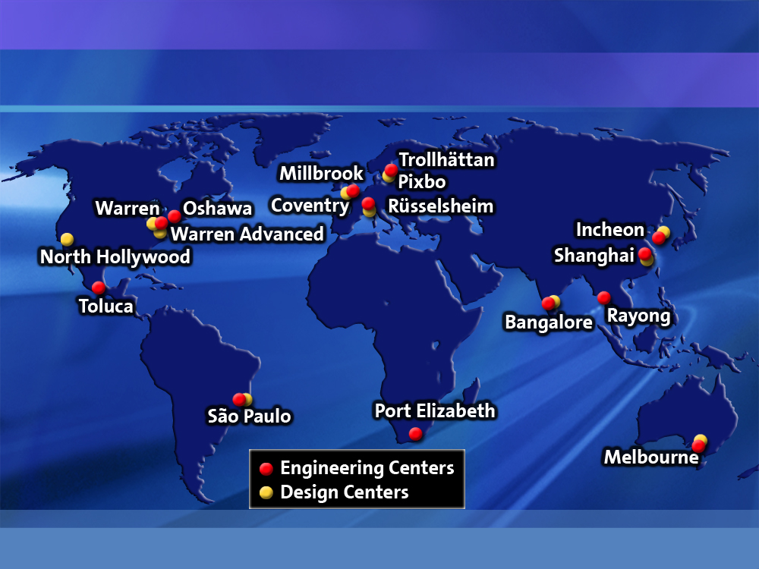
Global Engineering and Design Centers
Notes:
5
RAK_ARA05

Slide 6




Global R&D Footprint
Sweden
(2005)
Silicon Valley
(2007)
Canada
(2002)
Russia
(2005)
Mainz-Kastel
(2007)
Korea
(2004)
Warren
(1920)
China
(2008)
Honeoye Falls
(2007)
Israel
(2007)
HRL
(2000)
India
(2003)
Brazil
(2008)
Australia
(2006)
GM Labs
Science Offices
Affiliated Lab
Notes:
RAK_ARA06

Slide 7
Role of Science Laboratories in GM
  Drive front-end of innovation
    Interface with universities and national labs
    Early evaluation of and partnering with suppliers
    Internal exploratory investigations
  Responsible for leadership in key strategic technologies
  World-class technical experts for development projects and company key assists
  Provide technical credibility for interfacing with policy makers (government and NGOs)
  Recruiting deep technical talent for Corporation
Notes:
JA03

Slide 8

GM’s Global R&D Network
U. of Michigan
RWTH-Aachen
Brown
Carnegie Mellon
IISc-Bangalore
M.I.T.
Stanford
U. of Wisconsin
IIT-Kharagpur
SJTU-Shanghai
Collaborative
Research
Labs
Affiliated Lab
HRL
Alliance Partner
Universities
Suzuki
USCAR
EUCAR
OEMs
Sandia
Australia
Brazil
Canada
China
India
Israel
Korea
Russia
Sweden
Government
Lab
Warren Bangalore
Honeoye Falls
Mainz-Kastel
Palo Alto Tel Aviv Shanghai
Global
Sites
Strategic
Partners
…
…
…
Science
and Tech
Offices
Suppliers
Individual Contracts
Individual Contracts
Notes:
TPS14

Slide 9
Collaborative Research Labs – CRL
University
Technology Area
University of Michigan Engine Systems Research Advanced Vehicle Manufacturing
Smart Materials & Structures
Carnegie Mellon Information Technology
Autonomous Driving
Stanford University Work Systems
Indian Institute of Science Lightweight Materials
Brown University Materials Modeling
RWTH-Aachen Advanced Engines
University of Wisconsin-Madison Engine Combustion
M.I.T. Materials & Manufacturing Systems Analysis
Indian Institute of Technology-Kharagpur Electronics, Controls and Software
Shanghai Jiaotong University Advanced Manufacturing
Notes:
IR201

Slide 10
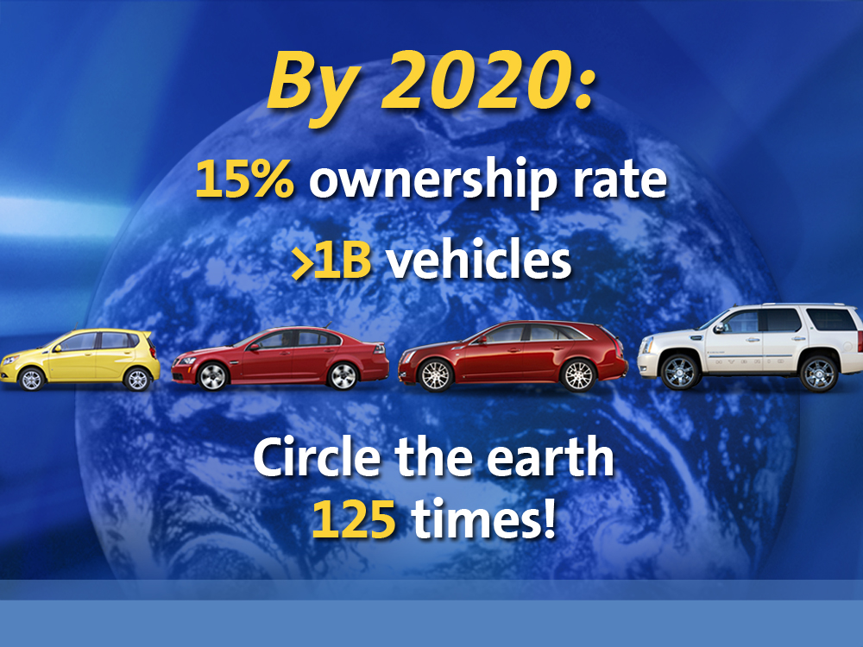
10
AW_TX03

Slide 11

Notes:
SF_INF12

Slide 12

Notes:
LDB_AFLA08

Slide 13
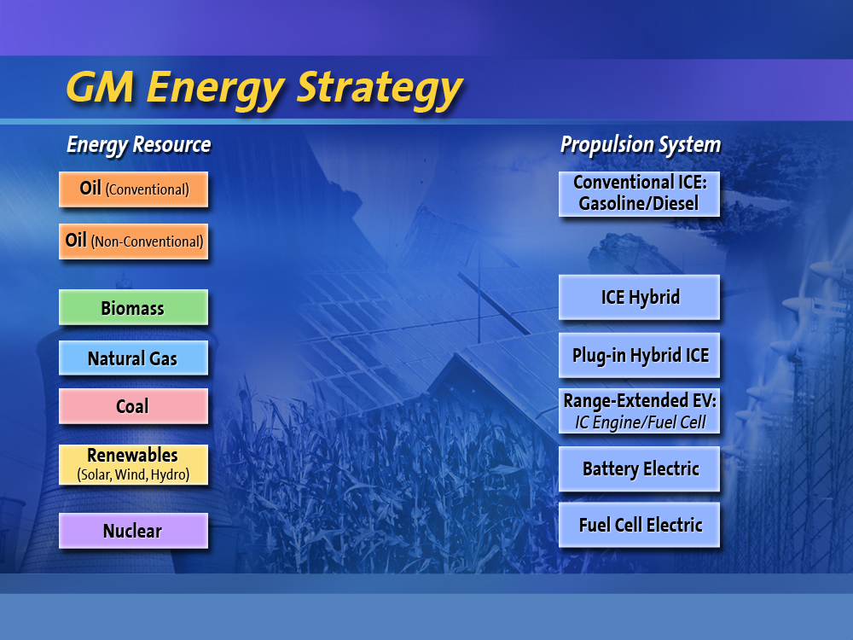
Notes:
SF_INF14

Slide 14
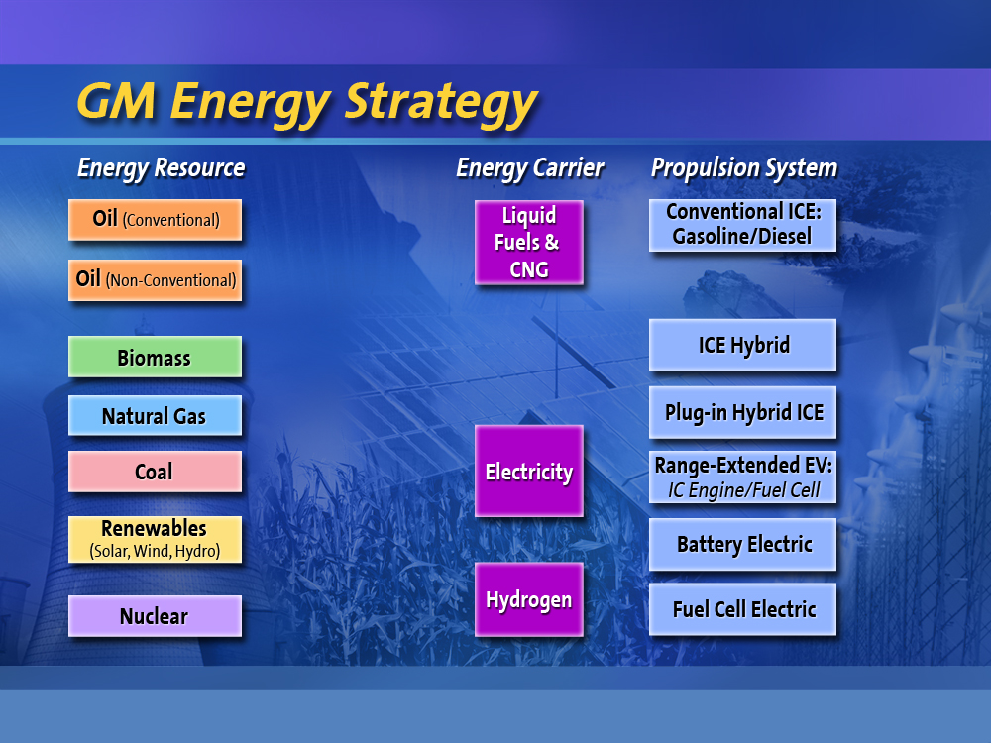
Notes:
SF_INF14

Slide 15
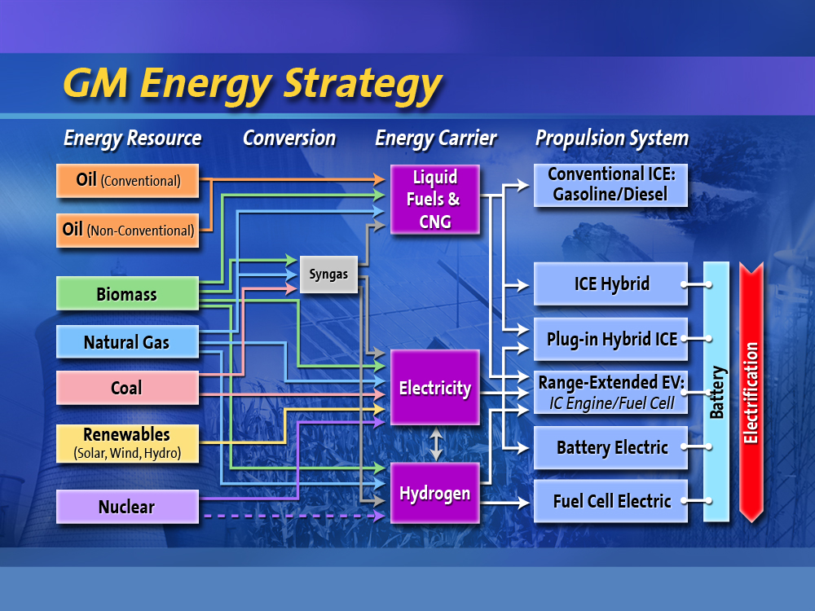
Notes:
SF_INF14

Slide 16
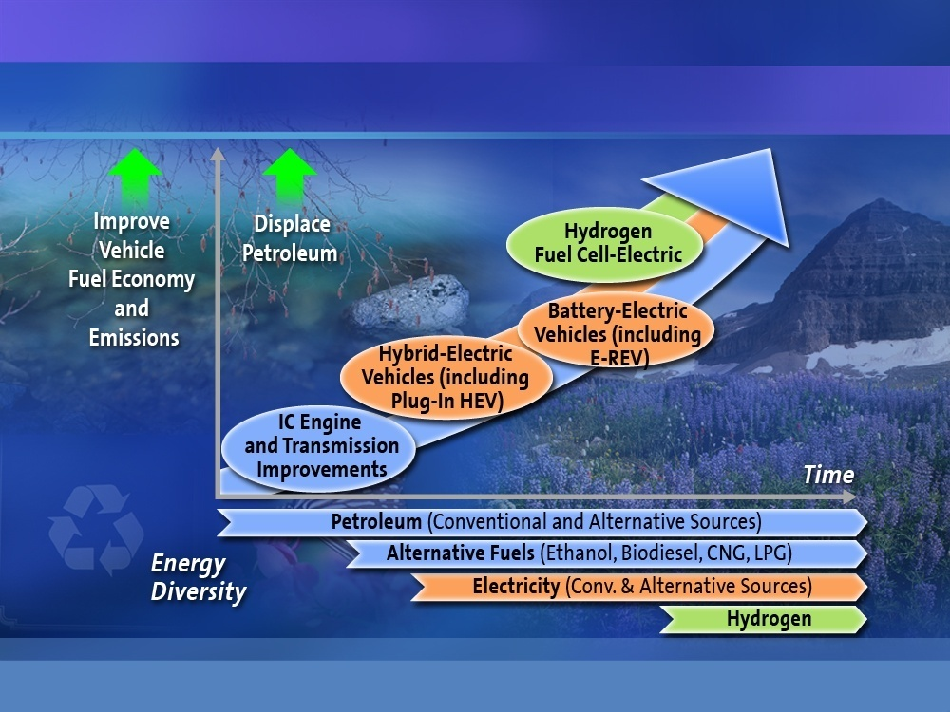
Advanced Propulsion Technology Strategy
Notes:
TGS Shanghai Media Event 031209
16
TGS_CME03

Slide 17

Notes:
SF_INF43

Slide 18
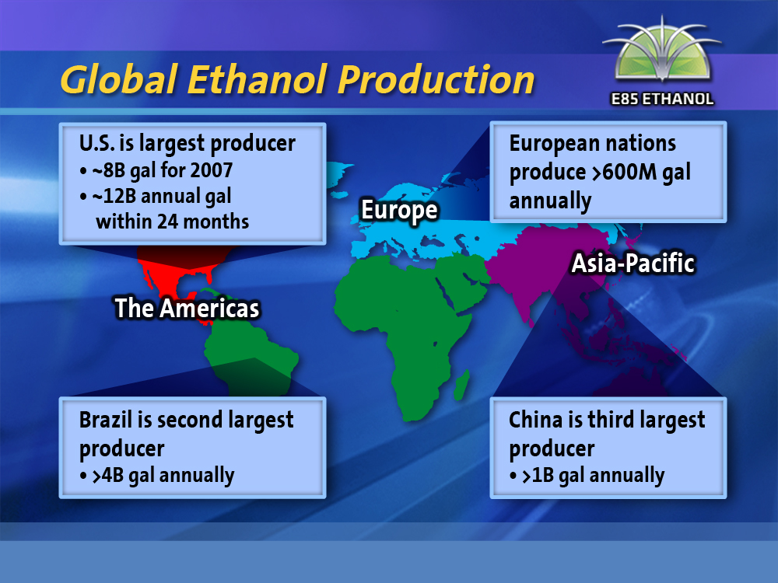
Notes:
LDB_AFLA22

Slide 19
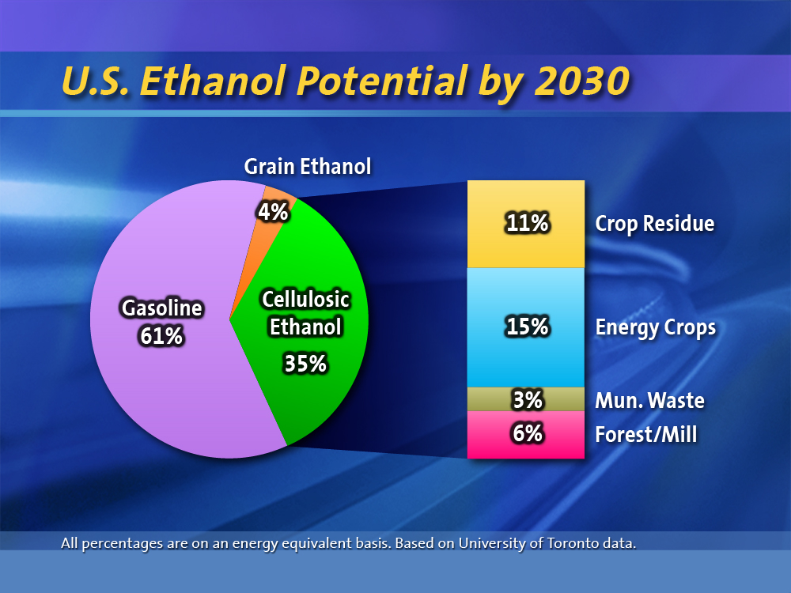
Notes:
LDB_COL37

Slide 20
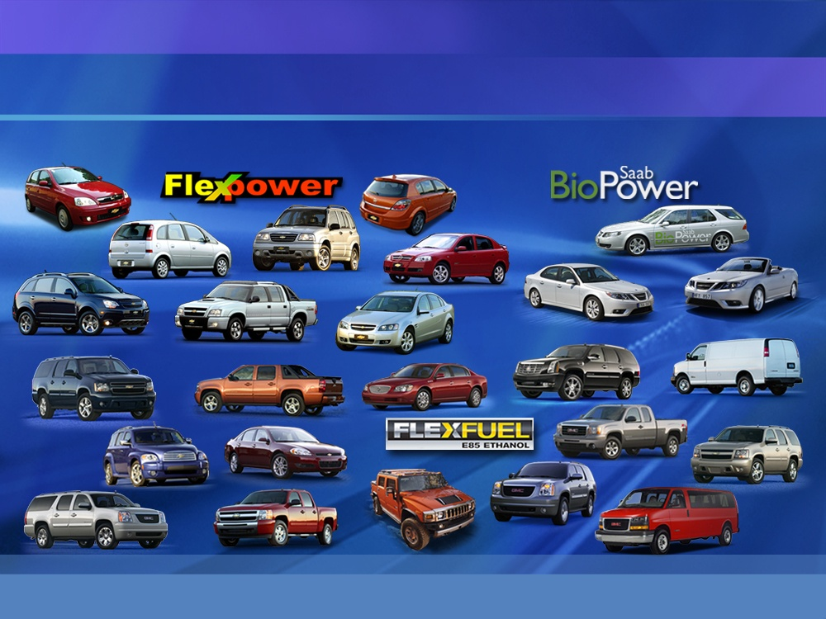
GM Ethanol Vehicles
Worldwide leader with >5 million flex-fuel vehicles
Notes:
20
TGS_CME12

Slide 21

GLC_MITcnv079

Slide 22
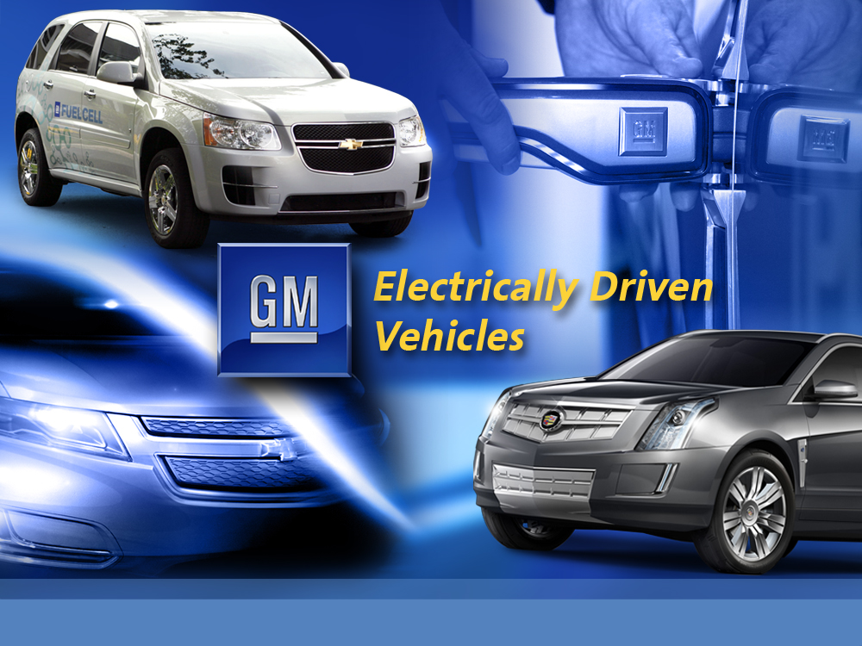
Notes:
LDB_ED01a

Slide 23
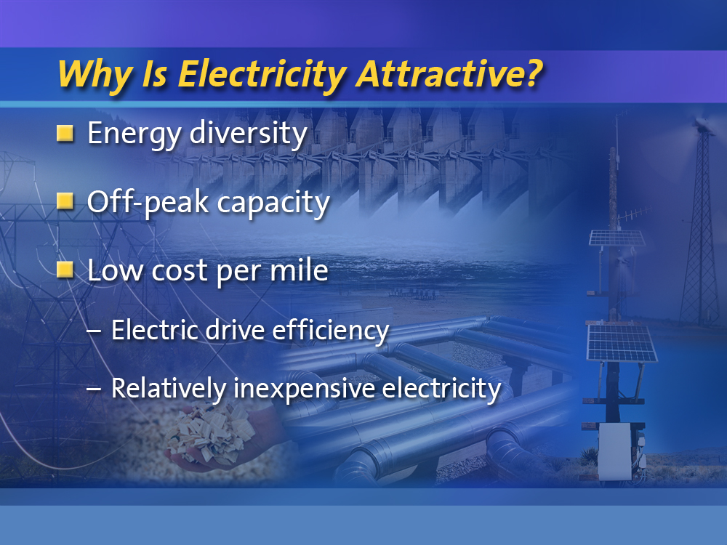
Notes:
LDB_ED12

Slide 24
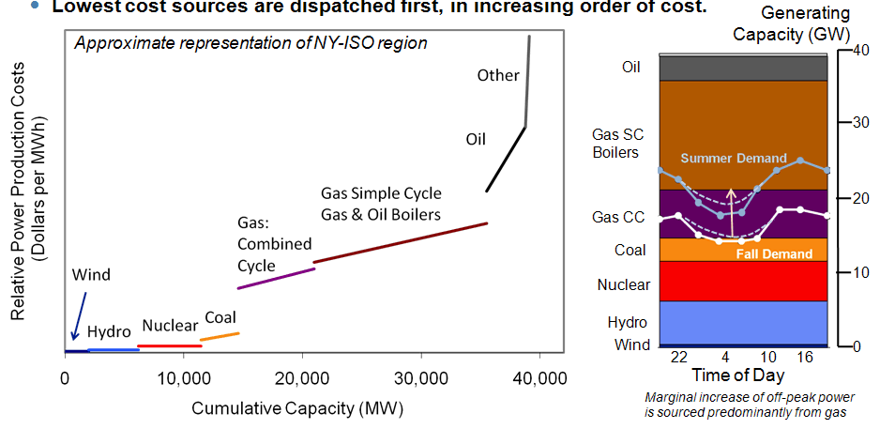
Power Generation Sources and Capacity

Slide 25
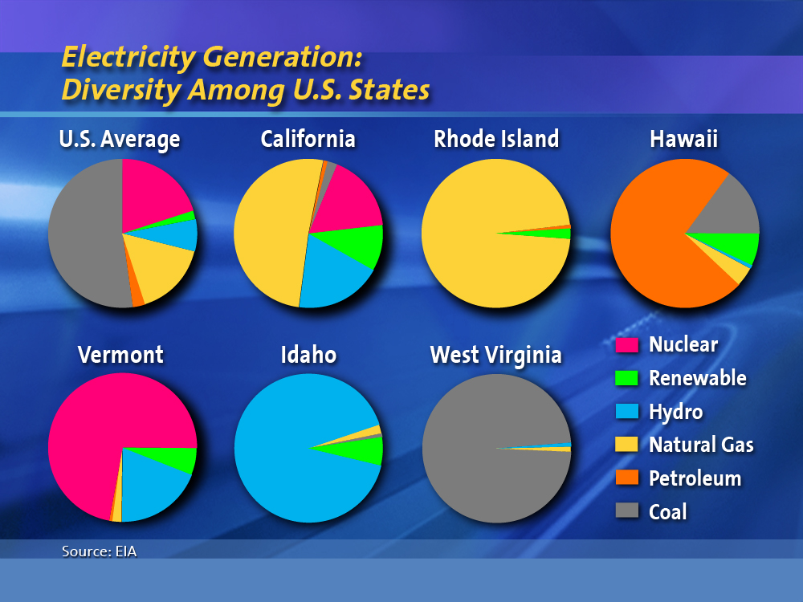
Notes:
JHPC35

Slide 26
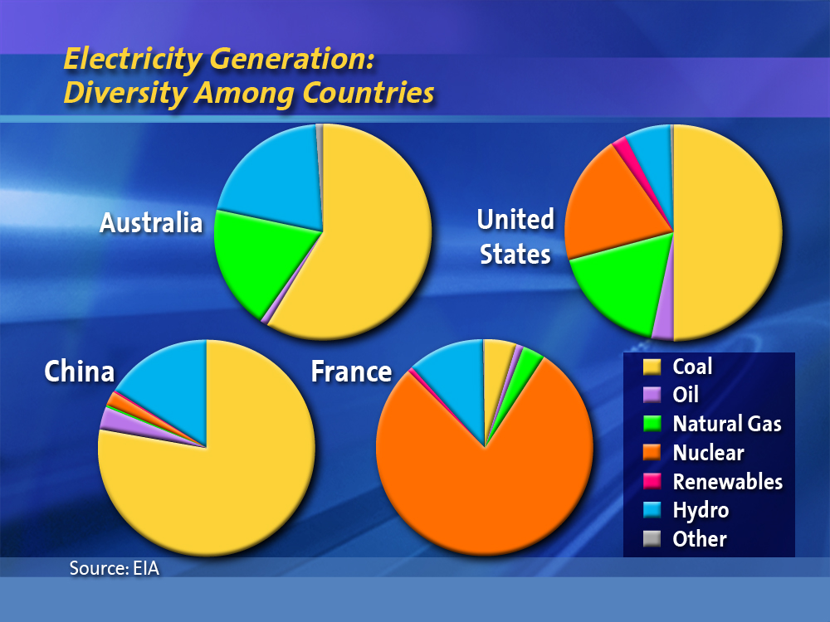
Notes:
CEDA47

Slide 27
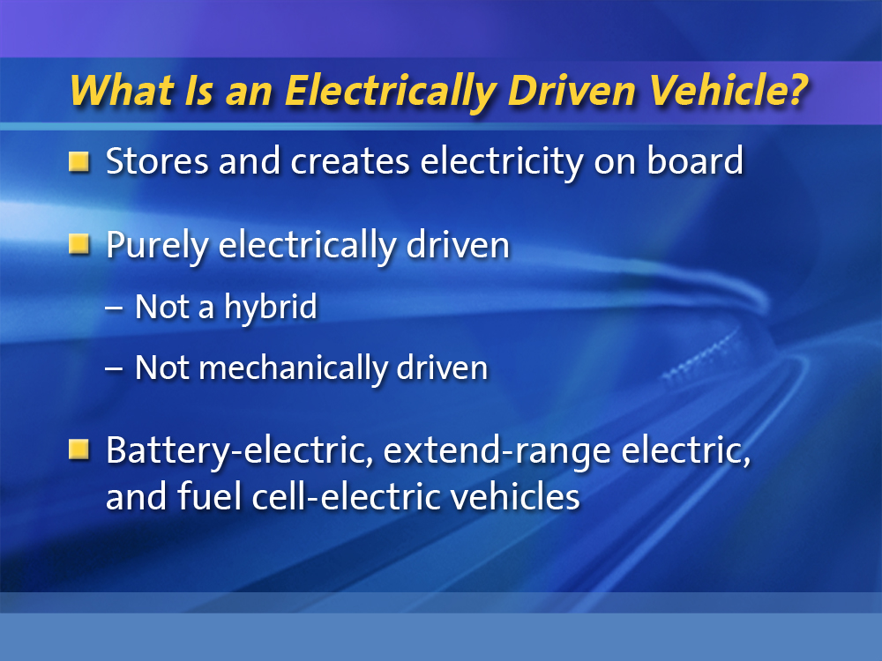
Notes:
LDB_ED11

Slide 28
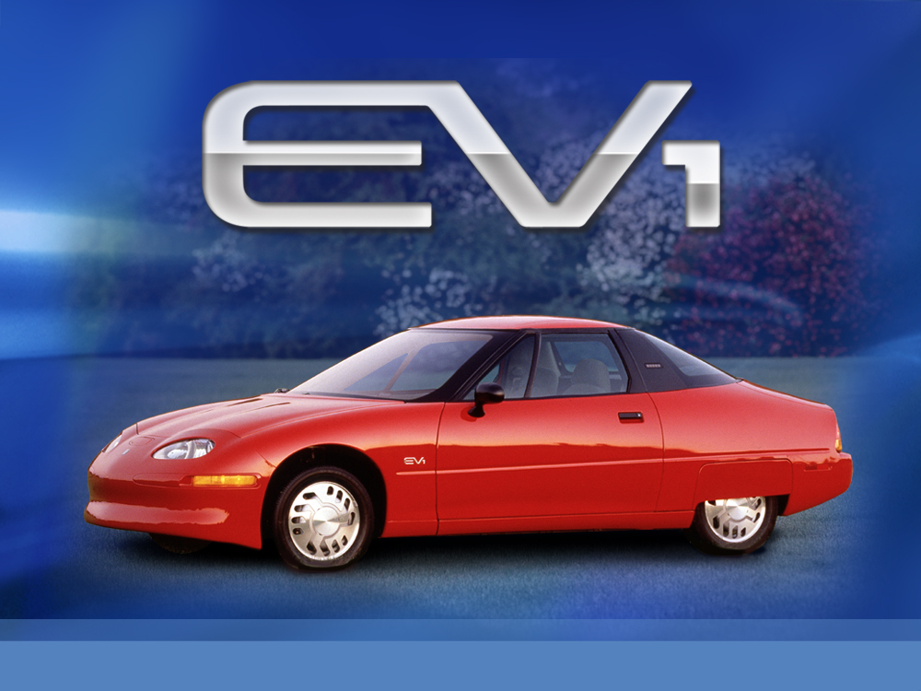
Notes:
LDB_ED13

Slide 29
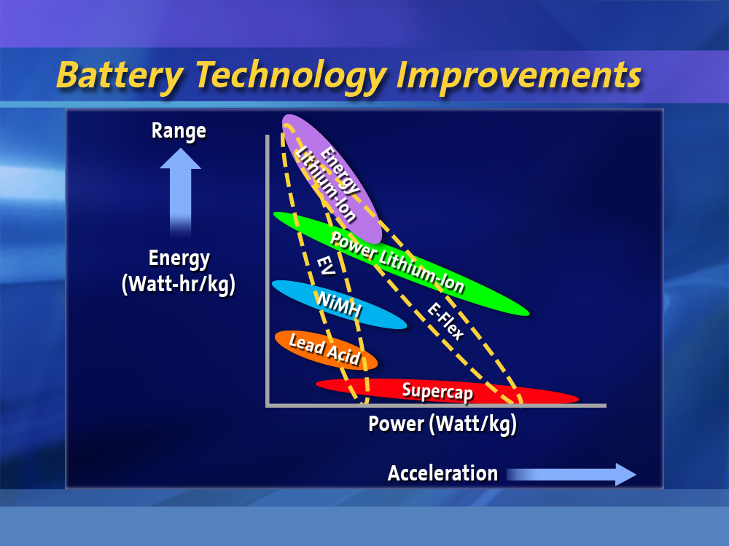
Notes:
LDB_ED18

Slide 30
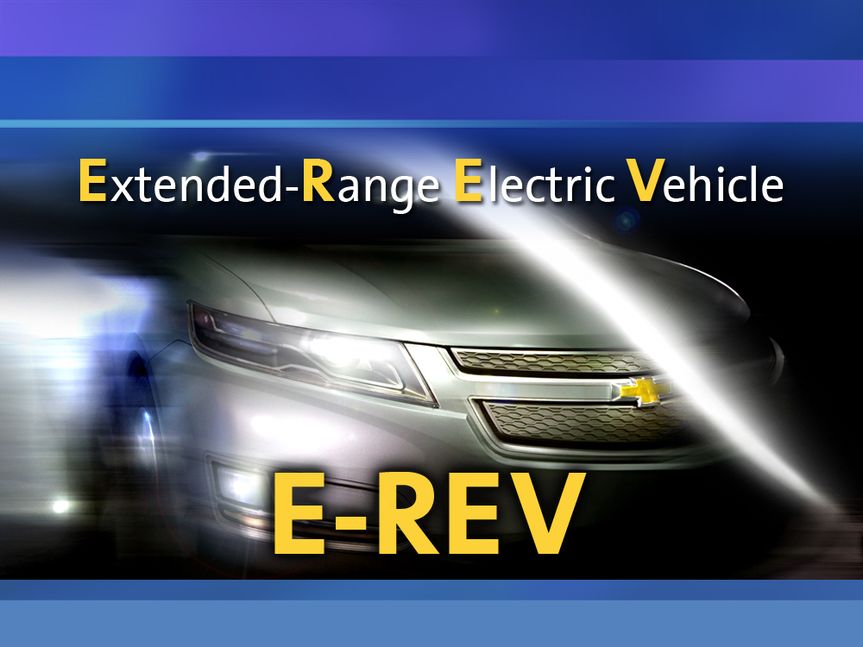
Creating a New Propulsion Category
30
DG_MBS21-02

Slide 31
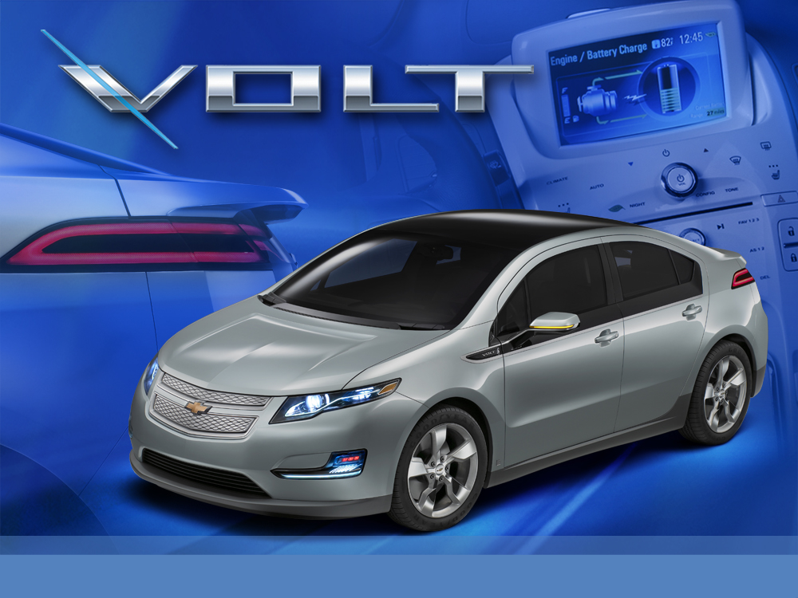
Notes:
VoltProd02

Slide 32
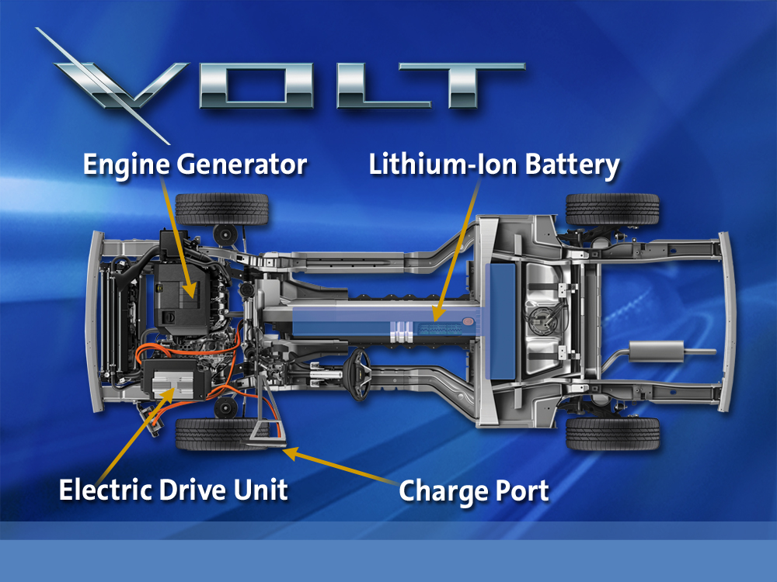
32
AW_TX27

Slide 33
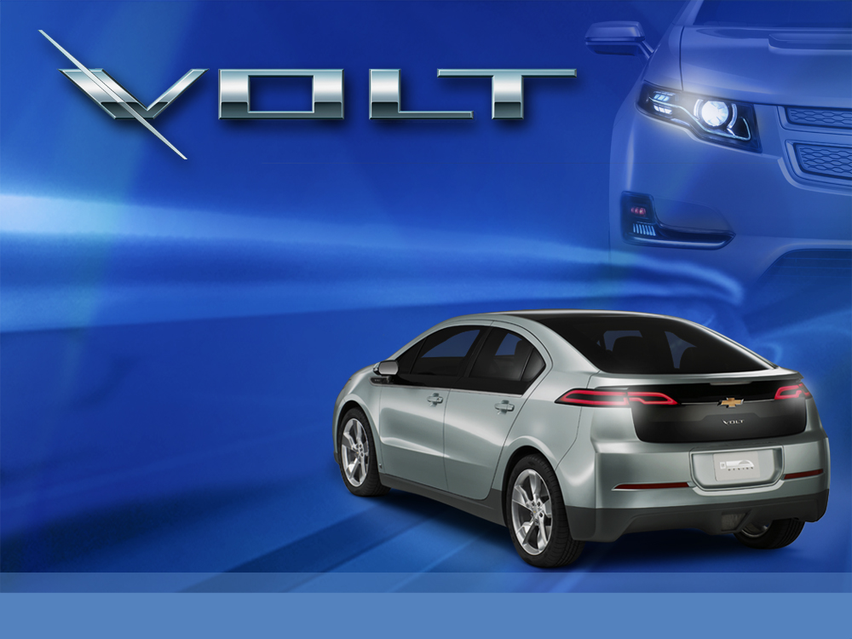
  Recharging
  Less than 3 hours using 240v outlet
  About 8 hours
  using 120v
  outlet
  Less time if
  battery not
  fully depleted
33
AW_TX25

Slide 34






Breaking the Paradigm…
Runs up to 40 miles solely on battery
Engine generates electricity to extend the range beyond 40 miles using gasoline or E85
Battery, motor and power electronics deliver full performance, acceleration, speed and hill climbing on electric power alone
RFW_ALM13
Notes:
RFW_ALM13

Slide 35
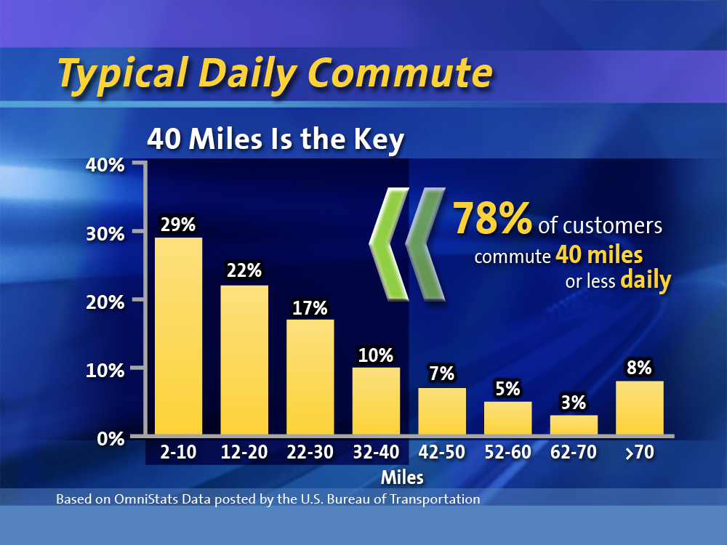
35
GLC_MITcnv101

Slide 36





How Does a Chevrolet Volt Compare?
Annual Energy Usage – Electrical Appliances
Home Heating System
Central Air Conditioning
Refrigerator/Freezer
Water Heater
Clothes Dryer
Lighting
3,524 kWh
2,796 kWh
2,610 kWh
2,552 kWh
2,520 KWh
1,079 kWh
940 kWh
2,520 KWh
RFW_BANK20
Notes:
RFW_ALM11

Slide 37

Notes:
SF_INF86

Slide 38
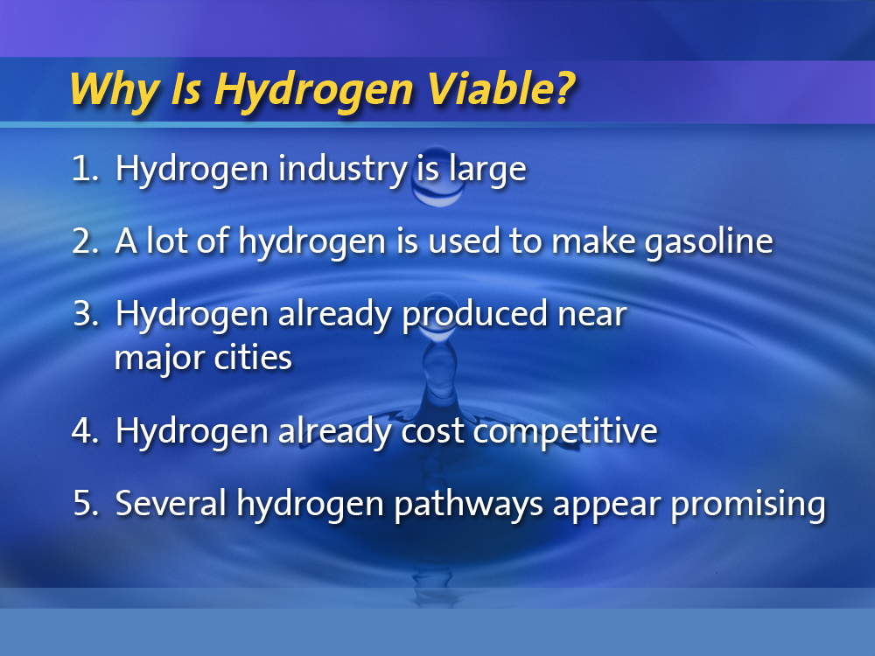
Notes:
LDB_COL52
→

Slide 39
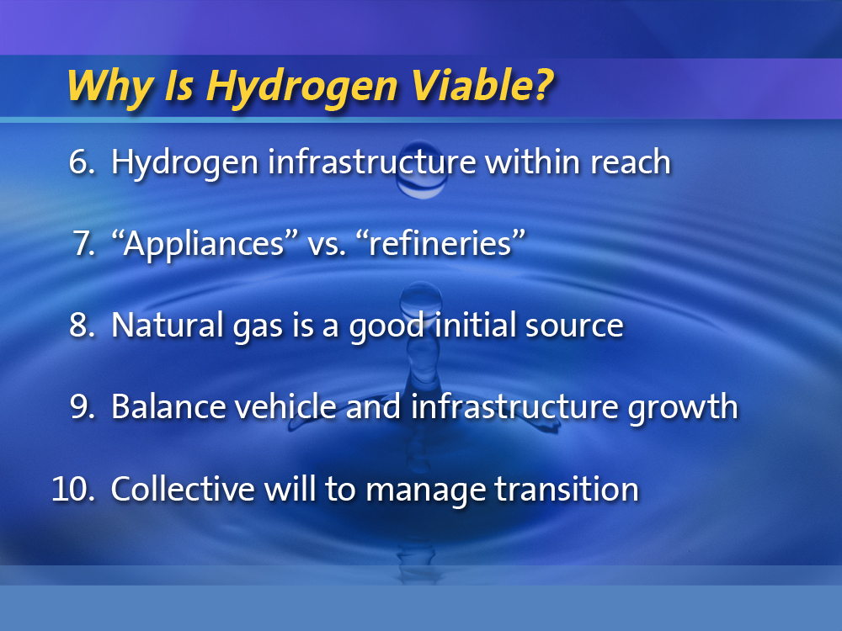
Notes:
LDB_COL52a

Slide 40
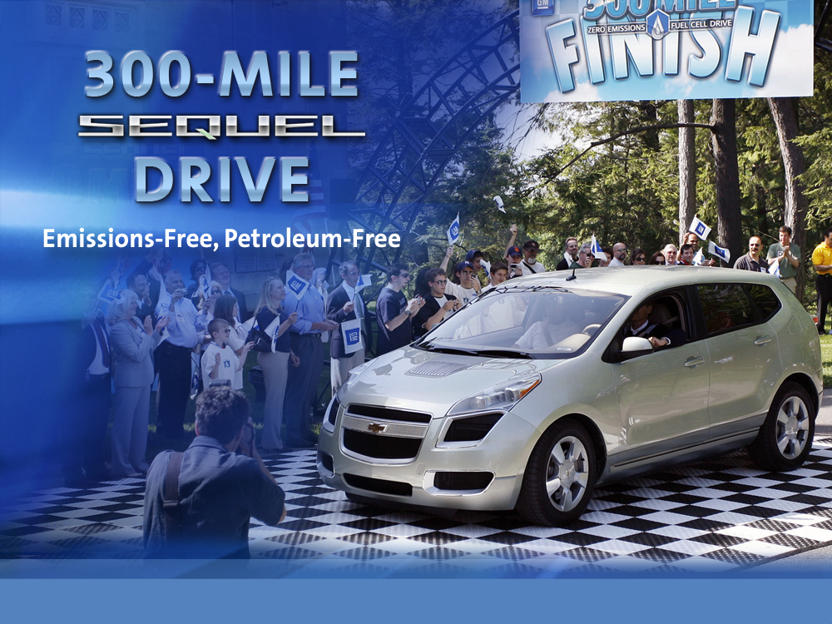
Notes:
SF_INF95

Slide 41

  Hydrogen fuel cell-electric vehicle
  >100 vehicles in
  the hands of
  everyday drivers
  1 million real-world kilometers
  10 HydroGen4 vehicles deployed in Berlin as part of Germany’s Clean Energy Partnership
Notes:
41
TGS_CME23a

Slide 42

Notes:
NC24

Slide 43
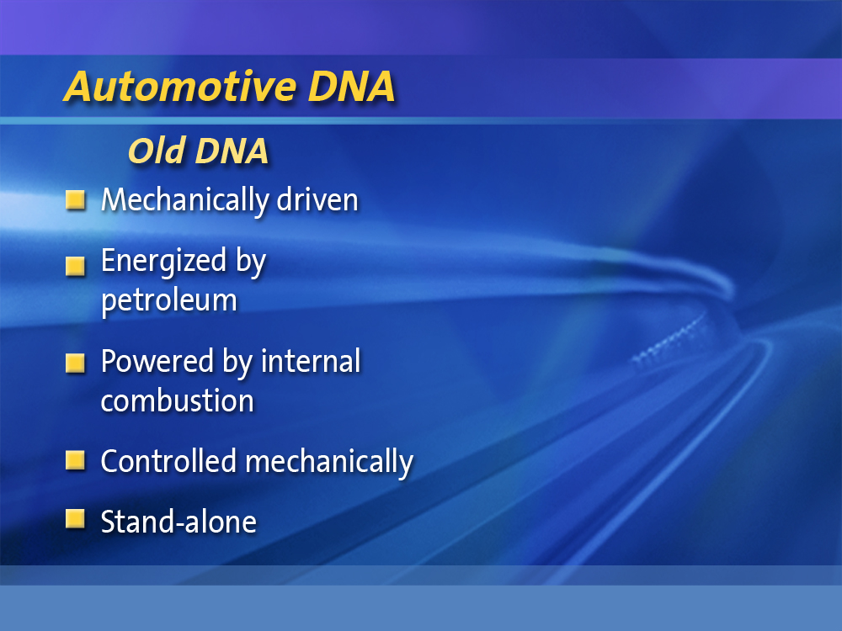
Notes:
IBTTA64

Slide 44
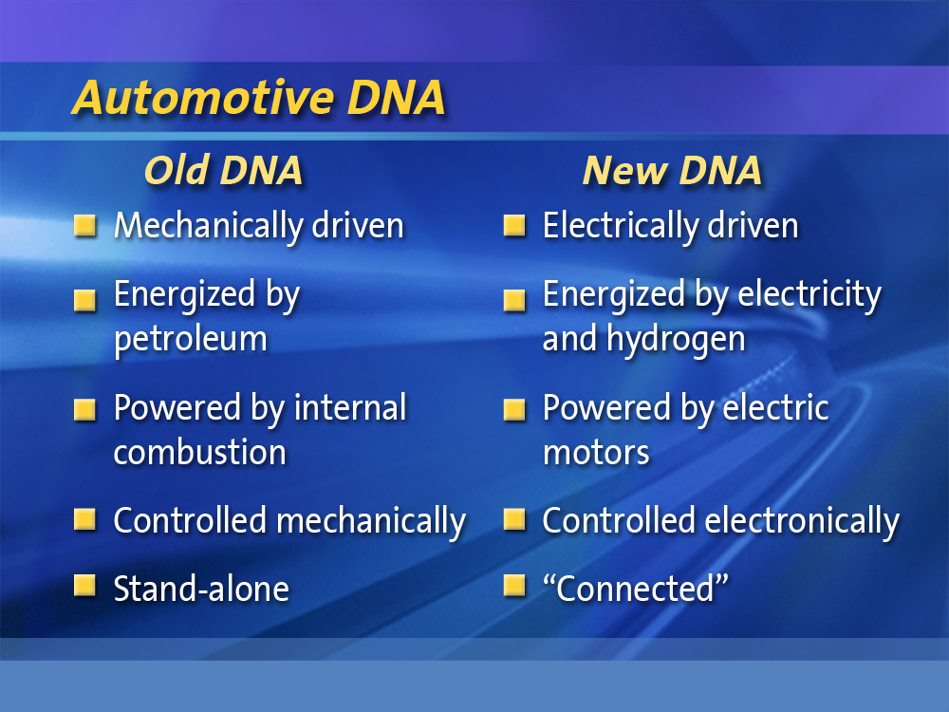
Notes:
IBTTA64

Slide 45
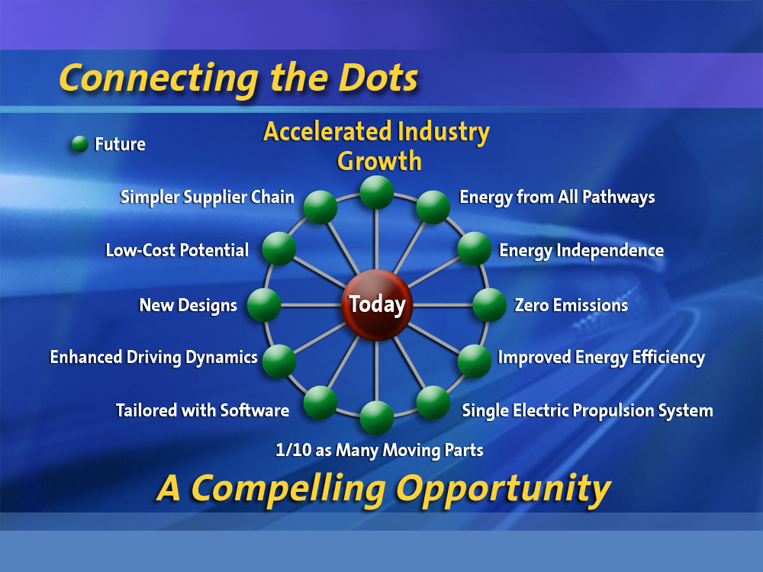
Notes:
JHPC49

Slide 46
Collaboration is Key Opportunity
Investment vs. Grants
Industry, Academia, and Government collaboration is a key opportunity
Transplant base research in home country
Domestic “Big Three” are likely to gain U.S. government funding for grand challenge

Slide 47
GM’s Advanced Propulsion Technology Strategy will…
Reduce fuel consumption
Be sustainable through energy diversity
Displace petroleum
Alleviate the issue of demand outgrowing limited supply
Reduce our dependence on a supply subject to uncontrollable risks

Slide 48
GM’s Advanced Propulsion Technology Strategy will…
Continue to make improvement of conventional powertrains
  Gas engines, diesel engines and transmissions will be the principle propulsion systems for the foreseeable future
Leverage alternative fuels
  Biofuels such as E85 ethanol and Biodiesel (i.e. B20)
Increase electrification of the automobile
  Rapid expansion of our hybrid portfolio, including plug-ins
  Extended-range electric vehicles (E-REV)
  Ultimately, hydrogen fuel cells

Slide 49
Summary
  Our challenges are to increase fuel economy, reduce vehicle emissions, and displace petroleum
    There is no single solution
  Our strategy is:
    Continued improvement of conventional powertrains
    More vehicles with biofuels capability
    Increased electrification of the automobile
  GM is working aggressively to become part of
  the solution through energy diversity and energy efficiency
Notes:
49

Slide 50
Q & A
Bob Kruse
Executive Director, Global Vehicle Engineering
Hybrids, Electric Vehicles & Batteries
Missouri Energy Summit
April 22, 2009

Slide 51
Back Up

Slide 52
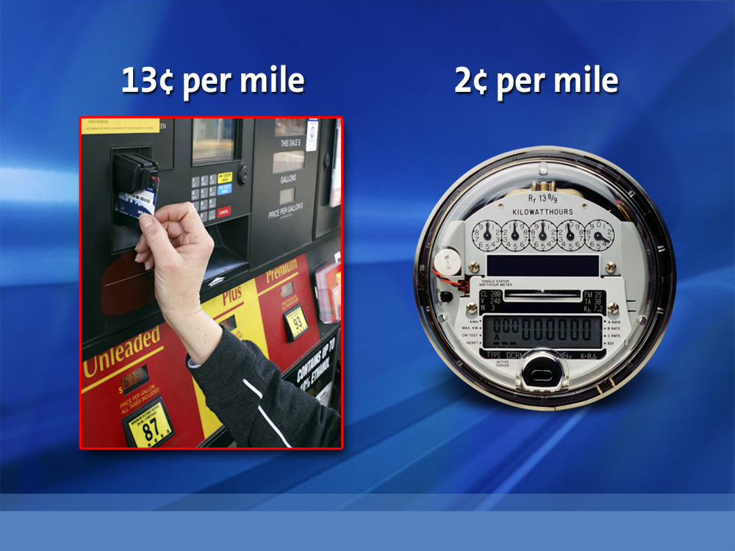
Notes:
LDB_ED17b

