Slide 1
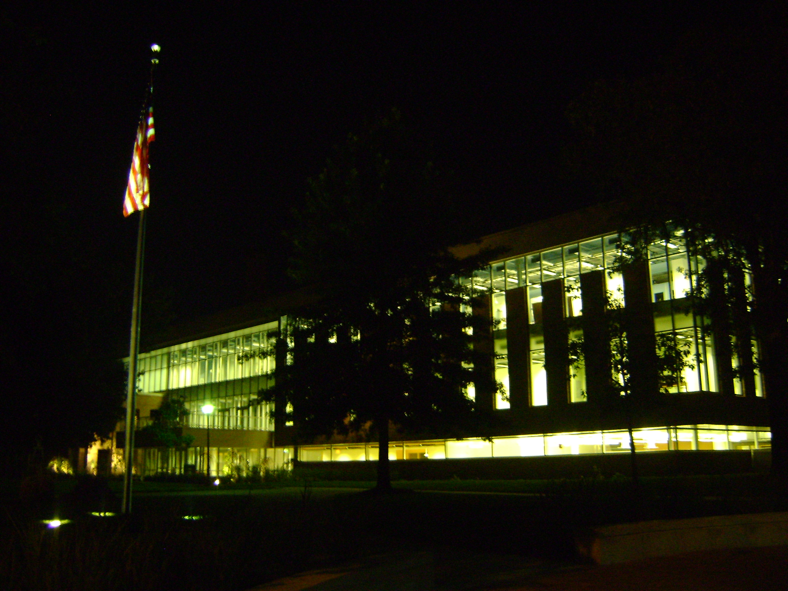
Missouri S&T Hydrogen Fuel Cell EcoCAR
Missouri S&T EcoCAR Team Burning the Midnight Oil at Toomey Hall

Slide 2

Missouri S&T Hydrogen Fuel Cell EcoCAR
OUTLINE
Background
E-Cubed Commons
EcoCAR: The NeXt Challenge
EcoCAR Summer Camp 2009
Missouri S&T EcoCAR Team Needs

Slide 3



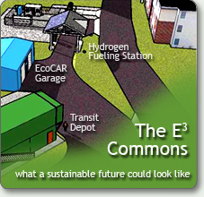
KETC's Science Minute: Missouri S&T's Hydrogen Fueling Station
E³ = C
Energy, the Environment and Education
equals Civilization.
That formula is more than a clever play on Einstein's theory of relativity. It also forms the foundation of our energy and sustainability initiatives at Missouri S&T.
And just as Einstein's equation E=MC² radically changed the way we view the universe, so E³ = C is altering the way we approach matters of energy production and conservation, environmental sustainability.

Slide 4
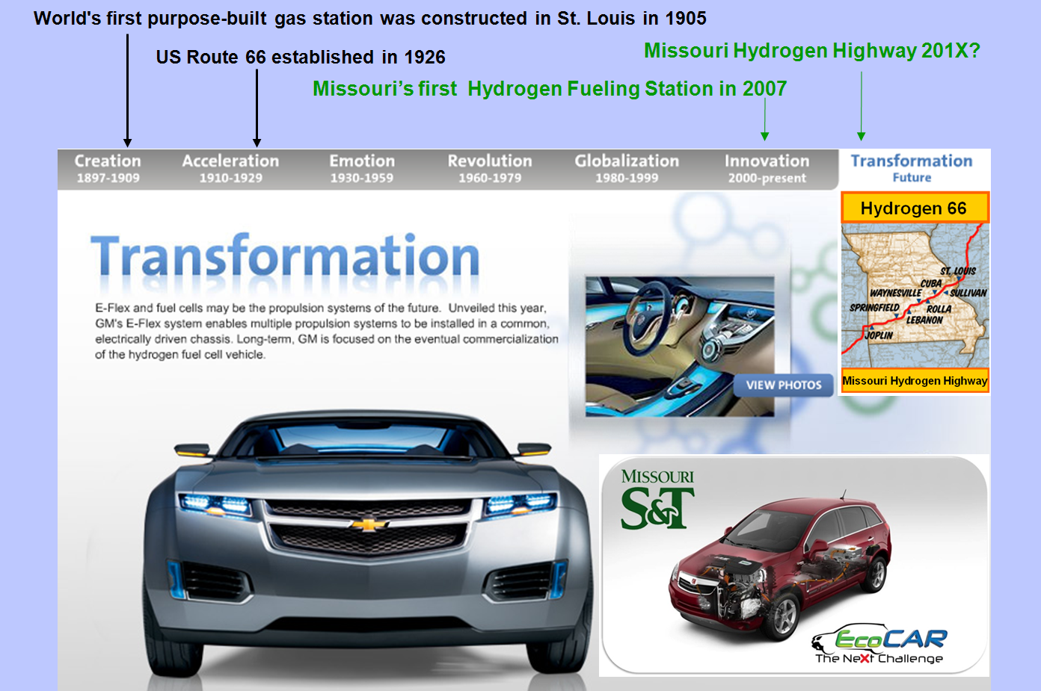
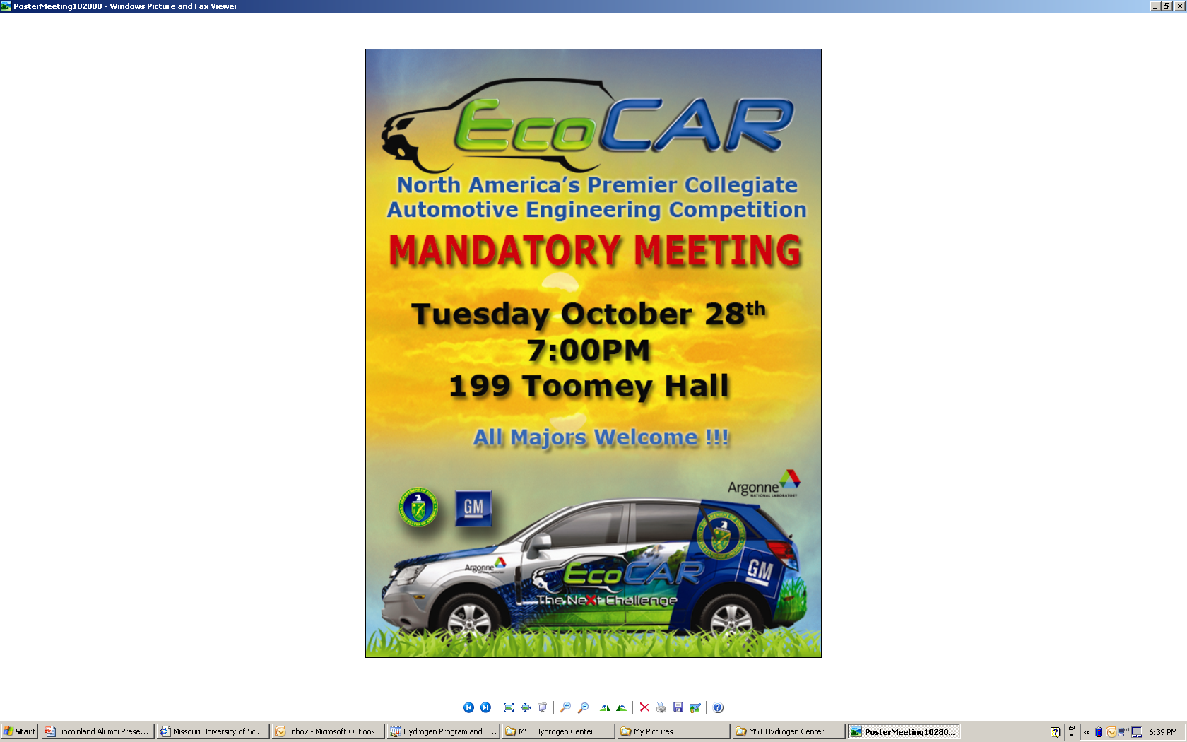

Slide 5
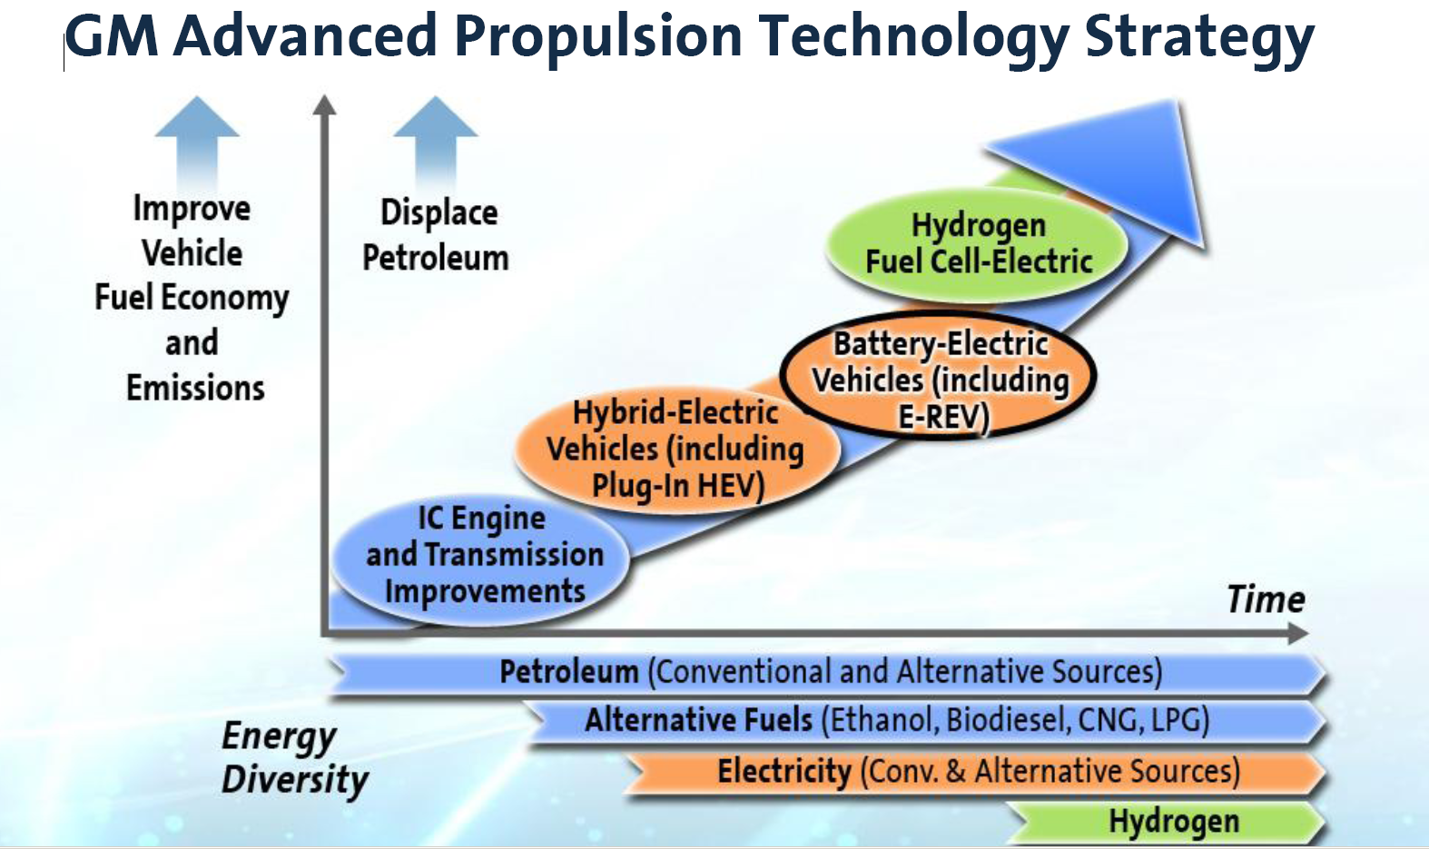

Slide 6
2004 National Hydrogen Association Student Design Contest
Honorable Mention (Hydrogen Fueling Station)
2006 AFRL/DLA Research Contract
Hydrogen Fueling Station Construction
Ford Hydrogen ICE Shuttle Buses
2006 DOT-Research and Innovative Technology Administration
National University Transportation Center
Theme: Transition-state fuel vehicle infrastructure
2007 National Hydrogen Association Student Design Contest
Grand Prize Winner (Hydrogen Airport Applications)
2008 Federal Transit Administration
Plug-in Electric Vehicle Demonstration Project
2009 EcoCAR: The NeXt Challenge
Only Fuel Cell Plug-In Hybrid Electric Vehicle in EcoCAR in USA

Slide 7
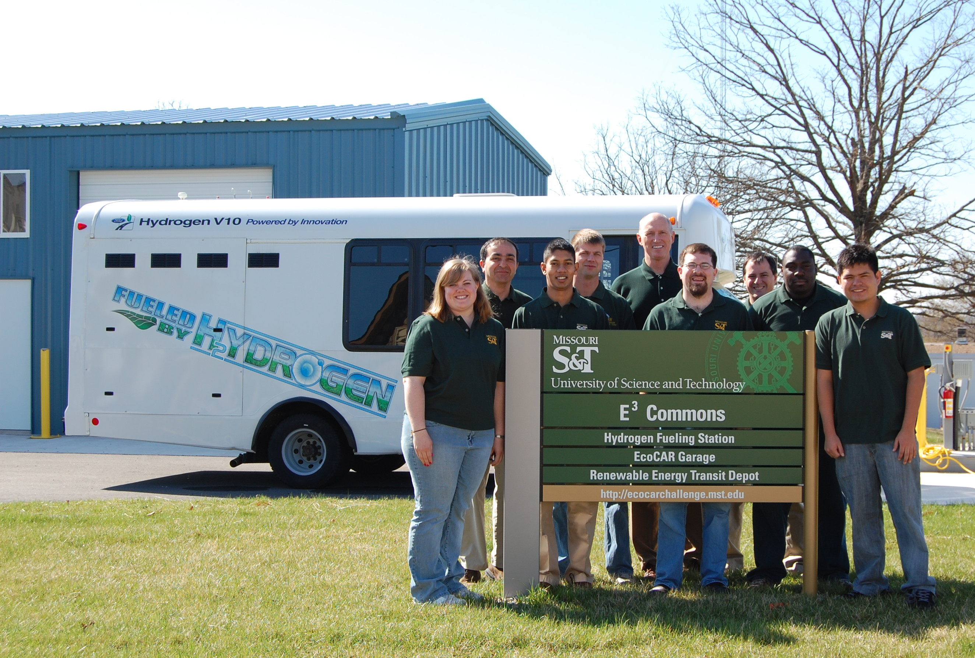

Slide 8

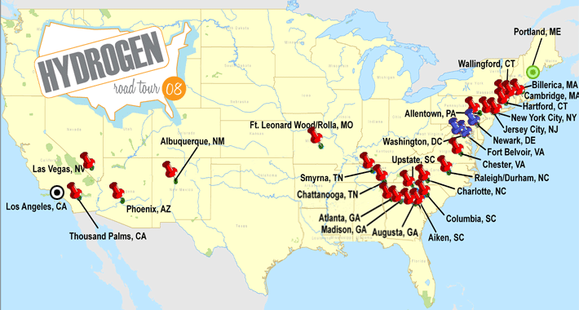
August 19, 2008
Hydrogen Road Tour & Ribbon-cutting for
Missouri’s First Hydrogen Fueling Station

Slide 9
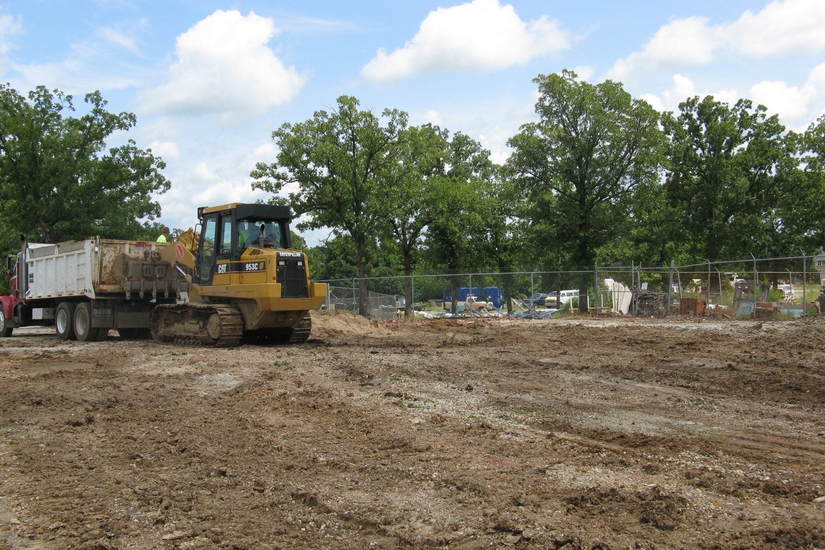
July 9, 2008

Slide 10
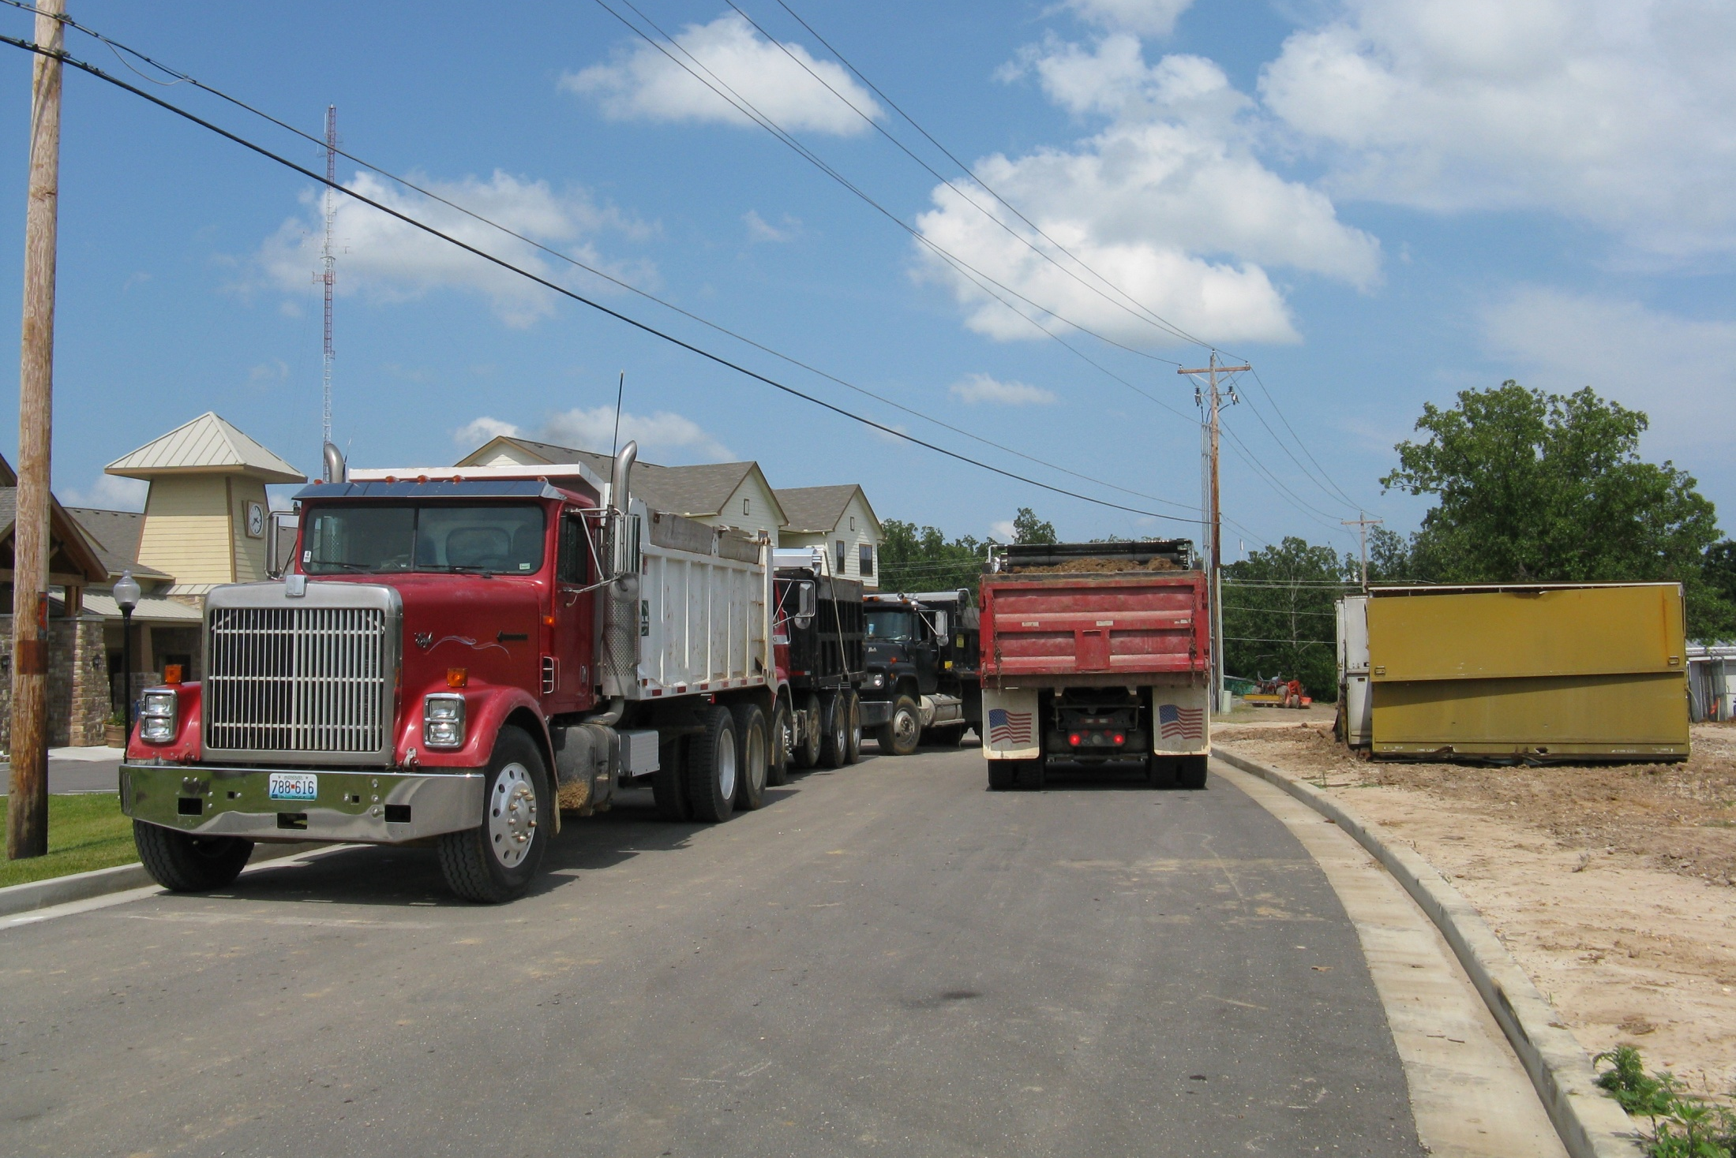
July 10, 2008

Slide 11
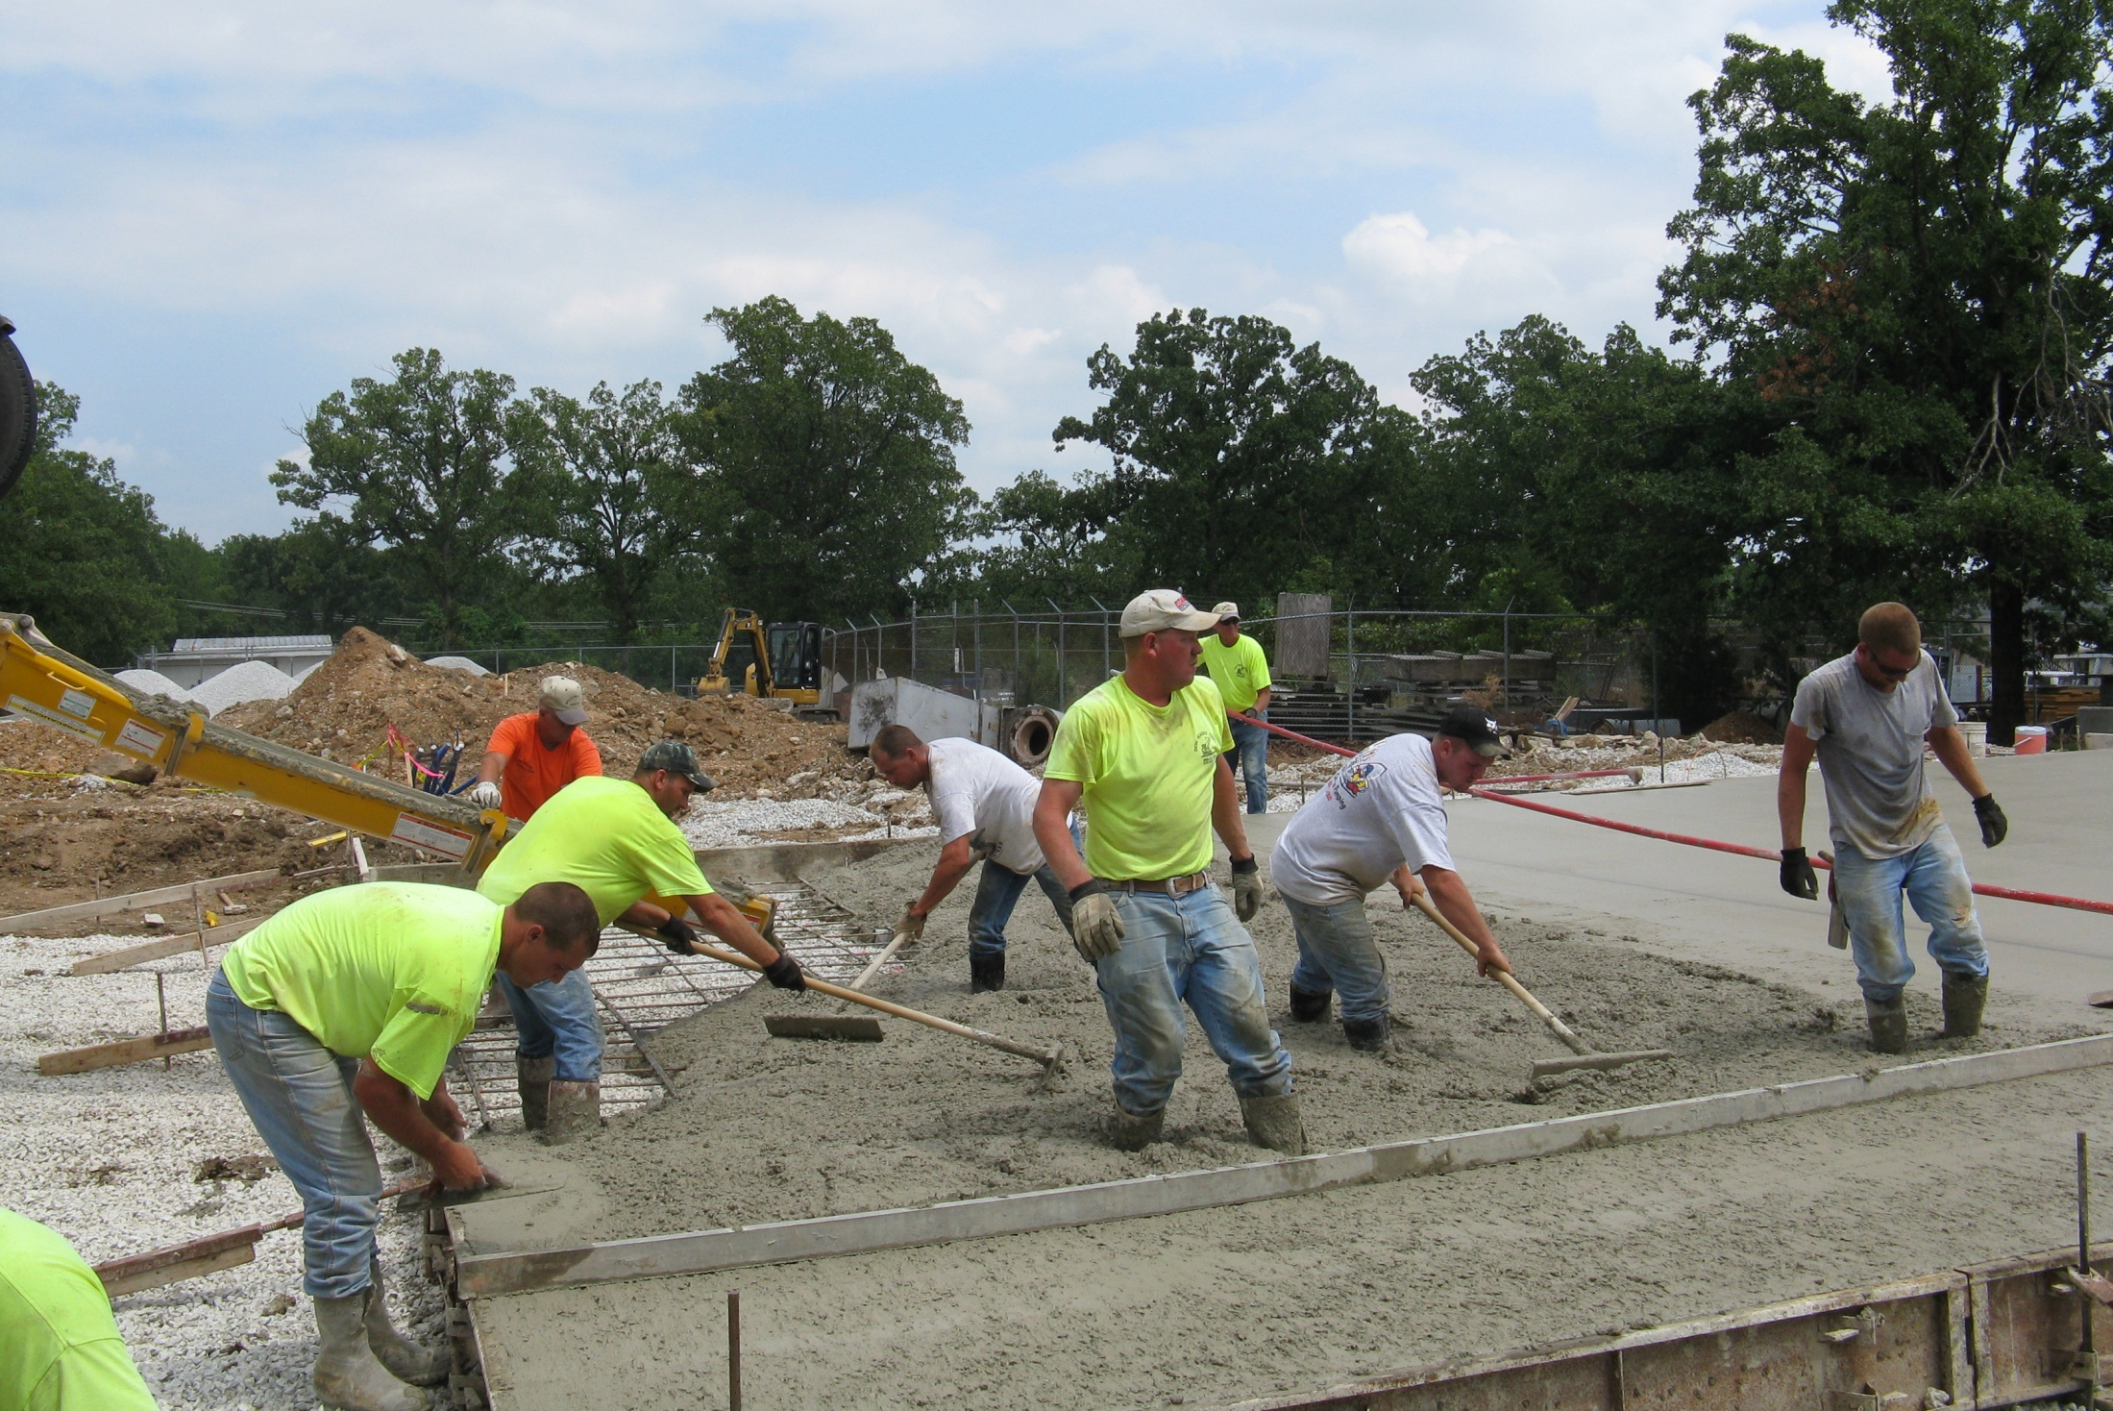
July 23, 2008

Slide 12
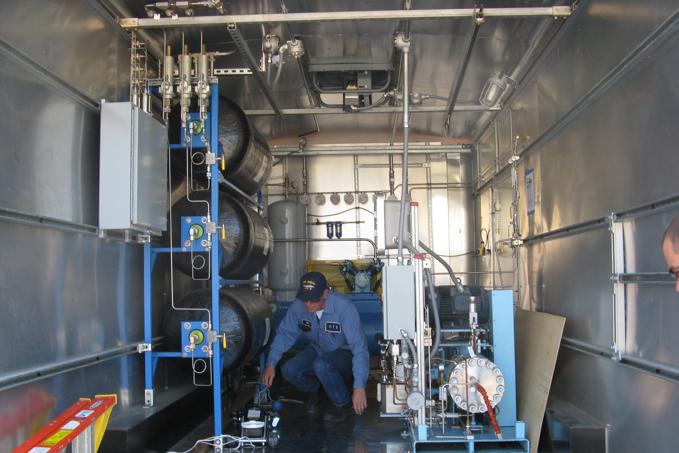
August 10, 2008

Slide 13
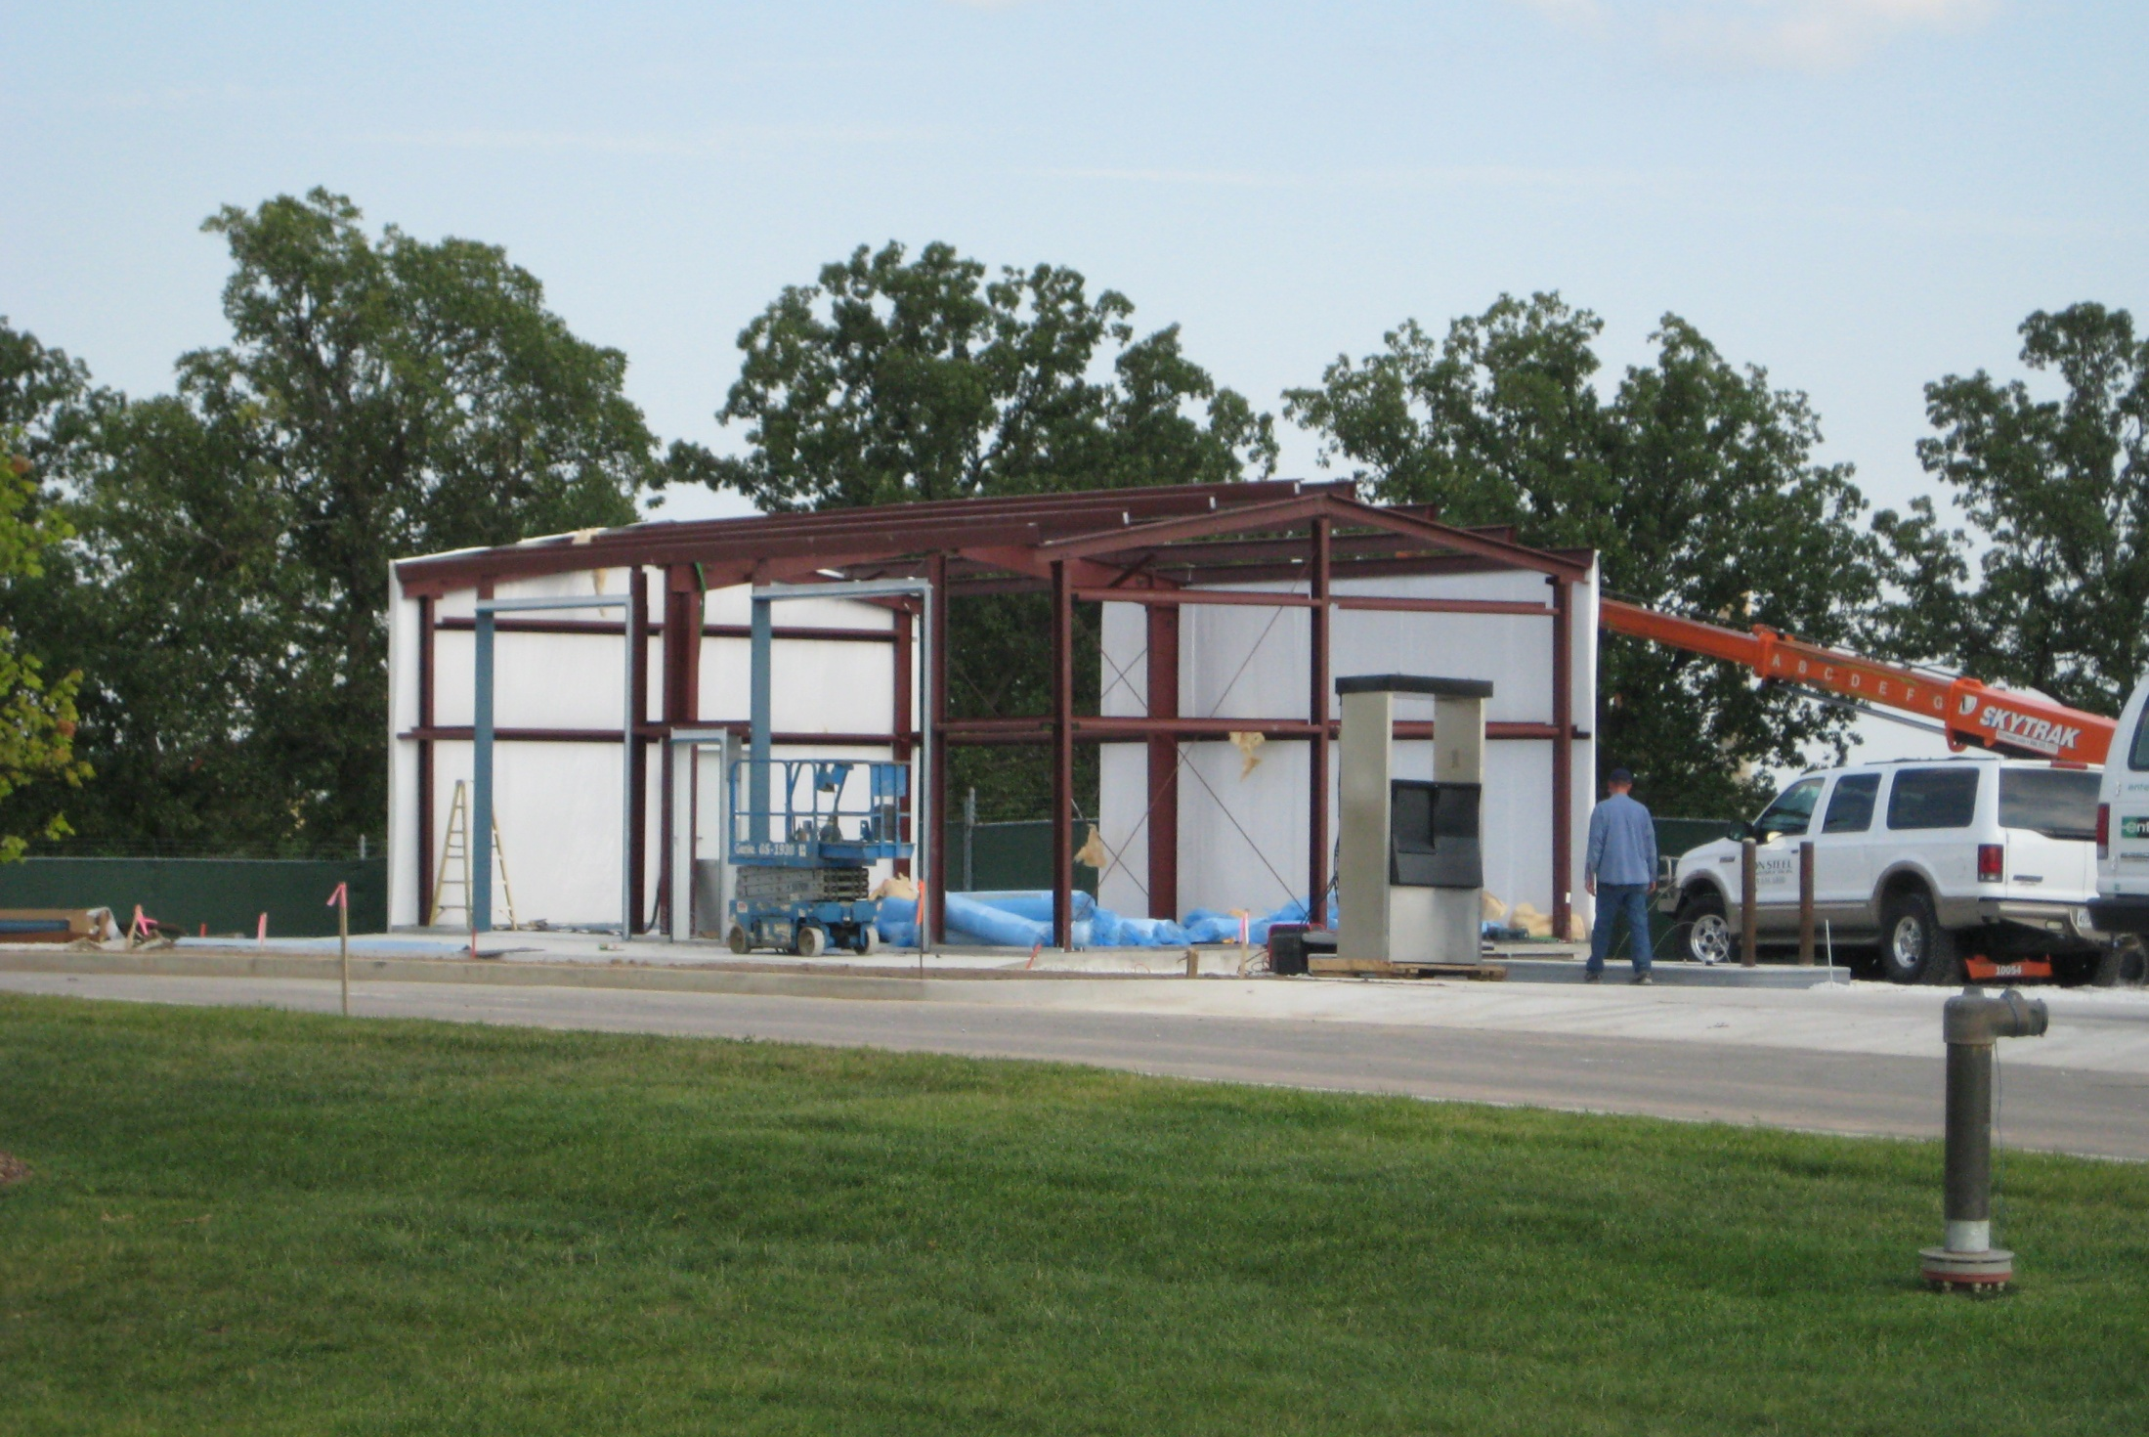
August 12, 2008

Slide 14
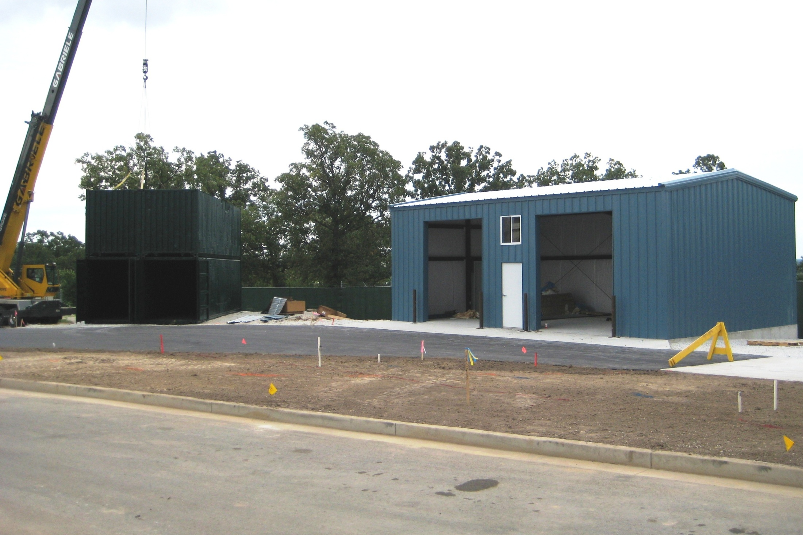
August 14, 2008

Slide 15
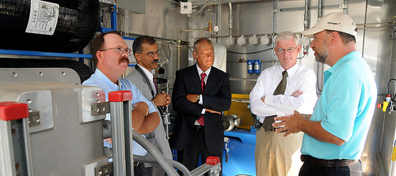
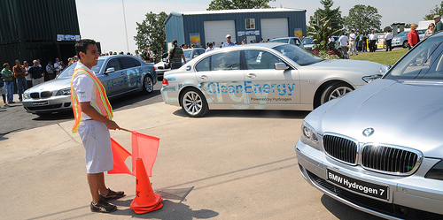
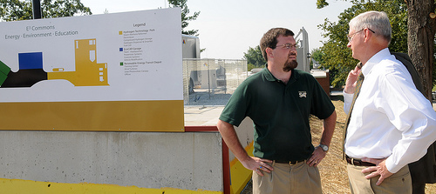
August 19, 2008

Slide 16
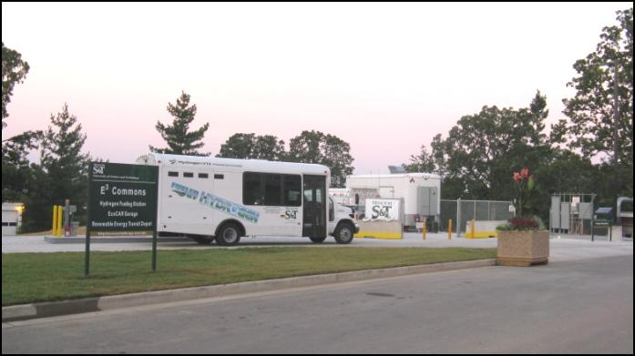
Missouri S&T is working towards making the hydrogen-economy a reality by evaluating the entire process of hydrogen production, compression, storage and dispensing. Currently, we are implementing a hydrogen-powered rural transit test bed under an initial grant provided by the Defense Logistics Agency (DLA) with additional support being provided by the Federal Transit Administration (FTA), Ford Motor Company, Gas Technology Institute (GTI), and the Missouri S&T National University Transportation Center.

Slide 17
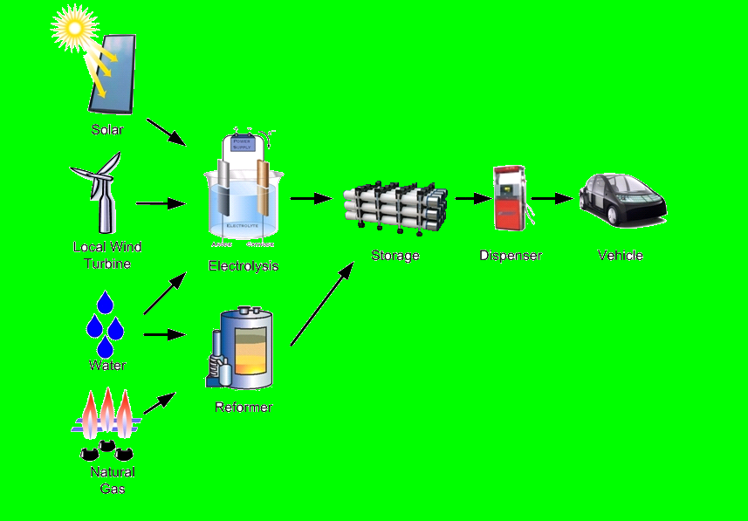
Renewable Energy
+ Water
= Hydrogen
Emissions:
Only Water Vapor
CNG

Slide 18


Slide 19
New major initiative
Notes:
Our New Major Initiative is the EcoCAR: The NeXt Challenge --- North America’s Premier Collegiate Automotive Engineering Competition.
This 3-year competition is organized by US DOE and GM along with a set of actively involved competition sponsors. The goal is to re-engineer a 2009 Saturn VUE to reduce petroleum consumption, increase vehicle efficiency, reduce emissions while maintaining the vehicle’s utility, safety and performance.
As we all know today, 20th of February, the automotive industry is at a crossroads. And this new initiative builds on the strengths and expands the goals of the “Show Me the Road to Hydrogen” initiative supported by funds from Defense Logistics Agency with additional support from the Federal Transit Administration and the Gas Technologies Institute.
So, it is with this NEW CHALLENGE, that our National University Transportation Center will focus on one of our themes: “Transition-state fuel vehicle infrastructure leading to a hydrogen economy” to help the very viability of the U.S. based automotive industry.

Slide 20
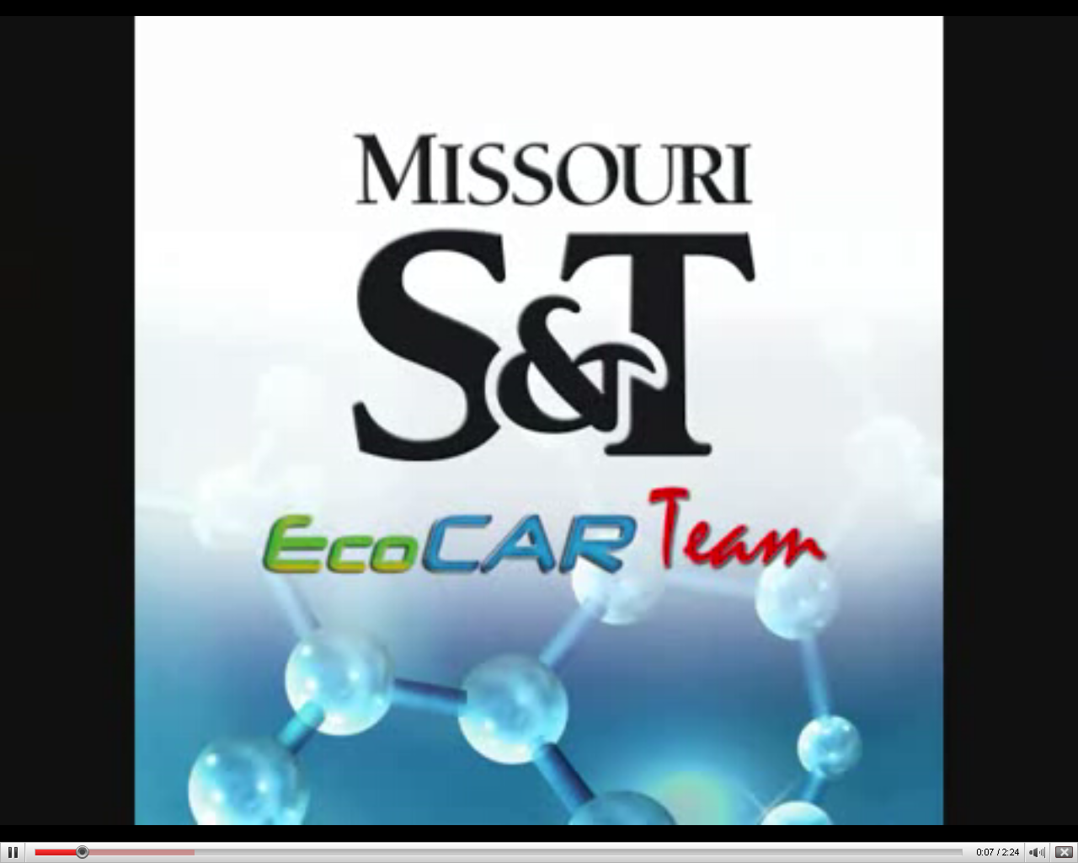
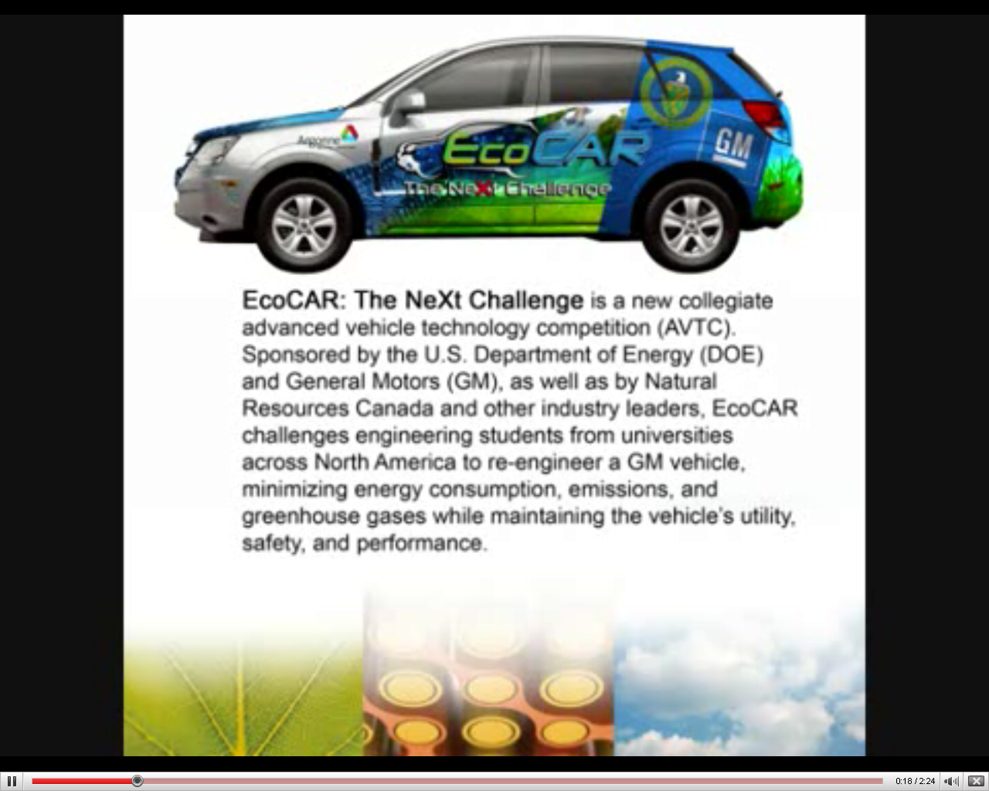
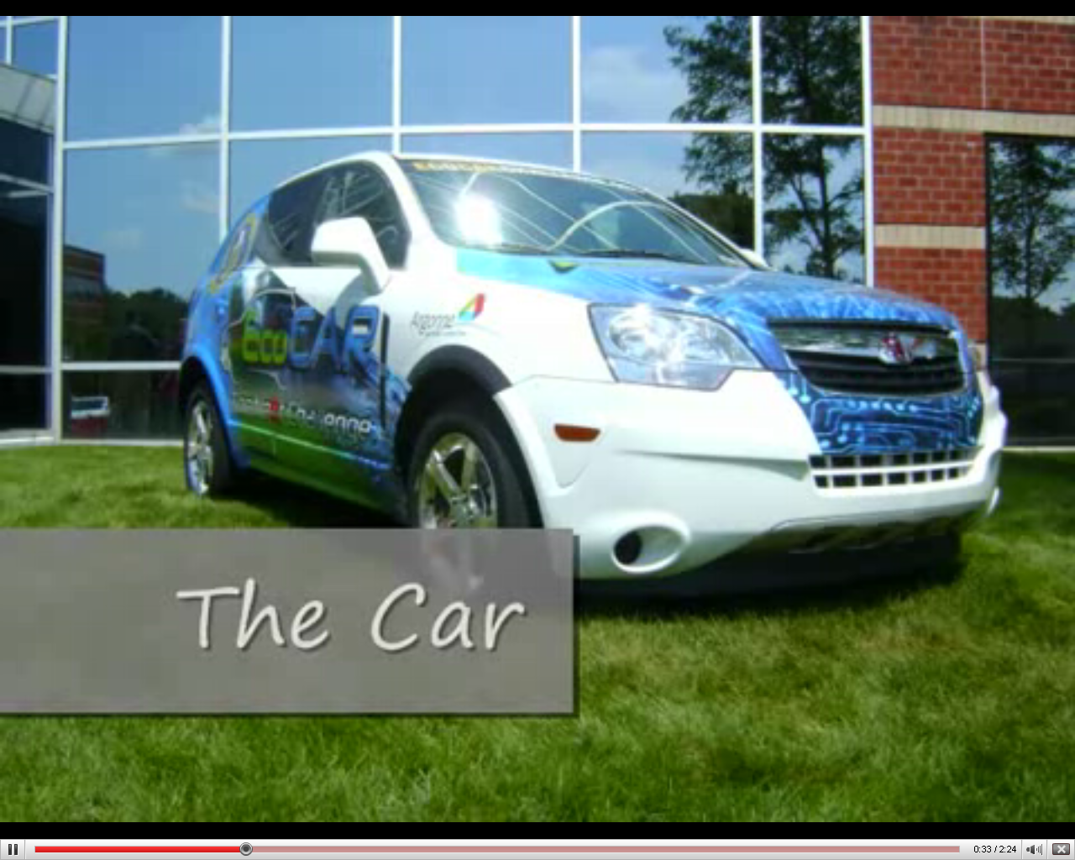
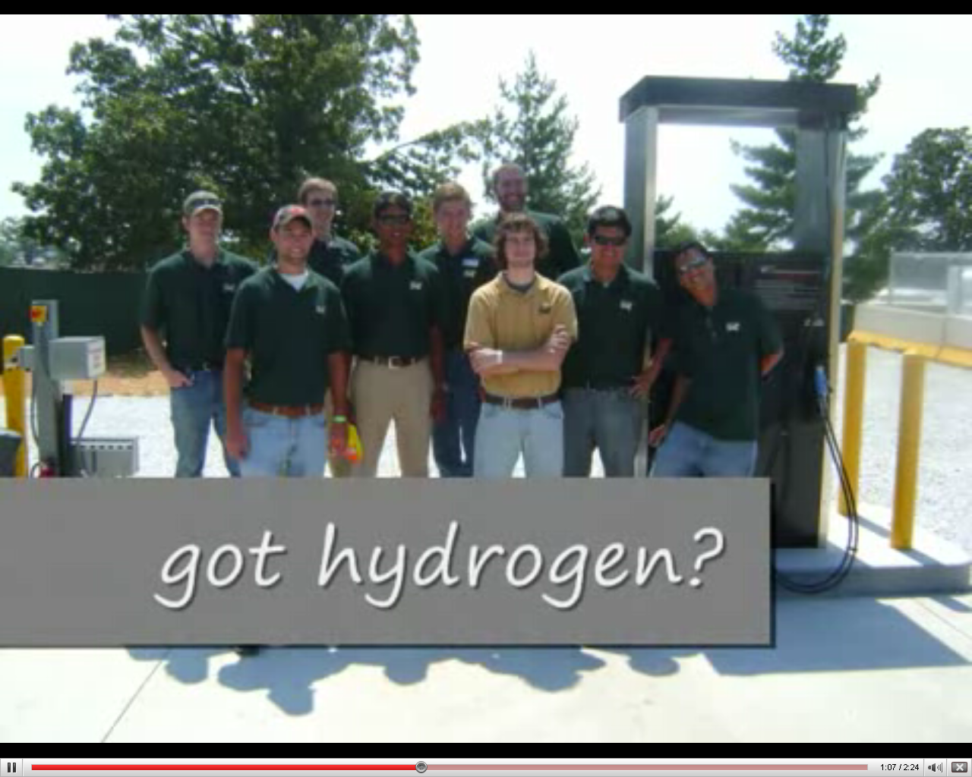

Slide 21
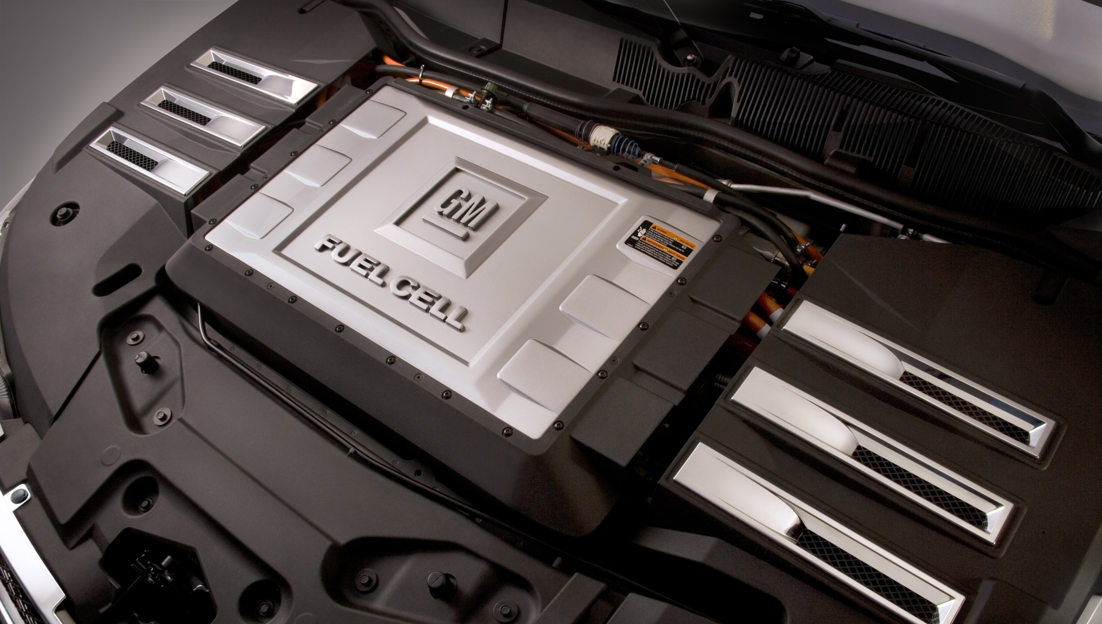

Slide 22
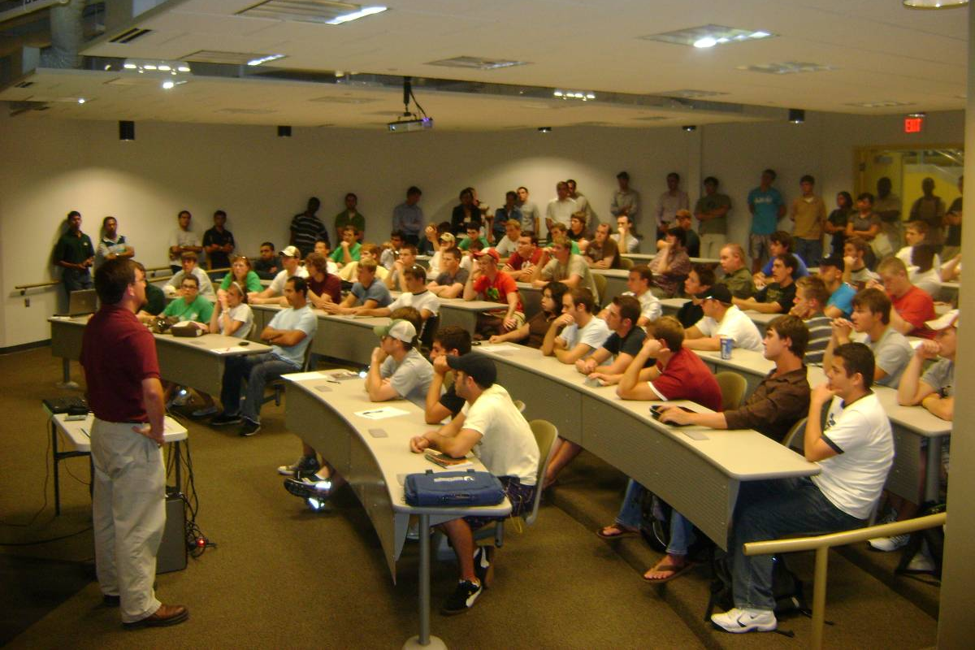
Missouri S&T EcoCAR Team

Slide 23
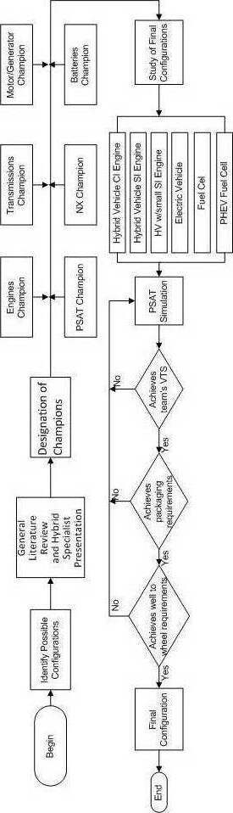
Powertrain Architecture Selection Process

Slide 24
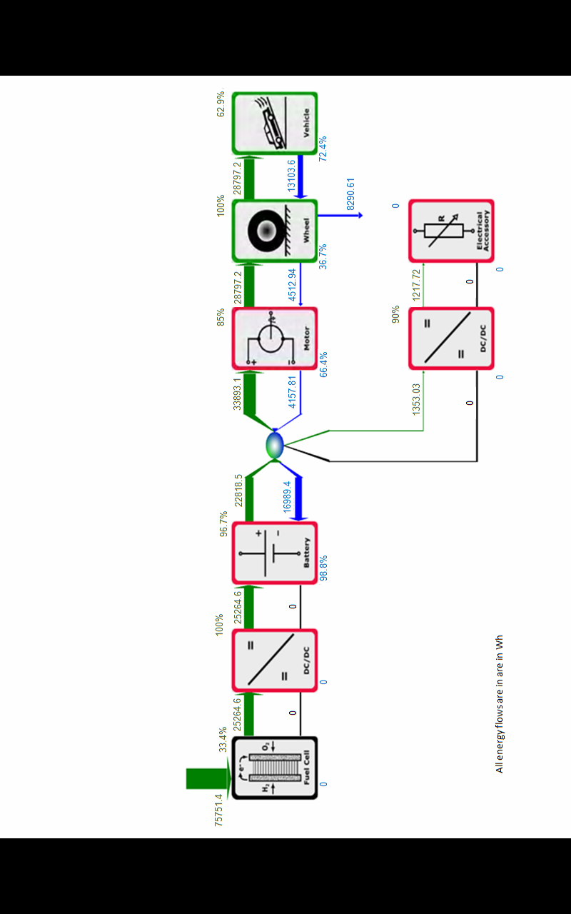
Powertrain System Analysis Toolkit ©
(PSAT) from Argonne National Laboratory
PSAT is a "forward-looking" model that simulates fuel economy and performance in a realistic manner — taking into account transient behavior and control system characteristics. It can simulate an unrivaled number of configurations (conventional, electric, fuel cell, series hybrid, parallel hybrid, and power split hybrid).

Slide 25
The Missouri S&T vehicle powertrain is a series fuel-cell plug-in hybrid electric vehicle (FC PHEV). Initially, the battery, Energy Storage System (ESS), will have to supply all the power requirements for the vehicle (accessories and propulsion). The vehicle then operates in a charge depleting or charge sustaining mode based off of the battery state of charge (SOC).

Slide 26
Specification | Competition |  | Missouri S&T Team
EcoCAR | Production VUE | Competition Requirement | Vehicle Technical Specifications
Accel 0-60 | 10.6 s | ≤ 14 s | 9.8
Accel 50-70 | 7 s | ≤ 10 s | 5.8
UF Weighted FE* | 8.3 l/100 km (28.3 mpgge) | 7.4 l/100 km (32 mpgge)
Towing Capacity | 680 kg (1500 lb) | ≥ 680 kg @ 3.5% 20 min @ 45 mph | 680 kg @ 45 mph
Cargo Capacity | 0.83 m³ | Height: 457 mm (18”) Depth: 686 mm (27”) Width: 762 mm (30”) | 0.83 m³
Passenger Capacity | 5 | ≥ 4 | 4
Braking 60 - 0 | 123 -140 ft | < 170 ft | < 170 ft
Mass | 1758 kg (3875 lb) | ≤ 2268 kg* (5000 lb) | 2238 kg
Starting Time | ≤ 2 s | ≤ 15 s | ≤ 15 s
Ground Clearance | 198 mm (7.8 in.) | ≥ 178 mm (7 in.) | ≥ 178 mm (7 in.)
Range | > 580 km (360 mi) | ≥ 320 km (200 mi) | > 200 miles

Slide 27
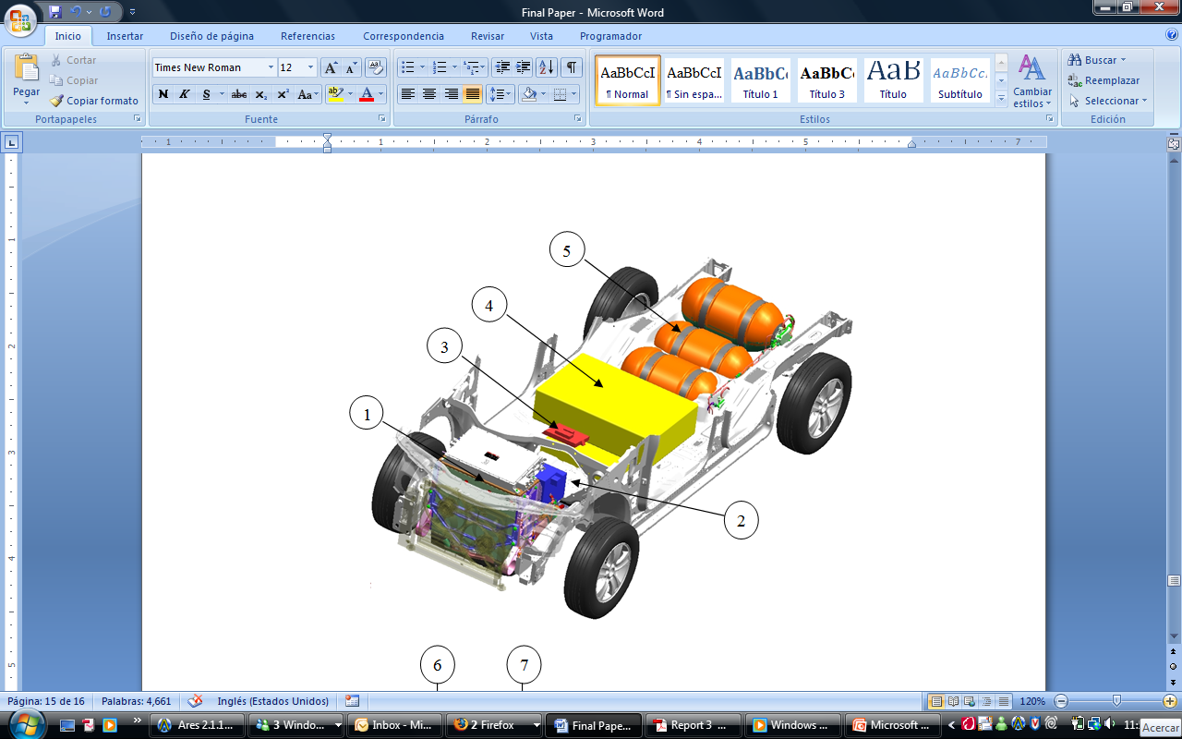
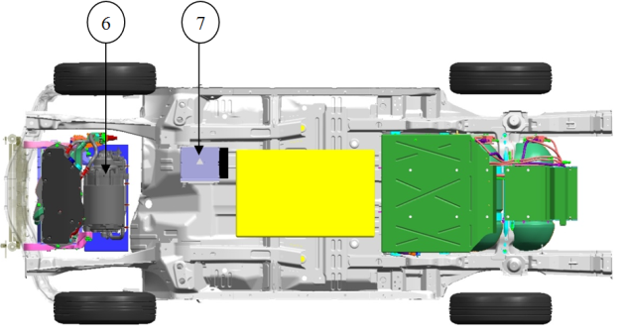
The main components are:
GM Fuel Cell
DC/DC Converter
MOTOTRON Controller
A123 Lithium-Ion Batteries
GM Hydrogen Tanks System
GM Electric Traction System
Battery Charger

Slide 28
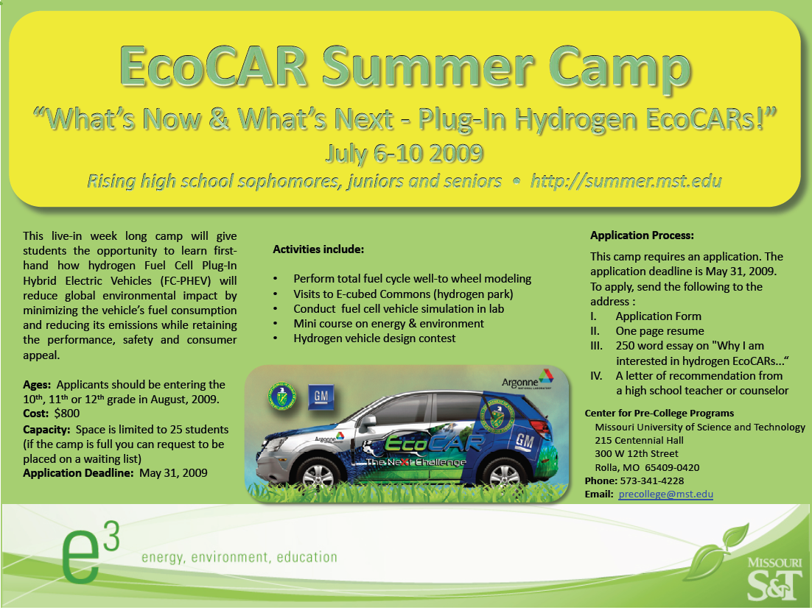

Slide 29
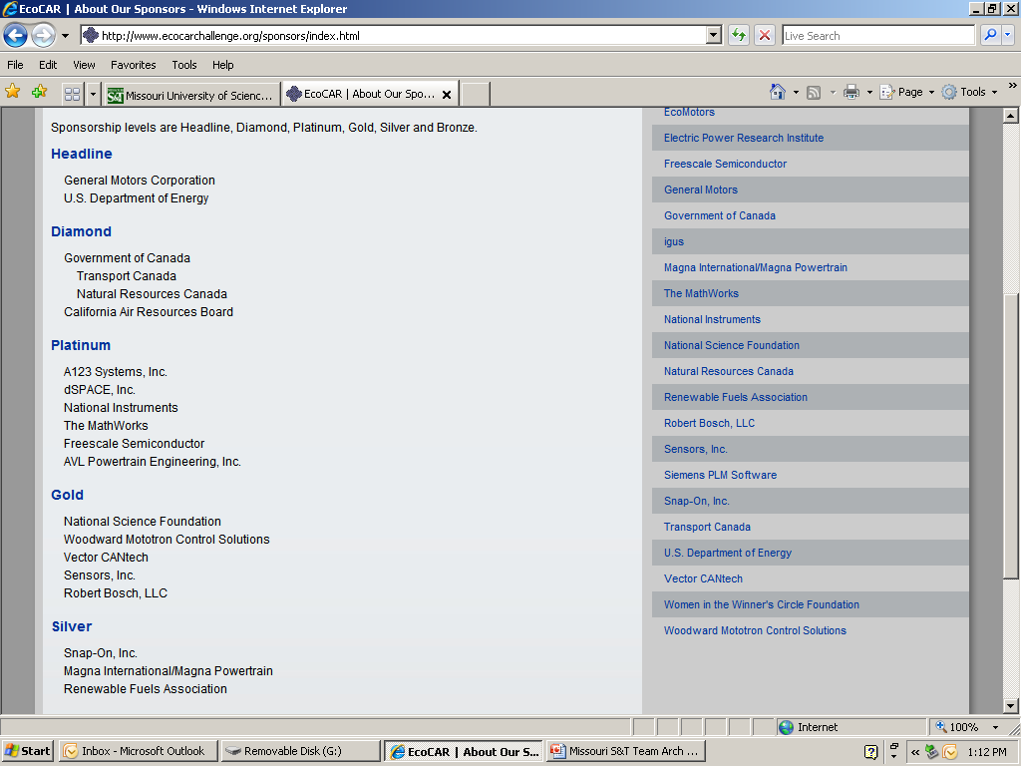
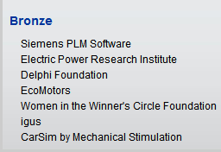
Competition Sponsors

Slide 30
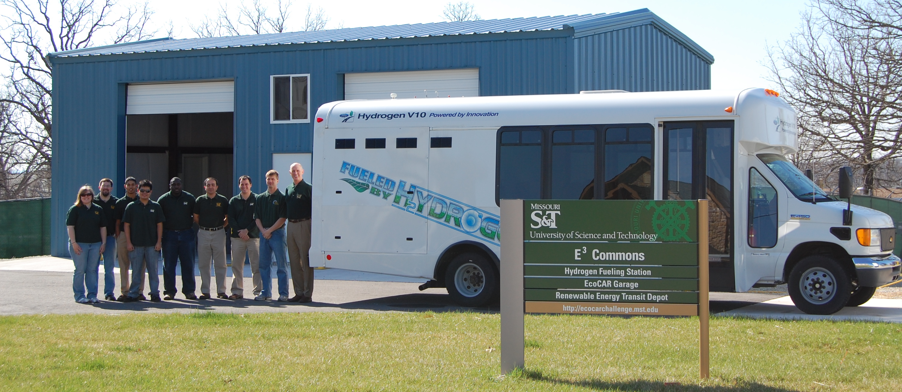
The Missouri S&T EcoCAR Garage will serve as the headquarters for the Missouri S&T EcoCAR team. Students will gain real-world, hands-on experience by transforming a standard production vehicle into a state-of-the-art-car utilizing cutting edge power train technologies. The EcoCAR garage needs to equipped with the necessary equipment for the team to build a re-engineered student vehicle prototype which minimizes energy consumption, emissions, and greenhouse gases while enhancing the vehicle’s utility, safety, performance, and consumer appeal.

Slide 31
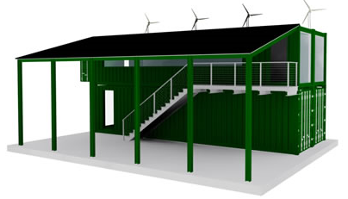
The Renewable Energy Transit Depot is a new “green-building” fabricated from four recycled shipping containers and future home of the Missouri S&T EcoCAR team offices and training space, architectural wind turbines and a solar photovoltaic canopy. The Depot needs to have the interior office/lab space finished for the student design, analysis, simulation and modeling efforts.

Slide 32
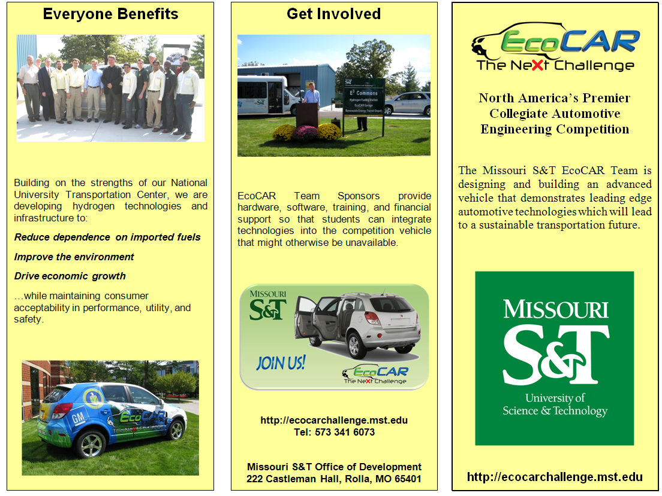

Slide 33
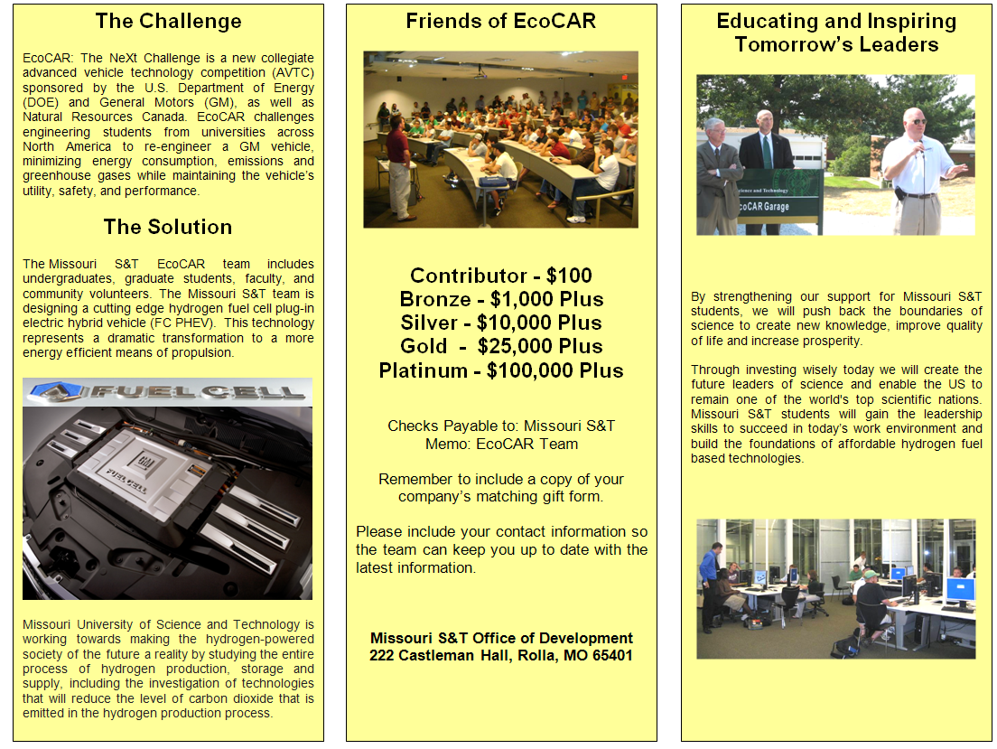

Slide 34

http://ecocarchallenge.mst.edu/

Slide 35
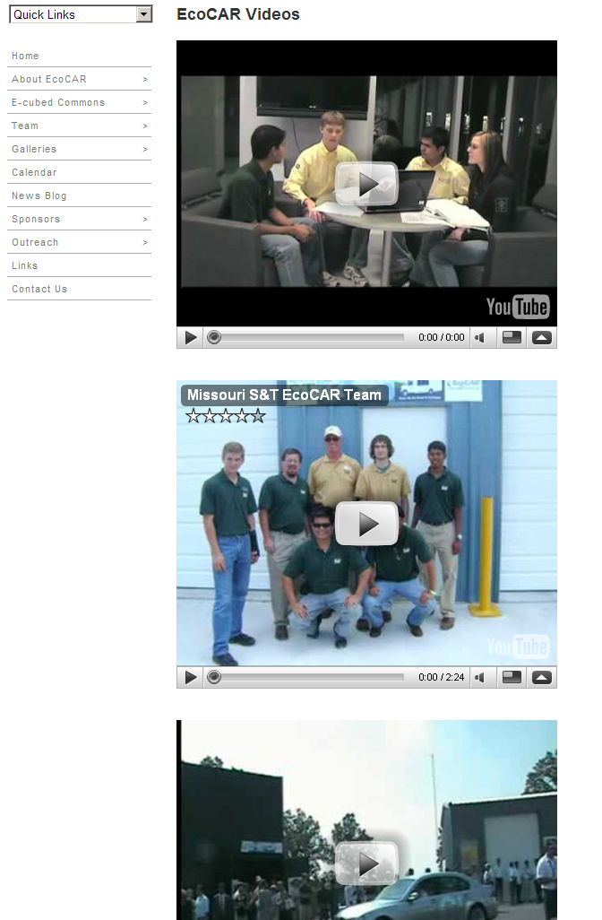
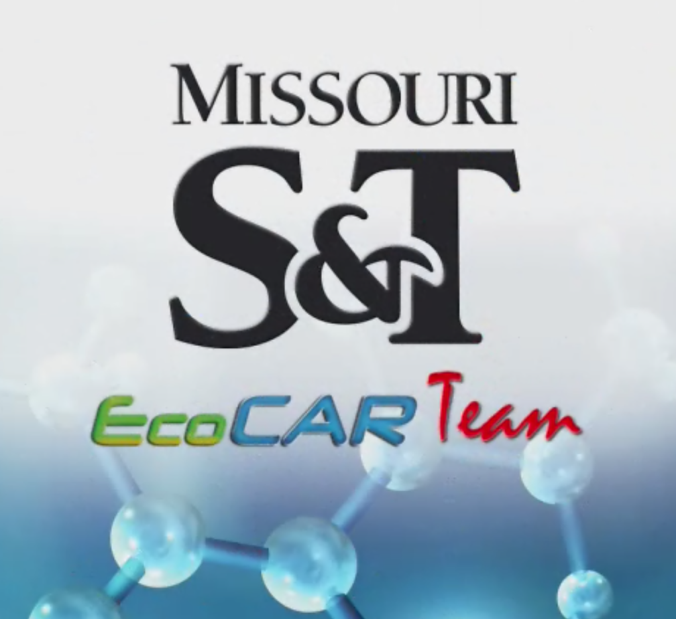
http://ecocarchallenge.mst.edu/galleries/videos.html
Movie

Slide 36
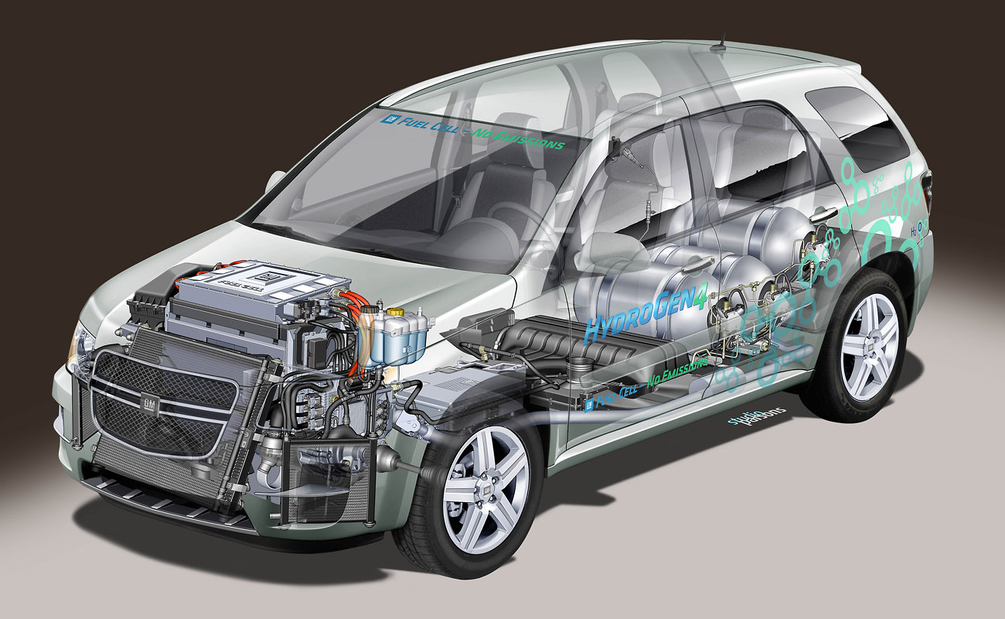
Thank You

Slide 37
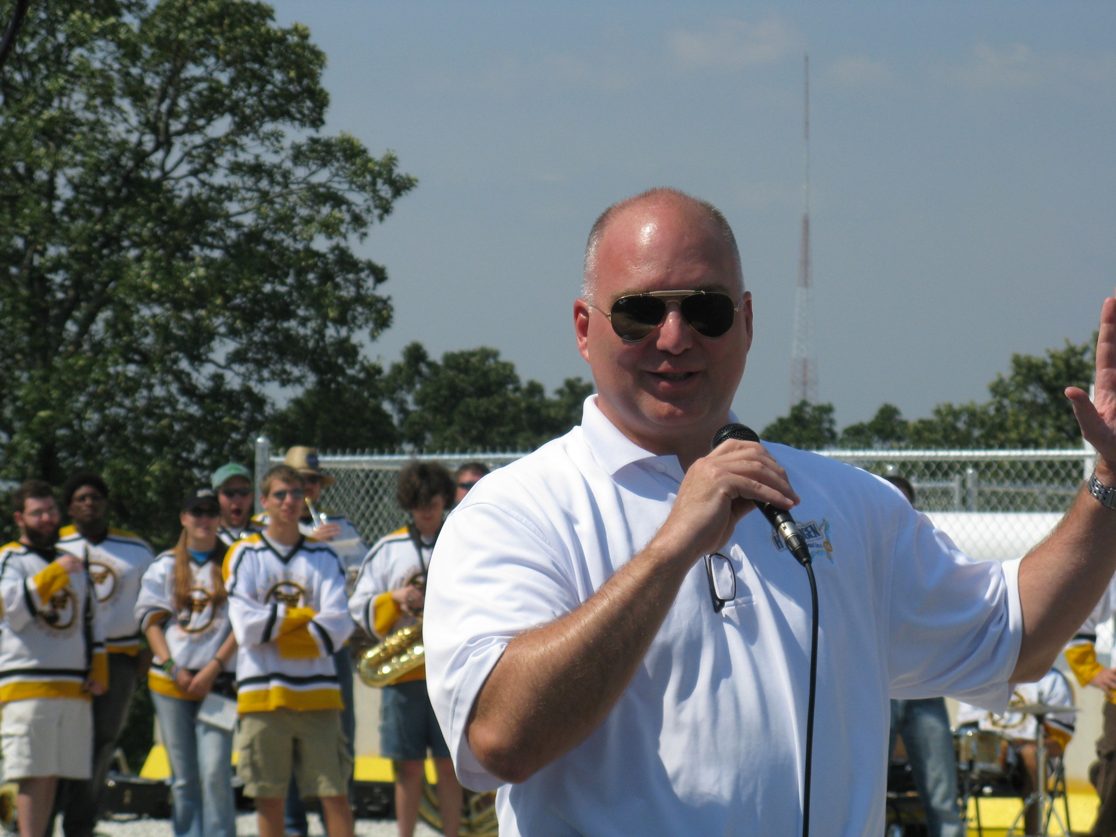
“Hydrogen can be domestically produced,
in whatever quantities you want.
We already make 9 million tons of hydrogen per year in USA, enough to power 35 million vehicles TODAY.
From an environmental sustainability,
from an environmental stewardships,
from an energy independence standpoint”
HYDROGEN ABSOLUTELY MAKES SENSE
Paul Brubaker, Administrator
of the U.S. DOT Research & Innovative Technology Administration (RITA)
Rolla, Missouri
August 19, 2008
Missouri Hydrogen Highway

