Slide 1


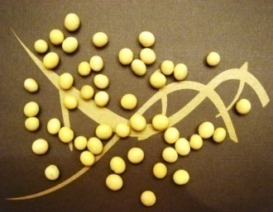
Genomic Strategies For Soybean
Oil Improvement And Biodiesel Production
Rajesh P. N.
Henry T. Nguyen’s Laboratory
Division of Plant Sciences and
National Center for Soybean Biotechnology

Slide 2

Team Members
Geneticists/Genomicists
Henry Nguyen
Xiaolei Wu
Breeders
Grover Shannon
Jeong Lee
David Sleper
Molecular Biologists
Rajesh Kumar
Babu Valliyodan
Bioinformaticists
Trupti Joshi
Dong Xu

Slide 3

Non renewable energy
Fossil fuels in use since 5000 years
Egyptians used for medicine and light
~ 80% of the world's commercial
energy
No potential renewable energy
systems to generate more than a
fraction of the power by fossil fuels
RE
NRE

Slide 4
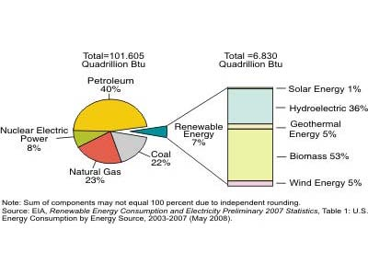
US Renewable Energy Consumption (2008)
Only 7% from renewable sources
RE- Solar energy, hydroelectric,
wind, biomass and others
Biomass comprises of 53%
Biofuel reduces net CO₂ emission
Also CO and other pollutants

Slide 5
Soybean oil- a promising renewable energy resource
Palmitic (11%), Stearic (4%), Oleic (23%), Linoleic (52%) and Linolenic (8%) fatty acids
Yields 93-320% more energy than input
73% biodiesel from soybean
Releases 100 and 12 times less N₂ and P
In US, 650 MGY production; 3000MGY capacity (2008) (Biodiesel 2020: A Global Market survey)
Currently contributes 6% diesel use
Hill et al. 2006; Fehr et al. 2007

Slide 6
Economical importance
Seed specific over expression of fungal DGAT from
20 to 21.5% by weight oil content in soybean (Monsanto)
Incremental increase in oil = An additional $17.9/mt.
(http://www.cbot.com; March 10, 2008)
In the US, 70.4 million metric tons = an increased crop value of more than $1.26 billion
(http://www.fas.usda.gov/oilseeds_arc.asp; 2007/08)
Lardizabal et al. 2008

Slide 7
NCSB: Objectives and strategies
Genomics
Biotechnology
Genetic diversity
Quantitative Genetics
Bioinformatics
Plants
Yeast
(Algae)
Genetic factors
Genetic engineering
Soybean oil improvement

Slide 8
Genomics: Diversity estimation
Plant materials (690)
- Maturity groups III, IV and V
- FA and protein extremes
Genome wide scanning using SSRs
Phylogenetic analysis
Four major clusters
Diversity 0.57 – 0.96 (mean- 0.86)
SNP assay of 192 diverse germplasm
Phenotyping for fatty acids,
protein and carbohydrates
Association mapping
I
II
IV
III

Slide 9
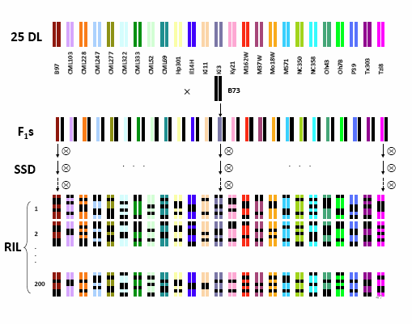
Genomics: Quantitative Genetics
Population development
Selection of 30 Diverse PI lines
Crossing with Elite this summer
5000 RIL population
SNP genotyping
High resolution QTL mapping
Nested Association Mapping
Yu et al. 2008

Slide 10
Genomics: Bioinformatics
Full length gene discovery
SNP discovery/Pathway mapping
Conserved domain prediction
Genome mining
367 lipid genes
Promoter prediction
Comparative genomics
Phylogenetic analysis

Slide 11
Genetic Engineering for Oil Content
In Arabidopsis
    - Over expression of yeast SLC1 (Zou et al. 1997)
    - AtDGAT1 (Jako et al. 2001)
  In Major Crops
    - Maize: PH09B (ancestral maize DGAT1 allele) (Zheng et al. 2008)
    - Soybean: Fungal DGAT2A (Lardizabal et al. 2008)
  Challenge: Impact on starch, protein and yield

Slide 12
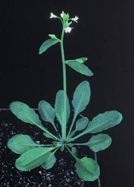
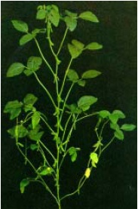
Biotechnology - Strategy
Gene source
Yeast
Plants
Yarrowia lipolytica
ACLs, ACH
Soybean, Arabidopsis
cb5
Yeast expression
Arabidopsis
High Seed Oil Content
PUFA modulation
Soybean
Courtesy: Dr. Rajesh Kumar

Slide 13
Oleic acid
One double bond - greater oxidative stability than linoleate and linolenate
Reduces cholesterol, transfats
Soy diesel, lubricants and cosmetic products
Average about 23% in commercial genotypes
Oleic acid content >50% is desirable

Slide 14
High oleic acid lines
N98-4445A with about 60% oleic acid (Burton et al., 2006)
{Unstable across environments (Oliva et al., 2006) }
M23 with 45% oleic content (Takaki and Rahman, 1996)
A transgenic line from DuPont Nemours Co with 80% oleic acid
{Patent Protection}

Slide 15
Inheritance of oleic acid
High oleic PIs is rare in late maturity groups
Pop 1: 18.3% - 75.3%; means: 36.1%
Pop 2: 20.4% - 66.6%; means: 41.0%
Poster: Higher Oleic Acid from Soybean Plant Introductions for Improved Oil Functionality
Jeong-Dong Lee, P.N. Rajesh, Kristin Bilyeu, David Sleper, Henry T. Nguyen, and J. Grover Shannon
Notes:
How many environments and years?

Slide 16
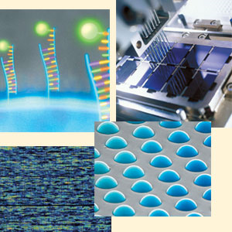
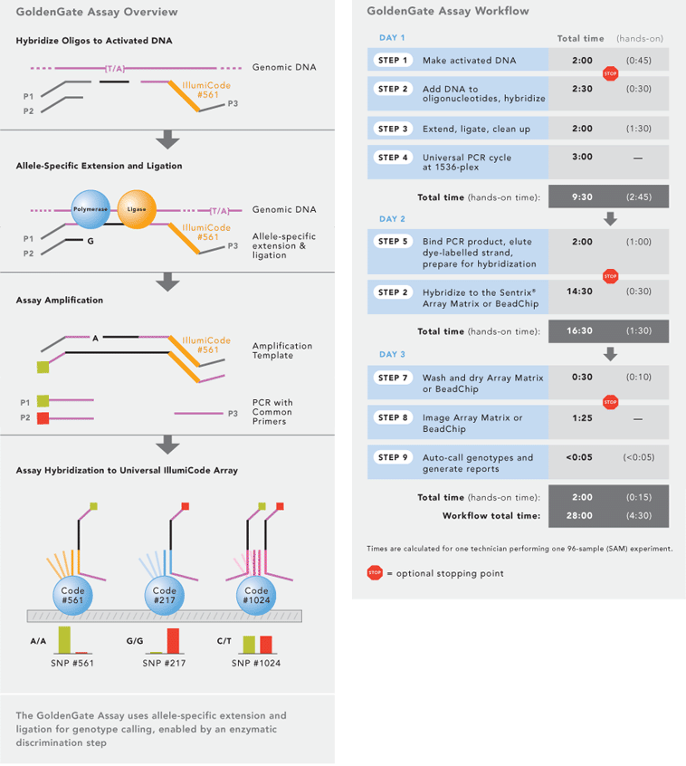
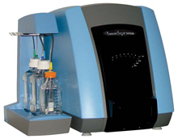
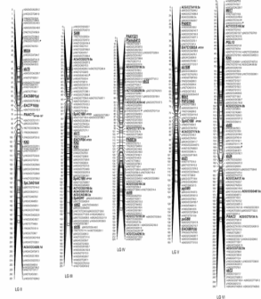
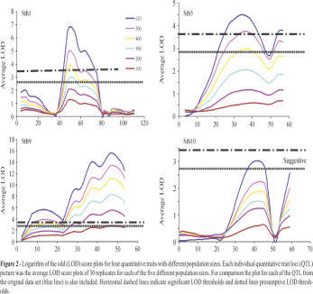
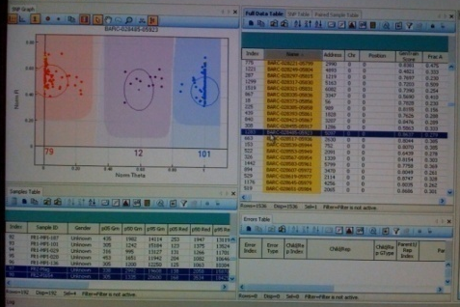
Golden gate assay (Illumina)
High throughput SNP genotyping and analysis
II. Bead assay
I. DNA labeling
III. Bead express
V. Linkage and QTL analysis
IV. Bead studio

Slide 17
Significant accomplishments
Development of genetic materials
Capitalizing genetic diversity
First genome mining for lipid genes
High throughput technology
Genetic engineering

Slide 18

Metabolomics research
Challenge
- To improve oil content and yield
- Systems biology approach
Metabolite profiling
  - To determine biochemical and genetic networks
  regulating seed development and composition including oil
  accumulation
Courtesy: Dr. Babu Valliyodan

Slide 19
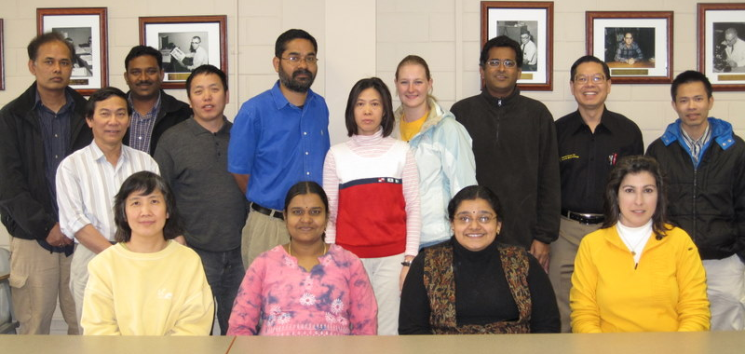
Acknowledgements
Molecular Biologists
Plant Breeders
Genomicists
Bioinformaticists
Lab members
MSMC and USB

Slide 20
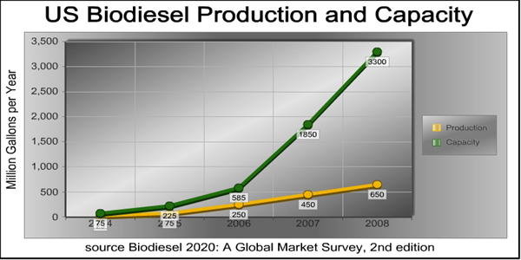
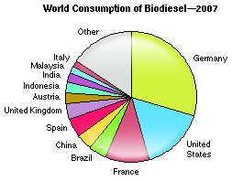
US biodiesel production and usage

