Slide 1
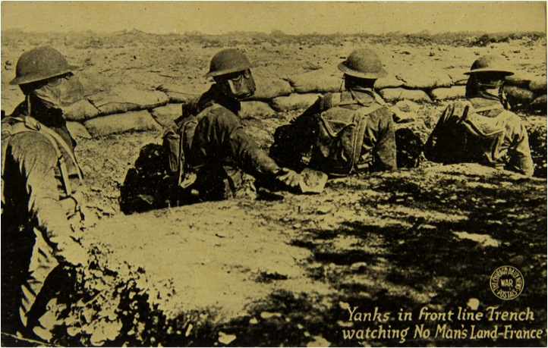
Opening Wednesday, June 19 at 6:00 PM.
¹
Then Came a Post:
Postcards and the Challenge of Communication
during the Great War
An Historical Exhibition in the
Dean’s Gallery of Miller Nichols Library
University of Missouri-Kansas City
& in the Research Center Gallery of the
National World War I Museum
Summer-Fall 2013
Postcard, G. J. Kavanaugh, The Chicago Daily News; National WWI Museum, 86.2.216.

