Slide 1
High Speed Production of Large Coal, to Facilitate Easier and More Effective Cleaning
by
David A. Summers, Stewart Gillies, Kwame Awuah-Offei, & Greg Galecki
Mining and Nuclear Engineering Department
Missouri S&T

Slide 2
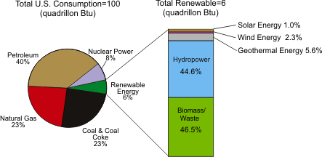
The United States has four major energy sources
One million barrels of oil a day is equivalent to:
  2.08 trillion cubic feet of natural gas a year.
  94 million tons of coal a year
  200 billion kilowatt hours of nuclear power a year.
  203 billion kilowatt hours of hydropower a year
  2.12 Quads (10¹⁵) Btu’s per year.
The US uses over 20 million barrels of oil a day (Source EIA).

Slide 3
But needs coal to create electricity
While coal is the current dominant fuel, because of concerns over carbon dioxide, most recent additions burn natural gas instead. But as it and oil become less available and more expensive coal will dominate.
Oil Other gas Hydro PS
Source EIA 2006 data

Slide 4
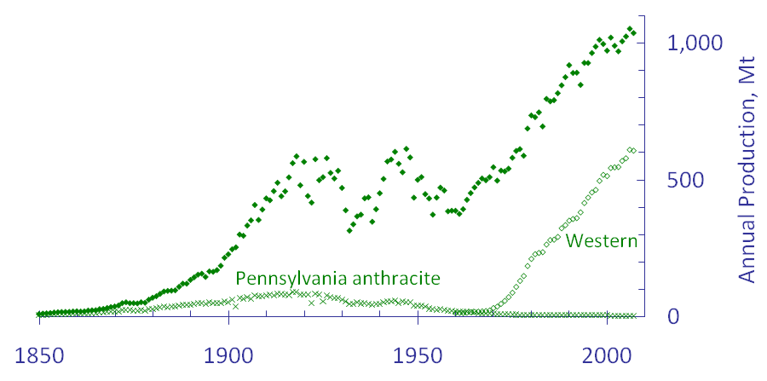
US Coal Production
Recently David Rutledge, and others have looked at sources of American coal and are concerned that the resource will start to run out by 2050.
Source: Hubbert’s Peak, The Coal Question, and Climate Change David Rutledge, Caltech
web: rutledge.caltech.edu
Notes:
Data from Robert Milici and the EIA Milici reference is at http://pubs.usgs.gov/of/1997/of97-447/
Time line on the Clean Air Act at http://www.environmentaldefense.org/documents/2695_cleanairact.htm

Slide 5
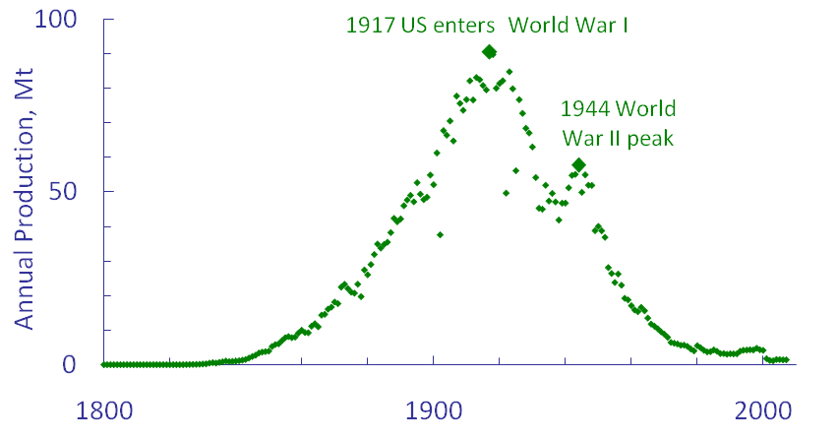
Pennsylvania Anthracite Production
By looking at plots such as this for PA Anthracite, they anticipate future declines
But the circumstances for these declines have not been because of a lack of resource, rather it has been because of other factors, including costs of production, relative to price elsewhere.
Source: Hubbert’s Peak, The Coal Question, and Climate Change David Rutledge, Caltech
web: rutledge.caltech.edu
Notes:
Annual oil production information at http://tonto.eia.doe.gov/dnav/pet/hist/mcrfpus1a.htm

Slide 6
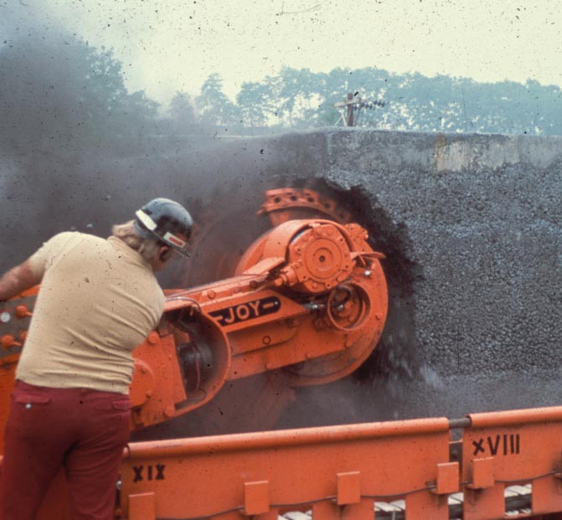
In the past mining machines have not looked to energy production costs, as they were low
  Most mining machines grind coal from the solid
  This produces lots of dust, and fine coal, which is neither efficient nor particularly safe.

Slide 7
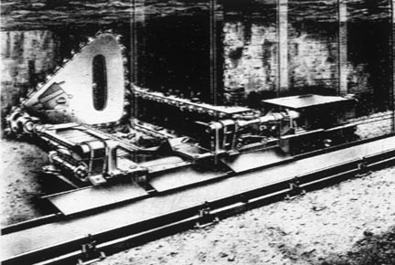
But earlier machines worked, as manual mining does, by only cutting part of the face
The Meco Moore machine used cutting bars to cut at the bottom middle and back of the coal and the remaining coal fell under its own weight and could be loaded onto a conveyor.

Slide 8
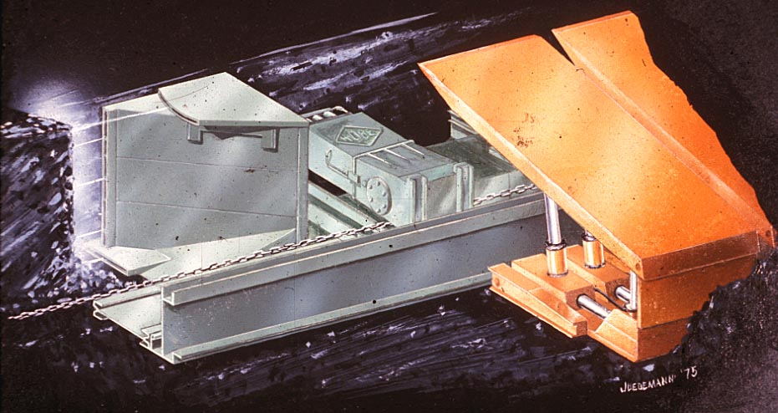
The MO S&T Hydro-miner was designed to use waterjets to make the same sort of cuts
Oscillating waterjetc cut at the top, bottom and back of the coal to break out a column

Slide 9
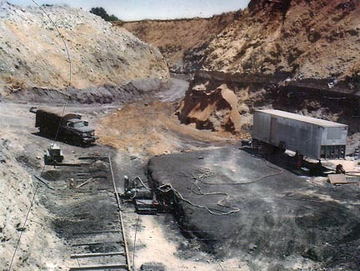
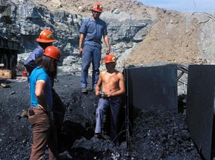
Tests of an initial design were carried out on the surface in northern Missouri
An initial design was pulled along an exposed coal seam

Slide 10
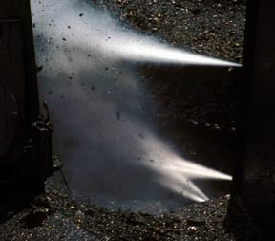
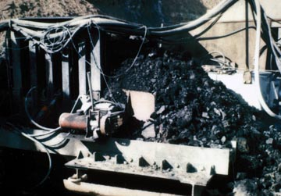
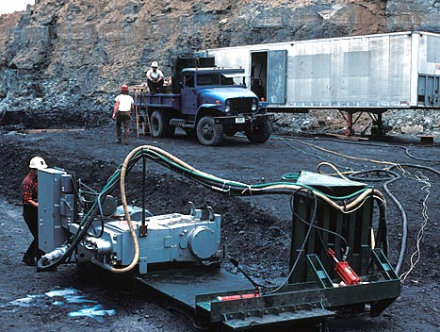
The jets produced larger coal, faster and with less force

Slide 11
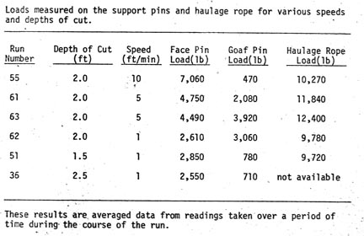
And because of the jet infusion and cutting there is no dust or risk of gas ignition

Slide 12
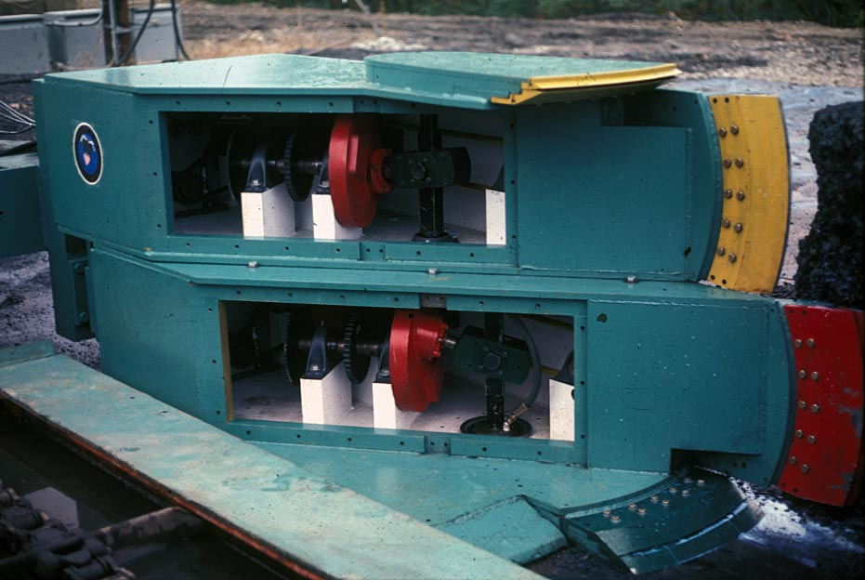
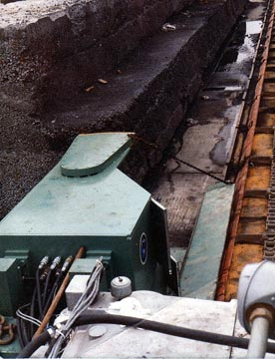
A second generation machine was built
And tested in a test facility in Bruceton by the Bureau of MInes

Slide 13
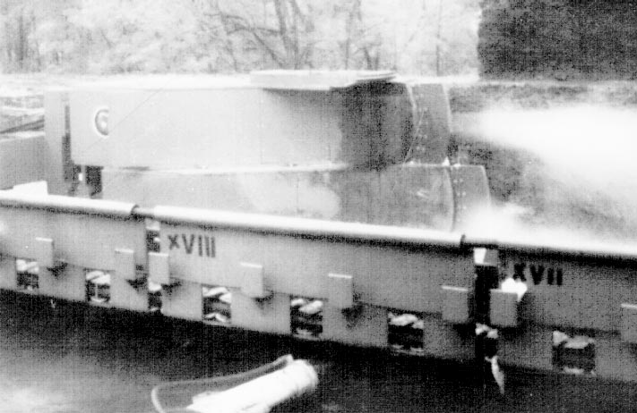
It worked even in cutting harder simulated coal
Though we learned the importance of wedge and clearance angles

Slide 14

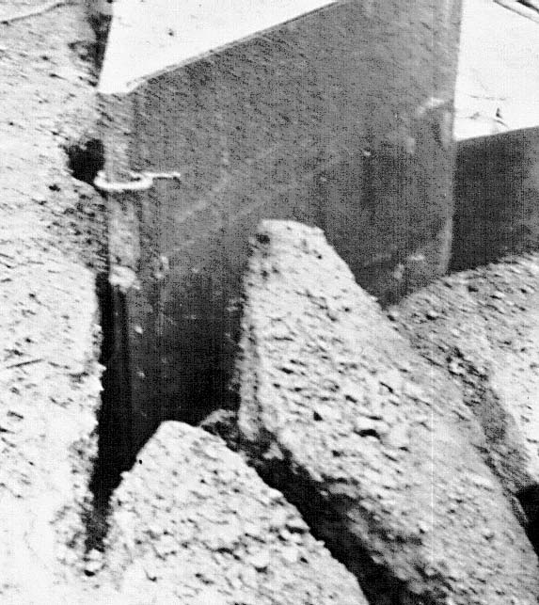
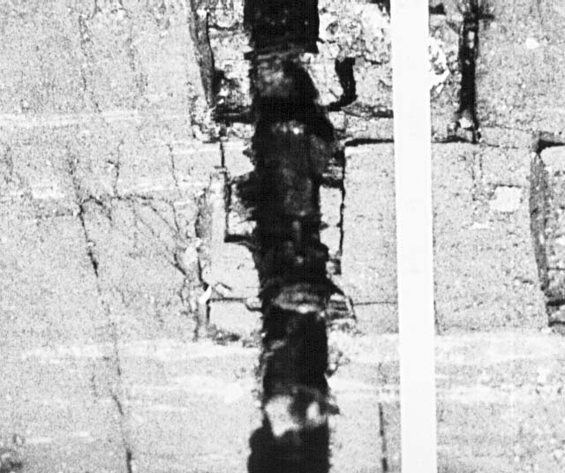
It used a dual jet to cut a wider slot

Slide 15
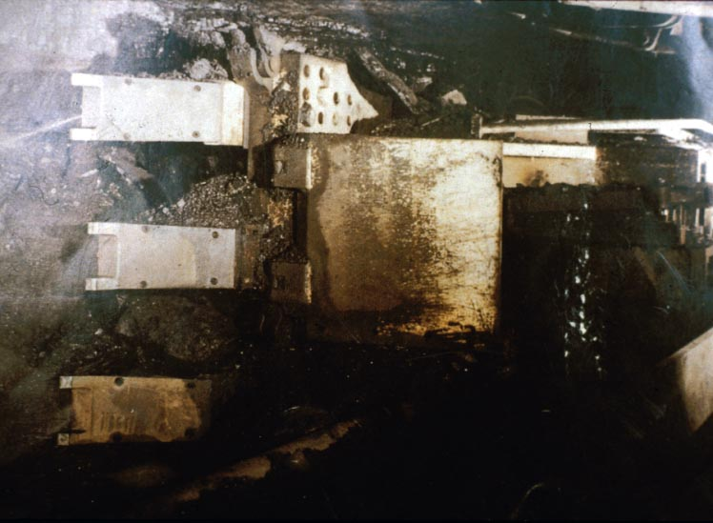
The method was tried underground
Tests at the Lohberg mine in Germany showed that the coal was mined fast, and relatively inexpensively. But the world market for the machines at the time was too small.

Slide 16
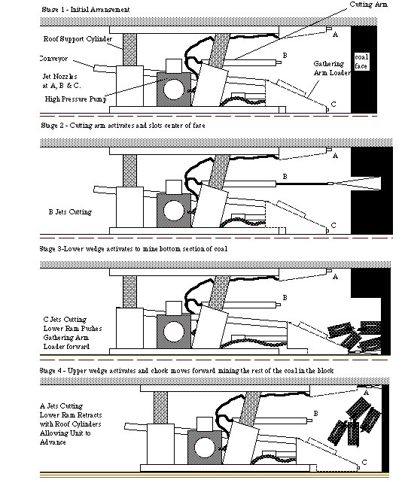
We tried the same idea in room and pillar

Slide 17
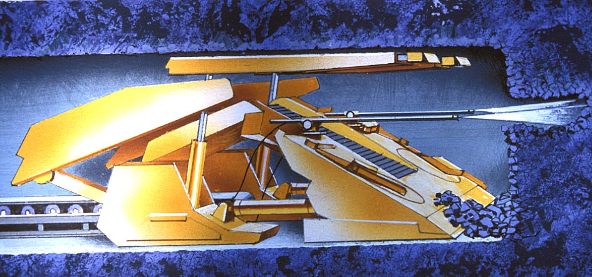
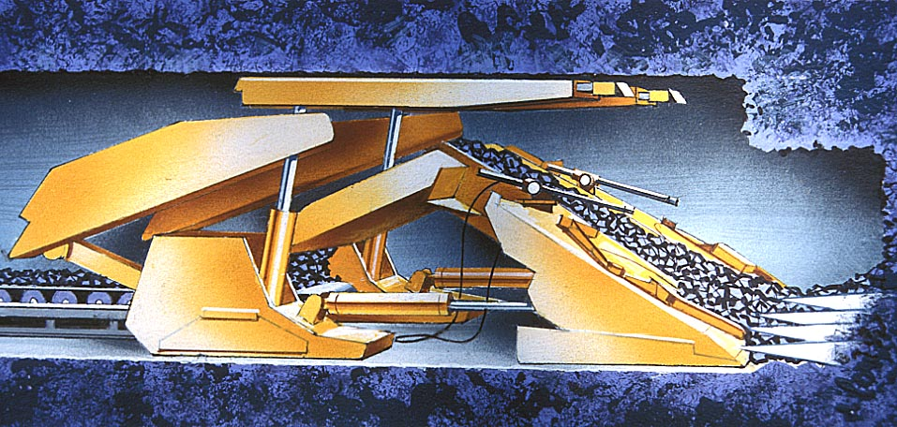
First two stages

Slide 18
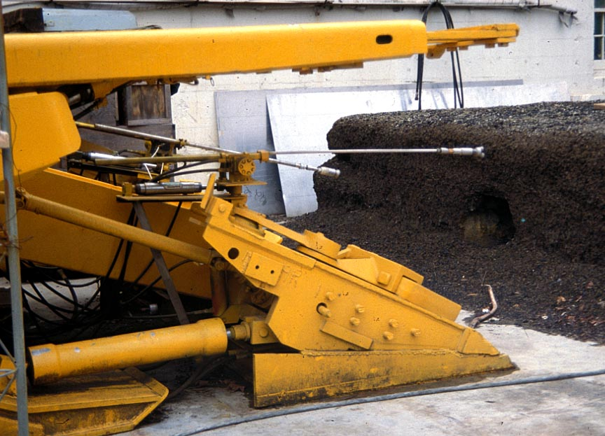
We built a prototype
But the end of the Energy Crisis meant that we ran out of funding

Slide 19
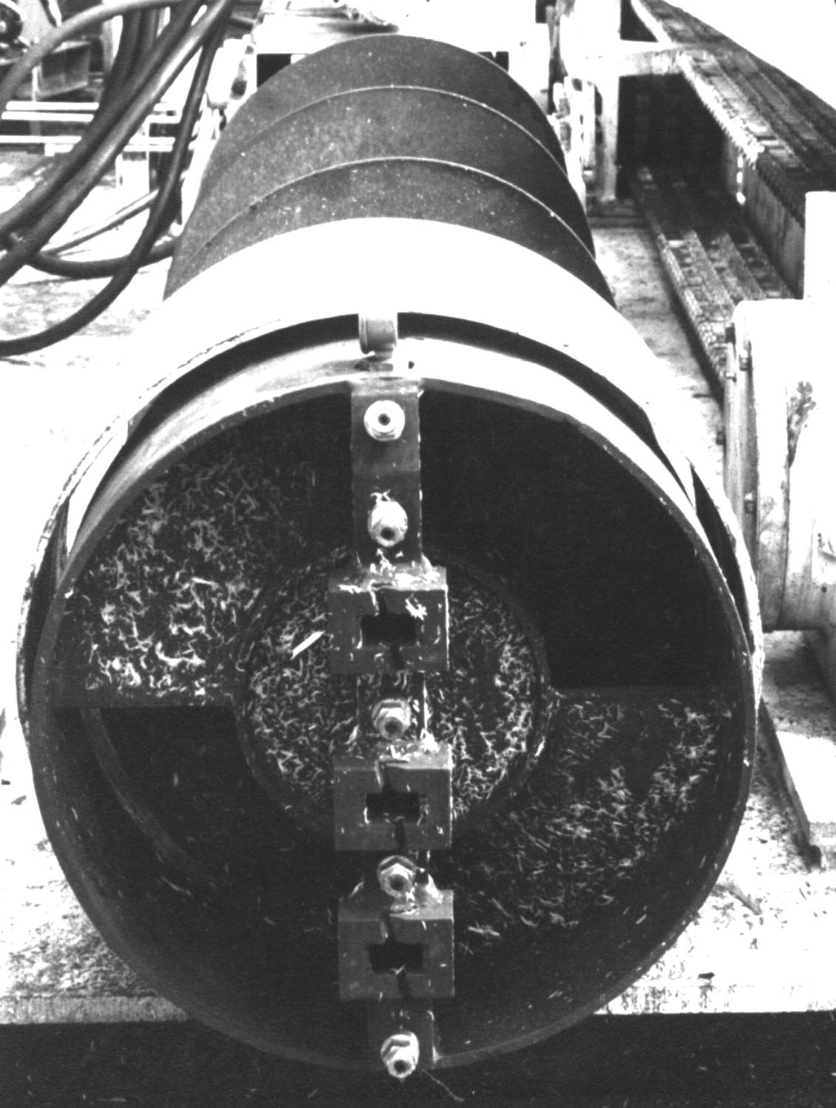
There are other ways to break the rib

Slide 20
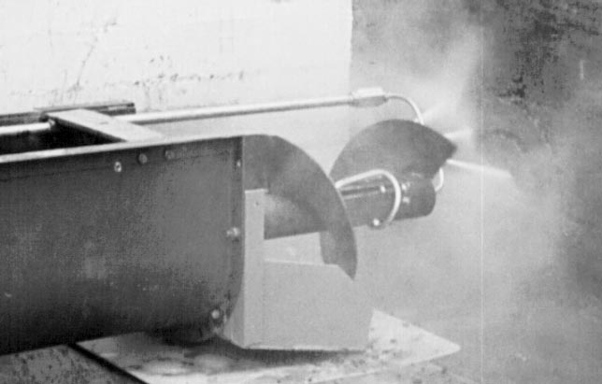
The jets cut ribs that the auger easily breaks

Slide 21
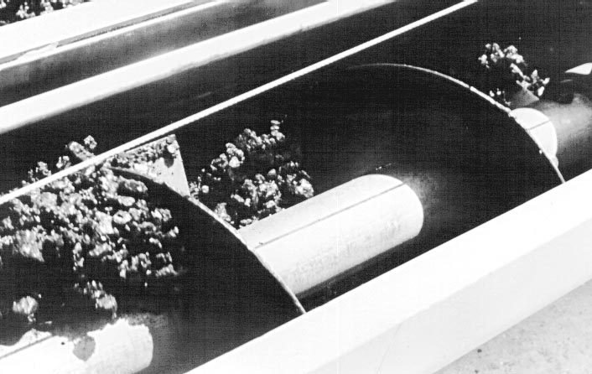
Inside the hole the walls keep the coal in the scroll

Slide 22
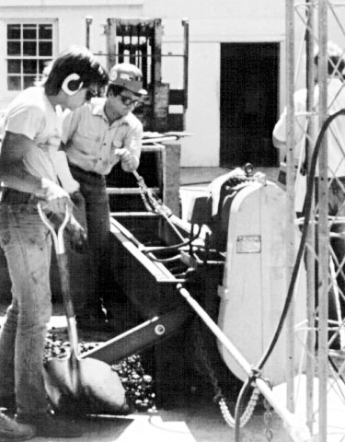
And you don’t need a lot of force to move it forward (note the broken arm)

Slide 23
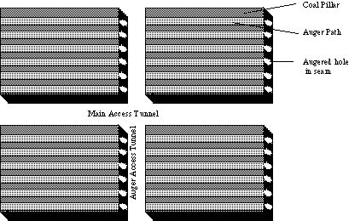
You can then bore out adjacent cuts along a highwall, or underground.

Slide 24
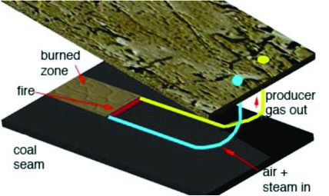
There are many ways of producing coal more easily and from thinner seams remotely.
The Mining Industry has not had to look to these ideas yet.
When they do they will be able to mine many seams that are now considered unworkable, but which are only, with current technologies uneconomic.

Slide 25
Acknowledgments
Dr. Clark Barker Of MS&T initial design
Jet Propulsion Laboratory for support and assistance
National Aeronautics and Space Administration for program support
RMERC staff for field support and system construction
U.S. Department of Energy for program support
U.S. Department of the Interior for program support
National Institute of Standards and Technology for program support

