Slide 1
Small Hydropower Potential in Missouri
Lea Kosnik
University of Missouri, St. Louis
2009
Ongoing work generously funded by the Smith Richardson Foundation and the UM Research Board

Slide 2
The leading cause of climate change today
→
the burning of fossil fuels related to energy production

Slide 3
The leading cause of climate change today
→
the burning of fossil fuels related to energy production
One solution to the problem of global climate change
→
would be to switch to renewable energy supplies

Slide 4
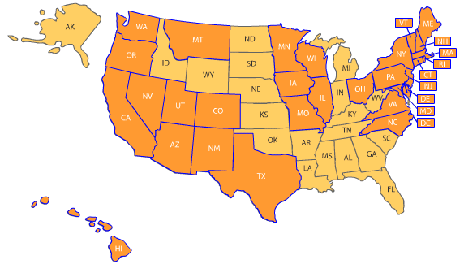
Currently, 28 states have such Renewable Portfolio Standard (RPS) legislation:

Slide 5
Small hydropower is a generation source that can satisfy renewable energy requirements quickly

Slide 6
Small hydropower is a generation source that can satisfy renewable energy requirements quickly
It is a mature technology
With reliable equipment
And conventional input materials

Slide 7
Small hydropower is a generation source that can satisfy renewable energy requirements quickly
It is a mature technology
With reliable equipment
And conventional input materials
Also, it isn’t large hydropower!

Slide 8
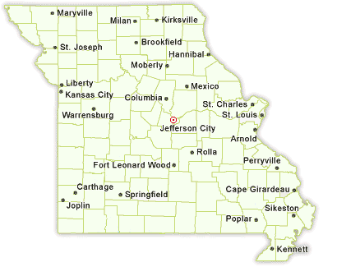
A 2004 Department of Energy study found:
> 5,000 sites
capable of providing over 4,000 MW
all across Missouri

Slide 9
But what are the costs?

Slide 10
But what are the costs?
Estimated this three ways:
RETScreen – Natural Resources Canada
Small Hydro Macro - Norewegian Water Resources and Energy Directorate
Interpolation – from Department of Energy, Energy Information Administration, and Idaho National Laboratory graphs

Slide 12
Average cost to develop small hydropower in MO is ≈ $5,000 per kW.

Slide 13
Average cost to develop small hydropower in MO is ≈ $5,000 per kW.
However, there are hundreds of sites which can be developed for ≤ $1,000 per kW

Slide 14
And, small hydropower has a promising future.
The American Clean Energy and Security Act of 2009 seeks to price carbon emissions in the U.S.
If this happens, a 1MW small hydropower plant will have an additional annual value of $185,000 in reduced carbon emissions.

Slide 15
Additionally, small hydropower has other positively valued ancillary benefits, including:
no sulfur dioxide, ozone, nitrogen dioxide, lead, or other air emissions

Slide 16
Additionally, small hydropower has other positively valued ancillary benefits, including:
no sulfur dioxide, ozone, nitrogen dioxide, lead, or other air emissions
smooth power supply source

Slide 17
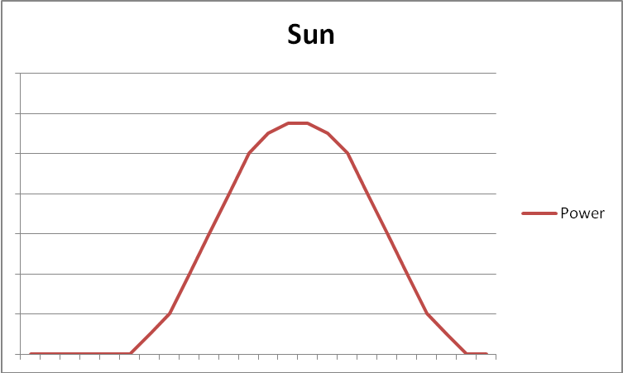
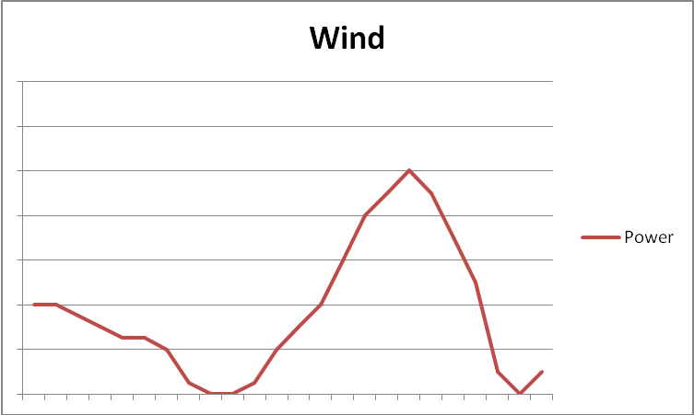
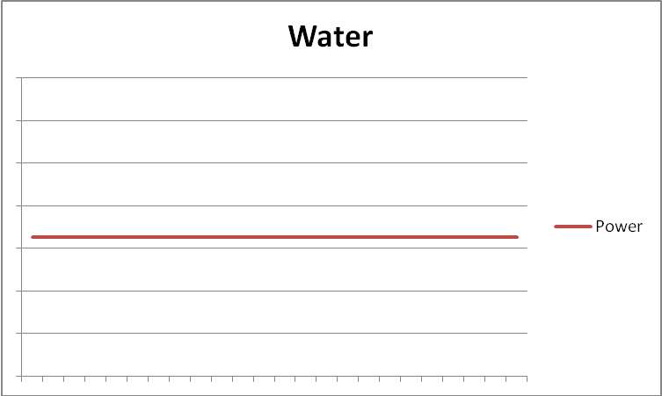
Typical generation service over a 24 hr. period
12 AM
11 PM
12 AM
11 PM
12 AM
11 PM

Slide 18
Additionally, small hydropower has other positively valued ancillary benefits, including:
no sulfur dioxide, ozone, nitrogen dioxide, lead, or other air emissions
smooth power supply source
decentralized power supply source

Slide 19
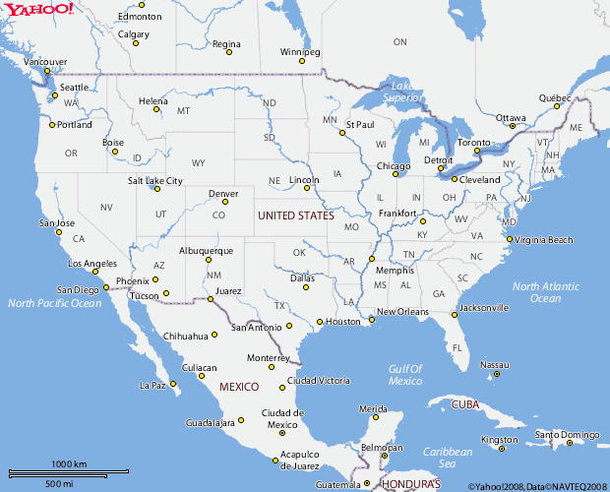
Generic map of large fossil fuel electricity plants

Slide 20
Relative map of small hydropower plants

Slide 21
If we were to numerically value these additional benefits of small hydropower

Slide 22
If we were to numerically value these additional benefits of small hydropower
→ then even more small hydropower sites would become cost-effective.

Slide 23
Conclusion:
Small hydropower not an overall panacea to Missouri’s energy supply needs
But, it can be a valuable component of an overall portfolio of energy generation resources
And best of all, it can be developed quickly.

