Slide 1

Breaking Down Barriers
This is your community,
here’s how to participate!
Hardy Pottinger
@hardypottinger
http://lso.umsystem.edu/~pottingerhj/
slides are at: http://hdl.handle.net/10355/41264
This work is licensed under a Creative Commons Attribution-ShareAlike 3.0 Unported License.

Slide 2
Who is this guy, anyway?
I’m a repository developer, working here in Missouri
I’m a DSpace Committer (since August 2011)
I really like to collaborate, not just with other developers
I complain, a lot
Notes:
I usually start my presentations with a map showing where Missouri is, but, I assume you all know, because you’re here.

Slide 3
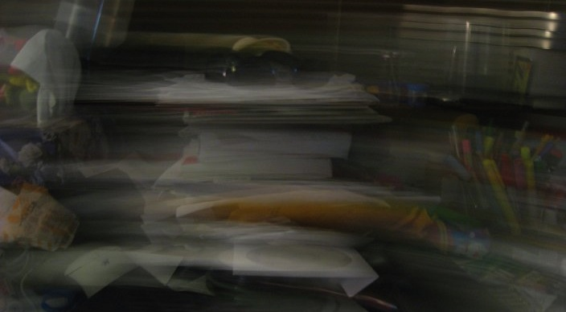
I have so much to do!
Notes:
True story, I was chatting with a librarian, she’s the director of one of our branch libraries, she was asking me about the progress on fixing a bug a few people had noticed. We’re friends, so I asked her if she cared to guess how many unread messages were in my inbox. You know, there’s a big red number that shows up on the icon, it was the thing I was looking at on my screen, it was a very large number, I was impressed, and thought it might be a good silly thing to bond over… she replied, fast as a gunshot, “don’t care.”

Slide 4
We all have so much to do!
Notes:
Why is that? Who here has a messy desk? Maybe not *this messy, but, maybe kinda messy? Why is that? Too much information, right? You’ve got to put it somewhere. There’s a word for this…

Slide 5
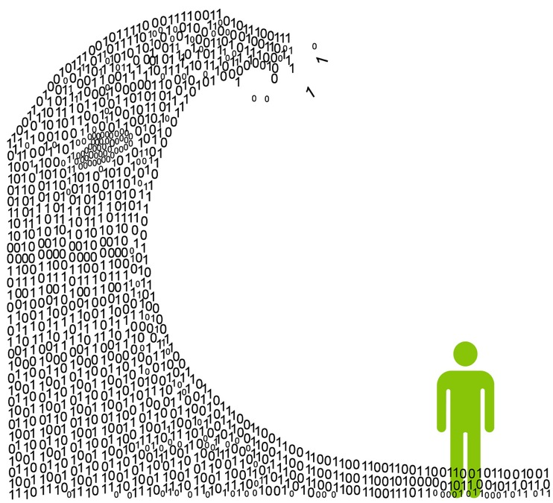
Information Overload
It’s exactly like this, isn’t it?
Notes:
OK, maybe it’s not quite that scary. What if I could tell you that scientists have produced an image of what is going on in a repository developer’s brain?

Slide 6

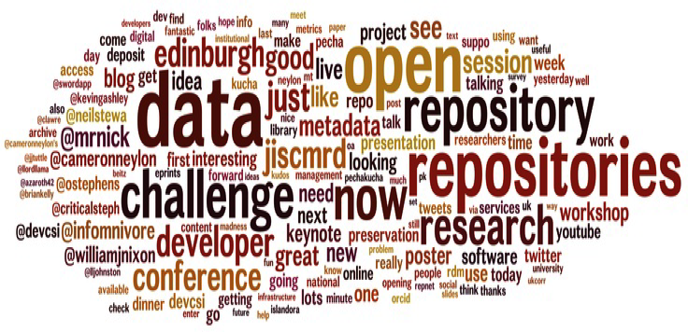
Apologies to Adam Field and Peter Burnhill….
I really like this wordle from OR12, and the color scheme matched, I had to put them together!

Slide 7

The point: we cram a lot in there
Notes:
And it’s not just our actual desks, here’s how we traditionally treat our digital workspace

Slide 8
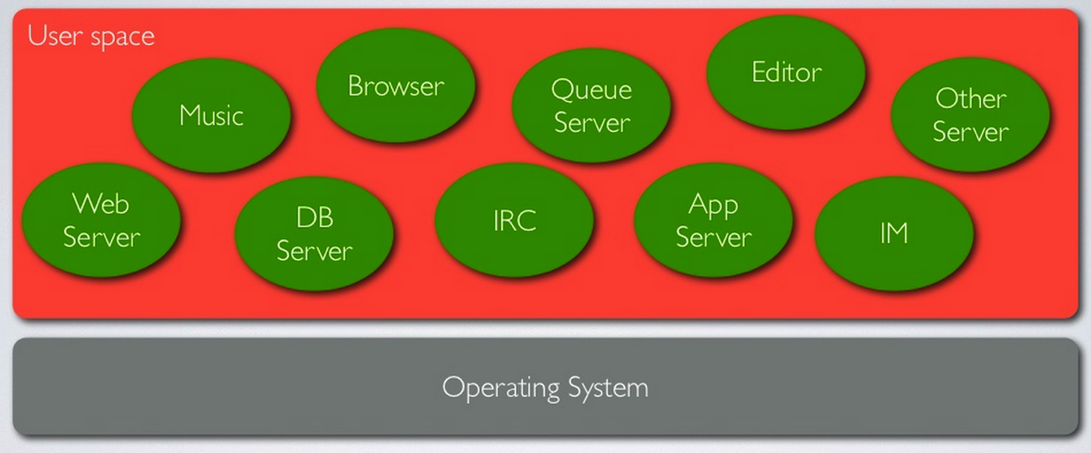
Inside the typical developer’s workstation
Here’s what we try to cram in to our computers. This is important, I’ll get back to it in a minute.
Notes:
This isn’t unique to developers, everybody uses their computers this way, what are the requirement? Install them and keep going… let’s step back though, and look at this from the outside a bit…

Slide 9
Perspectives
A manager sees an overwhelmed developer and thinks
  Need more developers
A repository manager sees long response times to change requests and thinks
  Need more developers
  These guys have no idea what they are doing

Slide 10
It’s all a little bit true.
I’ll explain why…

Slide 11
All admins (IT and Repository) agree
We don’t have enough developers to
get done, what we want done
How do we get out of this mess?
Notes:
Hands up, if you feel that way about your projects

Slide 12
Lower the barriers to participation!
there are many ways to participate (some you know, some you may not)
developing software does not need to be as hard as we have made it in the past
collaboration is fun! the spirit of play and exploration is really important
Notes:
----- Meeting Notes (3/4/14 16:04) -----
I can see it on your faces, you're thinking...

Slide 13
But, we’re not developers!
I don’t care!
OK, seriously, it doesn’t matter, you can still participate

Slide 14
What you probably already know
Subscribe and participate on the mail lists
  dspace-general
  dspace-tech
  dspace-devel
  dspace-release
  https://lists.sourceforge.net/lists/listinfo/dspace-
  …general, tech, devel, release
  You should sign up for all of them, no matter your technical background, and if anyone complains, send them to me
Notes:
Most of you won’t listen to me, but, trust me, we can use your input, and there’s nothing “scary” that goes on in these lists.
----- Meeting Notes (3/4/14 16:04) -----
Oh, man, the looks on your faces...

Slide 15
But I already get too much e-mail!
I don’t care!
OK, seriously, I care, and I know exactly where you are coming from, but, here’s the thing:
E-mail filters are awesome
  Promise me you’ll sign up for all the DSpace mail lists, and I promise I will figure out how to use e-mail filters again, AND…
  I will write a how-to
  But, while you wait, you should check out
  http://inboxzero.com/
Notes:
OK, so, e-mail lists, what else? Everybody here has heard of DCAT, right?

Slide 16
DSpace Community Advisory Team
http://tinyurl.com/dspace-dcat
“help review and facilitate community-wide discussions about new feature requests… and to provide support to the DSpace Committer group in producing software releases.”
Monthly teleconference via Skype
2nd Tuesday of every month

Slide 17

Who is this?
Notes:
Hands up if you know who this is…

Slide 18

Who is this?
Notes:
OK, now, keep your hands up if you have a GitHub account

Slide 19
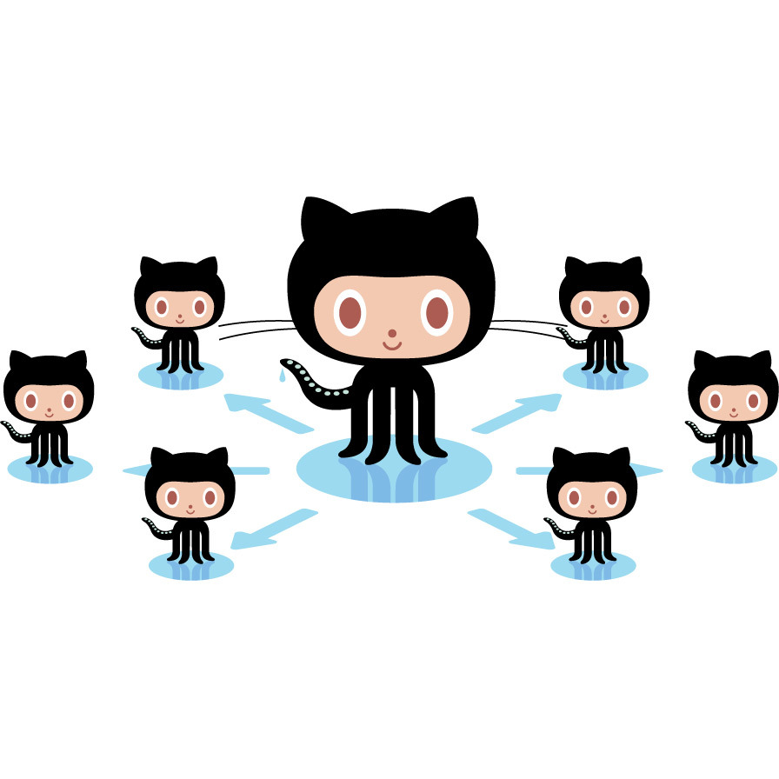
What you may not know
You NEED a GitHub account
  https://github.com/signup
  GitHub is “Social Coding”
  Just like any other social network (Facebook, Twitter, Google Plus) you can follow developers and projects they are working on
  This isn’t just good for you, the social network map you help create can be used by the entire community
  And you’ll need the account if you want to play

Slide 20

GitHub is Social Coding
https://help.github.com/articles/be-social
Follow your own developers
  they will notice, and will take it as a compliment
  seriously, don’t worry about frightening them
  besides, they deserve it!
Follow all contributors to DSpace
“Star” and “watch” interesting projects
Configure your notifications (but
don’t just turn them off)

Slide 21
GitHub is Social Coding
Follow all the contributors to DSpace, not just the committers
  https://github.com/DSpace/DSpace/graphs/contributors
  Star and “watch” interesting projects
  Keep an eye on the DSpace wiki for new and interesting projects

Slide 22
New and interesting projects
Terry Brady at Georgetown University
  https://github.com/terrywbrady
  File-Analyzer
  Batch-Tools
Kim Shepherd (kshepherd)
  http://tinyurl.com/dspace-streaming
Hardy Pottinger (hardyoyo)
  http://tinyurl.com/dspace-replace-auth

Slide 23
New and interesting (continued)
Richard Rodgers’ MDS (Modern DSpace)
  https://github.com/richardrodgers/mds
Anja LeBlanc’s REST-API work (search, plus the new JORUM interface)
  https://github.com/DSpace/DSpace/pull/434
Almost anything that looks interesting in the list of DSpace “pull requests”
  https://github.com/dspace/dspace/pulls
Notes:
Anja hasn’t yet posted the new JORUM site’s code, but it’s worth watching for it. Follow her on GitHub!
One of my favorite things to do as a developer is, when we start planning for a DSpace upgrade, I will go through the list of open pull requests and make a list I call my “dance card,” of PRs I want to try to “sneak into” our upgrade. It’s a good trick to get me excited about the upgrade, and I get double-duty out of our upgrade testing process. I know it sounds crazy, but I’m pretty confident in the stability of DSpace 4, so I’m a bit more tolerant of the “bleeding edge” than some.

Slide 24
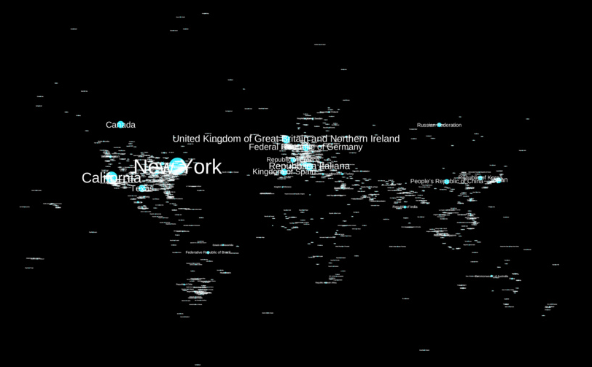
MIT: API for data mining OA fulltext items in DSpace
@sandsfish
Notes:
“Preliminary mapping of geo-parsed place references in the MIT Open Access Collection at dspace.mit.edu Our goal is to understand what parts of the world aren't being focused on in the MIT research output corpus.”
This is a “side project” for Sands, he hass recently moved to a position that involves a lot more data visualization work, like this. That is his twiitter handle there, if you’re interested in knowing more, give him a tweet. You might say “Sands who?” He was the release coordinator for DSpace 3.0, and is a DSpace committer.

Slide 25
Also worth watching
Harvard’s MyDASH site code
  https://github.com/oscharvard/mydash
  It’s a Drupal interface to DSpace statistics
  See it in action at
    https://osc.hul.harvard.edu/dash/mydash
Notes:
I know those were a lot of links, and a bunch of them are to code on GitHub, I can see you’re thinking “we’re not developers!”

Slide 26
You don’t need to be a developer to participate in the conversation!
“Just watching” is enough, the number of watchers on a project is useful data
if you get a notification about something interesting to you, pass it on to your developers: be their “eyes and ears”
if a developer asks for help in evaluating their work, you may be able to provide that feedback (don’t assume you are not able)
Notes:
Speaking of conversations…

Slide 27
Let’s talk a little bit about IRC
Internet Relay Chat, it’s the great grandfather of Instant Messaging
You’ve heard of it, but it’s “scary”
It even scares developers
But, IRC remains the best way to regularly interact directly with the DSpace developer community, while we discuss building the software, day in, day out

Slide 28
IRC: it’s not that scary, really
You don’t have to install anything, just go here:
  http://webchat.freenode.net/?channels=dspace
Or here:
  http://webchat.freenode.net/?channels=duraspace
Pick a nickname for yourself
  FirstnameLastname works fine and is friendly
Say hello, start a conversation (whatever is on your mind about DSpace works)
Or listen to the ongoing conversation
We are all very friendly and will treat you with courtesy,
I promise

Slide 29
IRC: it’s not that scary, really
You don’t have to hang out all day every day
  Though, if you do, that’s cool
  We won’t judge, but we might put you to work
If you can spare the time, sit in on our weekly Developer’s Meeting (every Wednesday at 20:00 UTC in #duraspace)
Watch for an announcement of a release date, the #dspace room can get pretty entertaining on release days

Slide 30
Developing software does not need to be as hard as we have made it
I was overwhelmed
My boss said, “We’ll get you some help.”
We hired a student
I did my best to show him the way
Notes:
Let me tell you a story…

Slide 31
The old way

Slide 32
We spent months, he did not get past this hurdle

Slide 33
I complained, again
Our sysadmin pointed me to Vagrant
http://www.vagrantup.com/
Go there now if you want, it’s cool with me.
“Development environments made easy.”

Slide 34
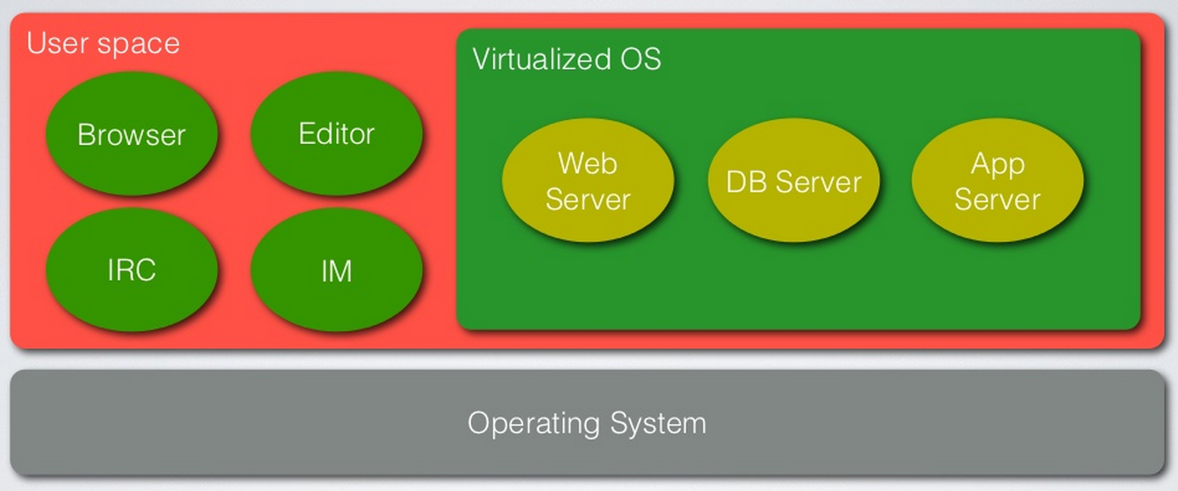
What is Vagrant?
Notes:
Vagrant is a tool for building Virtual Machines, tailored for use in development, in a repeatable, sharable way.

Slide 35
No, really, what is Vagrant?
“Vagrant is a tool for building complete development environments.”
Set up a development environment
Quickly
Reproducibly
In a way that is readily sharable with others
http://www.vagrantup.com/

Slide 36
Vagrant-DSpace is born
https://github.com/dspace/vagrant-dspace
A collaboration between myself and Tim Donohue, with some help from Luigi Andrea Pascarelli (thanks, Tim & Andrea, we owe you)
I knew Tim was working on Puppet modules for provisioning DSpace Direct, so I pestered him to share his modules with me
Vagrant has Puppet embedded, Tim shared what he had, we got it all working with Vagrant
Notes:
What is puppet? You can think of it as a “configuration language” for servers, a way of specifying and ensuring a server is set up in exactly the way you need.
This, incidentally, is how almost all open source software projects get their start…

Slide 37
Open Source Software Development is a conversation
“Hey, I hear you’re working on something awesome, can I play, too?”
GitHub formalizes the process
  Fork a project (“hey, this is cool, I want to play!”)
  Provide Pull Requests (“here’s something cool I did with your thing, you might like it, let’s play!”)
  Code comments (“I tested your cool thing, here’s what I found out, thanks for sharing, you are awesome!”)

Slide 38
This is fun! the spirit of play and exploration is really important
try new things (especially try Vagrant-DSpace)
talk about what you are learning
if you find a solution to a problem you've asked someone to work on for you, tell them! They'll be really excited, and so will you!
consider testing a Pull Request and providing feedback in GitHub (watch the DSpace-release mail list for suggestions on what needs testing)

Slide 39
Issue trackers are awesome
there is lots of "low hanging fruit" in the DSpace JIRA issue tracker
https://jira.duraspace.org/issues/?filter=12102
The label “low hanging fruit” is a work in progress, we will tag more tickets as we review them
Tell your developers, this is an easy way to get your feet wet, and be useful at the same time
Notes:
----- Meeting Notes (3/4/14 16:04) -----
as you're venturing into the DSpace development conversation

Slide 40
If a developer is working on something you're interested in, let them know
good: email or face to face
better: try their code and give them feedback on it
  what works,
  what doesn’t
  what surprised you
  what delighted you

Slide 41
If no one is working on the feature you’d like to exist, let the community know
Good: ask about it on the mail lists
Better: work with DCAT, and advocate for the feature
If you know of other institutions that might be working on the feature, or something similar, start a conversation with their developers, or have your developers do the same

Slide 42
“My code is not ready to share”
If you start a collaboration conversation, you may hear this
Ignore them (but don’t be rude about it)
Keep asking anyway (just not every day)
Talk about what they are working on with others (they may also ask them)

Slide 43
There are many ways to participate
mail lists
DCAT
meetings like this one
GitHub is “Social Coding”
IRC is worth the time
Development doesn’t have to be scary or hard
Collaboration is fun!

Slide 44
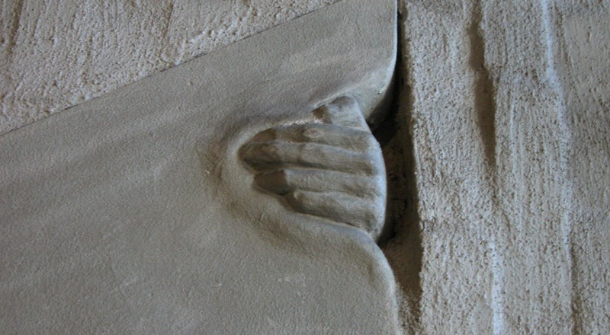
Come play with us!
slides are at: http://hdl.handle.net/10355/41264

Slide 45
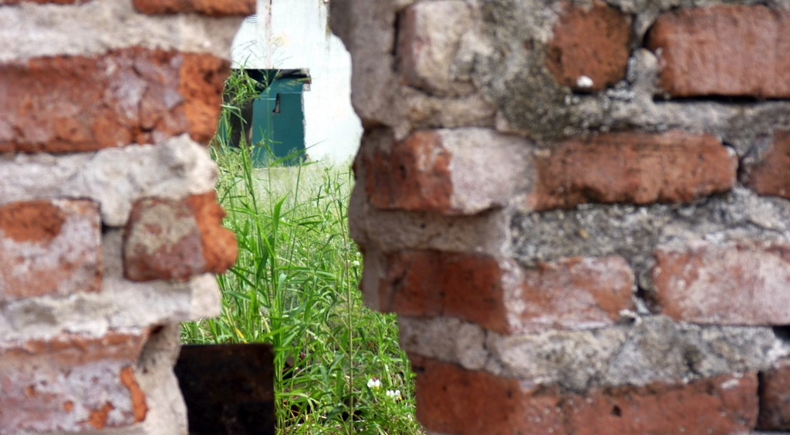
Questions?
slides are at: http://hdl.handle.net/10355/41264

Slide 46
Images Used
Push by Rohan Gupta http://thenounproject.com/term/push/11715/
Messy Desk by Yatoobin http://www.flickr.com/photos/30661646@N00/243293760/
Information Overload by Intersection Consulting http://www.flickr.com/photos/intersectionconsulting/7537238368/
Information Overload is Painful by Bandita http://www.flickr.com/photos/cosmic_bandita/3004255043/
Think by Jack Mallon http://www.flickr.com/photos/18924124@N00/8071905112/
OR12 Wordle used by permission of Adam Field http://www.adamfield.net/oldsite/or2012/wordle.png
Slides 18 & 23 from San Francisco DevOps: Introducing Vagrant,
used by permission of Mitchell Hashimotohttp://www.slideshare.net/mitchellh/sf-devops-introducing-vagrant
MIT Open Access Collection Lens + Labels, used by permission of Sands Fish
http://www.flickr.com/photos/sandsfish/11822705353/
Hand by AtleB
http://www.flickr.com/photos/atlebra/17789996/
Behind the Wall by Joaquin Lopez Pereyra http://www.flickr.com/photos/pkjoa/5433895795/
slides are at: http://hdl.handle.net/10355/41264

