Slide 1
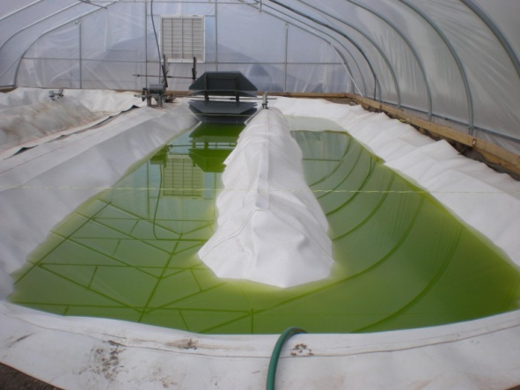

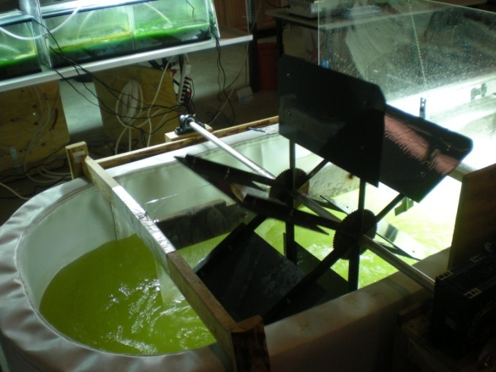



Microalgal biofuels a systems approach
Richard Sayre
Director, Enterprise Rent-A-Car Institute for Renewable Fuels
Director, BioCassava Plus

Slide 2
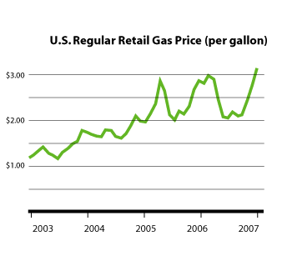
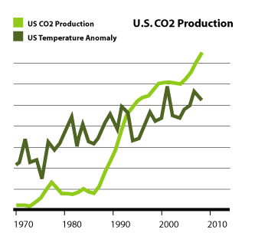
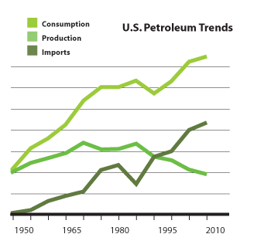
Trends and issues in domestic energy consumption
Economics
Economics
Security
Environment

Slide 3
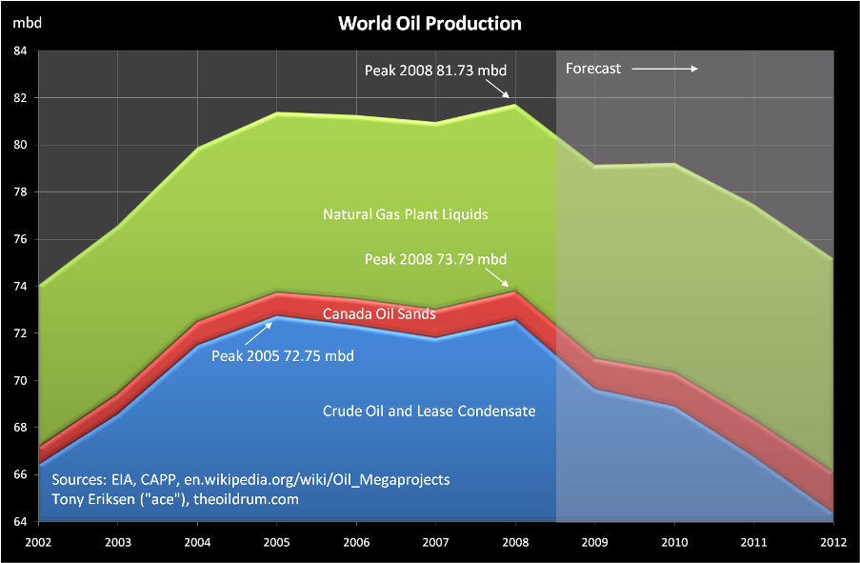
World peak fuel production

Slide 4
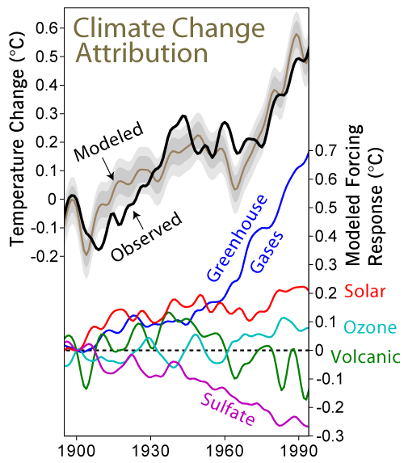
Greenhouse gas emissions and global warming

Slide 5
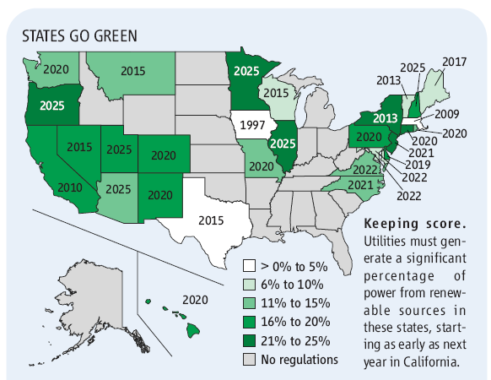
Renewable Energy 0-25% renewables by 2025

Slide 6
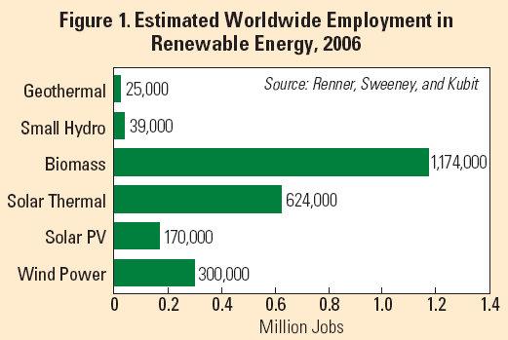
Renewable Energy Creates new jobs

Slide 7
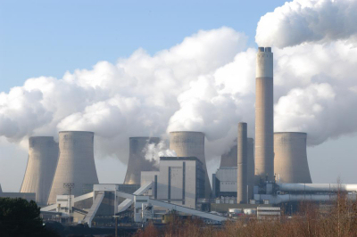

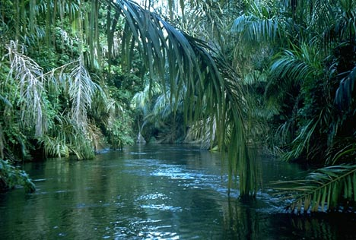
Biofuels an alternative to fossil fuels
Advantages
Sustainable versus extractive technology
Reduced CO₂ emissions
Energy independence
Decentralized energy economy
Constraints:
Low solar energy density
Potential competition with feed production
Technological hurdles
Production systems must be optimized for each site
Seasonal harvests

Slide 8
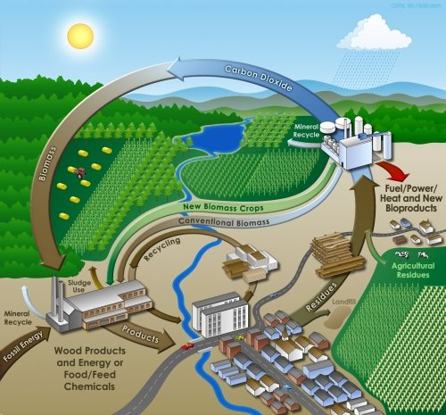
Integrated biomass utilization

Slide 9
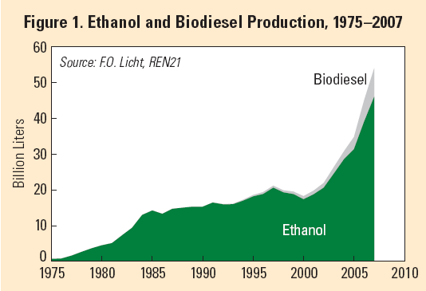
Biofuel production A growth industry

Slide 10
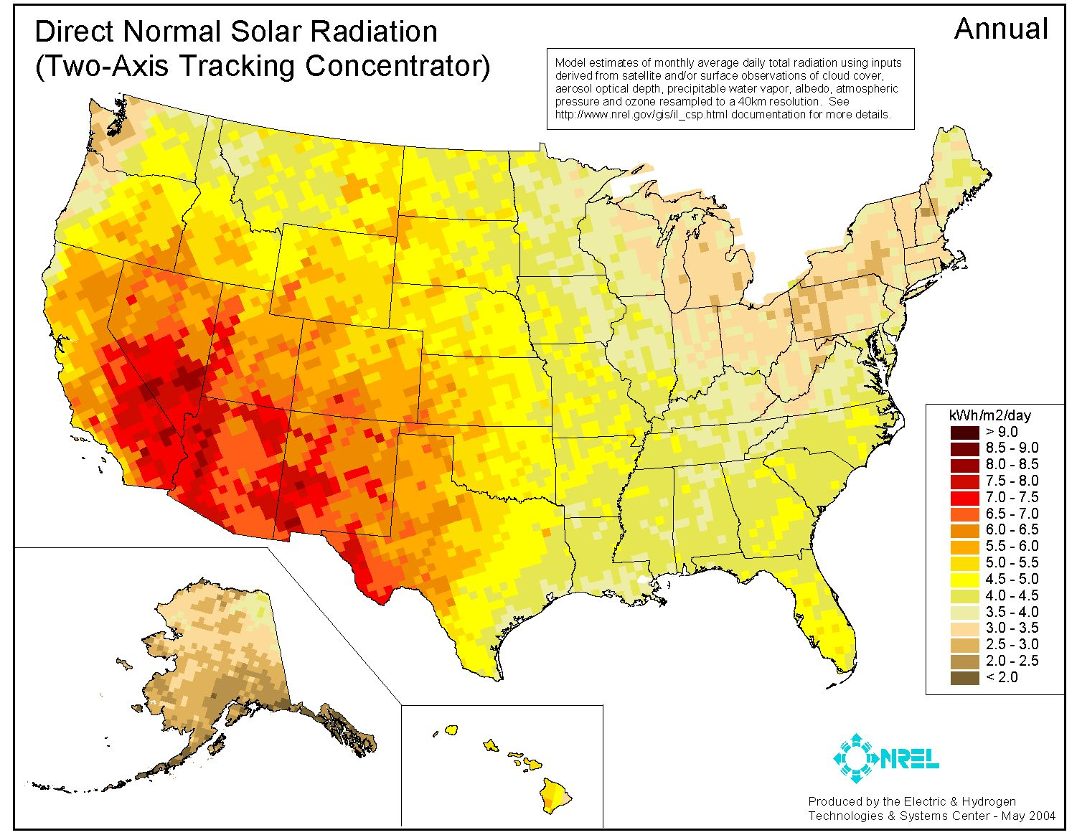
Where is the best place to grow biofuels
Highest solar radiation (4X) in the desert southwest

Slide 11
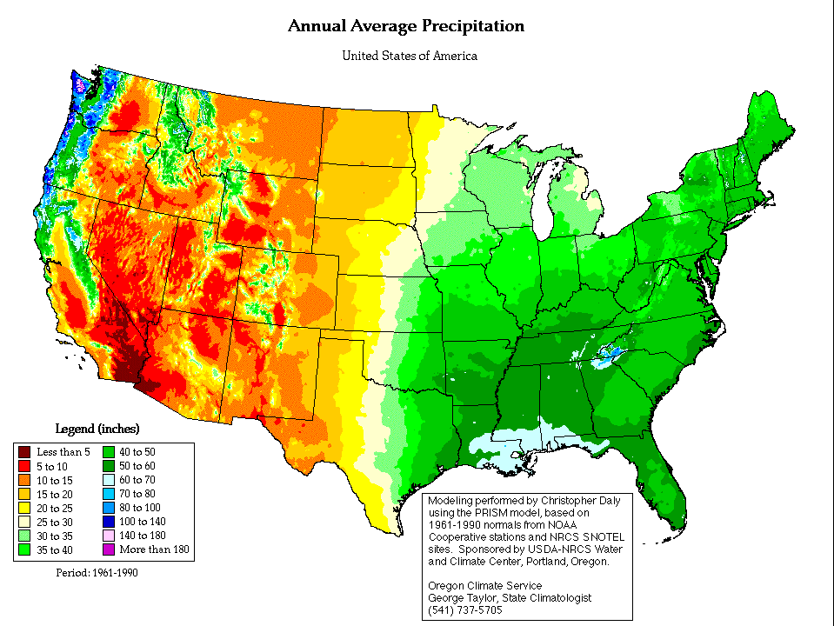
But, there is little water in the west
30 inch line

Slide 12
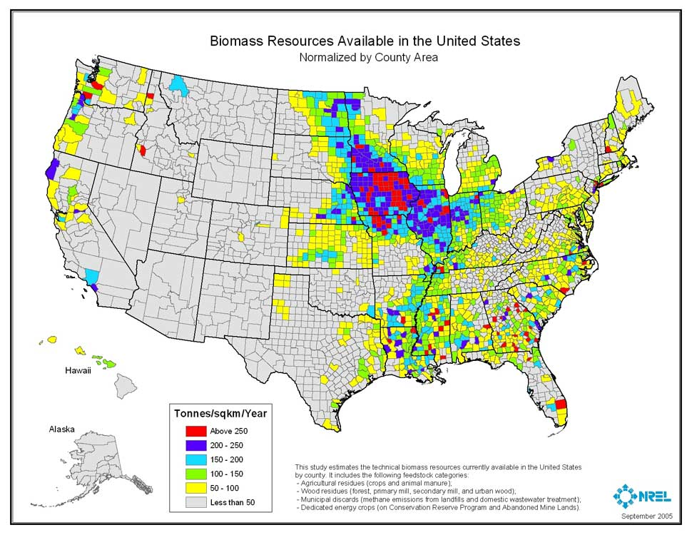
Biomass resources are highest in the midwest The midwest is ideally suited for biomass production

Slide 13
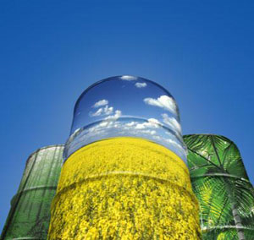
Which biofuel system? Oils versus starch-based ethanol
Oil crops yield more energy than starch crops used for ethanol
Starch-based ethanol yields 25% more net energy than energy inputs.
Plant oils yield 93% net more energy.
Oil-based fuels have twice the energy density of ethanol.
Oils crops are less polluting than starch-based ethanol fuel systems
Compared to starch crops for ethanol, plant oil crops generate only less nitrogen, phosphorous and pesticide pollutants.
Oil crops generate less green house gasses than starch-based ethanol fuel systems.
Relative to petroleum fuels, greenhouse gas emissions are reduced by 12% and 41% for ethanol and plant-based oils, respectively.
Hill et al. (2006) PNAS 103:11206.

Slide 14
Which oil crop to choose? The untapped potential of algae
Chisti (2007) Biotechnology Advan. 25:294

Slide 15
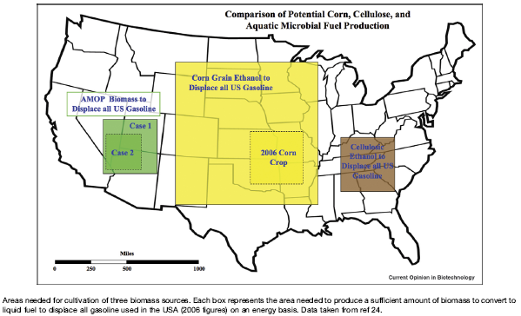
Relative land area to displace current US gasoline demand

Slide 16
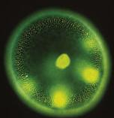
Biofuels from algae
Rapid growth rate
Double 6-12 hours
High oil content
4-50% non-polar lipids
Biomass harvested
100%
Harvest interval
24/7, not seasonally
CO₂ capture in ponds
Bicarbonate used by algae
4-50%
Lipid biomass
50-90%
Other biomass

Slide 17
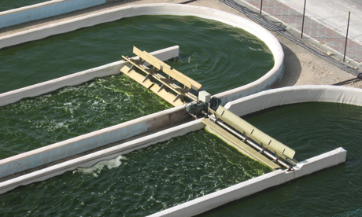
How do we make it work? It’s not dirt farming
Algal production systems (50-60% costs)
Fastest growing, highest biomass yielding strains
Grow well across a wide range of temp., light, etc.
Genomics, transformable, stable transgene expression
Containment of GMO algae
Enhancing photosynthetic efficiency
Increase oil accumulation with minimal biomass penalty
Environmental control and optimization
Contamination: algae, bacteria, viruses, grazers
Removal of growth-inhibiting waste products
Recycle growth media to reduce environmental impact
Harvesting systems (40-50% of costs)
Harvesting systems
Oil extraction processes
Optimized co-product yields to offset production costs
Bottom line is economics
How do we reduce the price from $35/gal to $2/gal?

Slide 18
Can we grow algae in the midwest? Summer, not winter is the issue
Water temperature
Ambient temperature
Growth temperature range
Heating/cooling load (right axis)

Slide 19
Enhancing biomass and oil yields A thermodynamic model Solar to biomass conversion efficiency = 3-5%
Increasing useable photons
Frequency shift UV and green light to wavelengths absorbed by chlorophyll.
Optimize light-harvesting antennae size
Percent total solar energy gain
Capture 300-400 nm = 1.2
Capture 500-600 nm = 1.9
Eliminate LHC = 2.0
Inhibit photorespiration = 3.5
Enhance Calvin Cycle = 2.2
Recycle glycerol = 0.08
Solar efficiency gain 10.8
Increasing CO₂ fixation
Inhibit photorespiration.
Enhance Calvin Cycle efficiency.
Increasing oil yield
Supplement media with reduced carbon (sugars) to increase oil yield.
Engineering oil synthesis and turnover
Proposed modifications could increase biomass yields by 2-3X assuming effects are additive.
*Total solar energy = 9.0 KWh/m²/day
No modifications = 5% efficiency

Slide 20
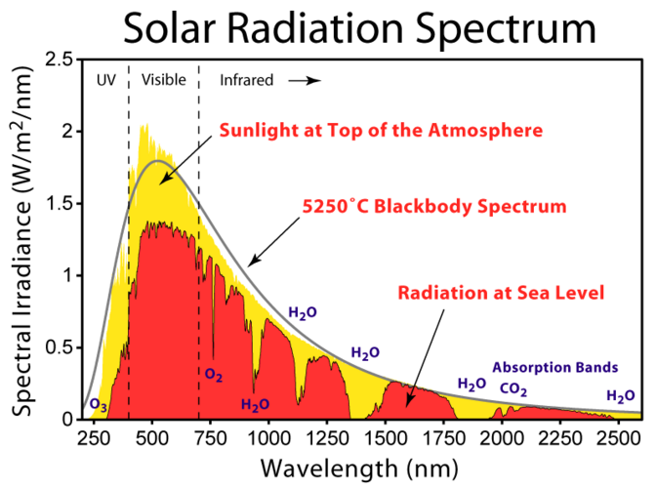
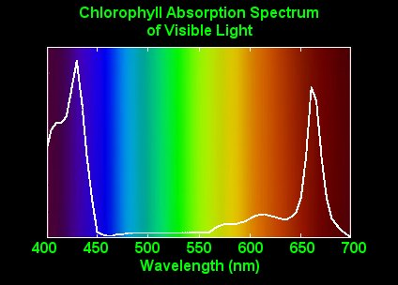
Shifting green to red light would provide more photons for photosynthesis
Green and near infra-red light are not absorbed by chlorophyll

Slide 21
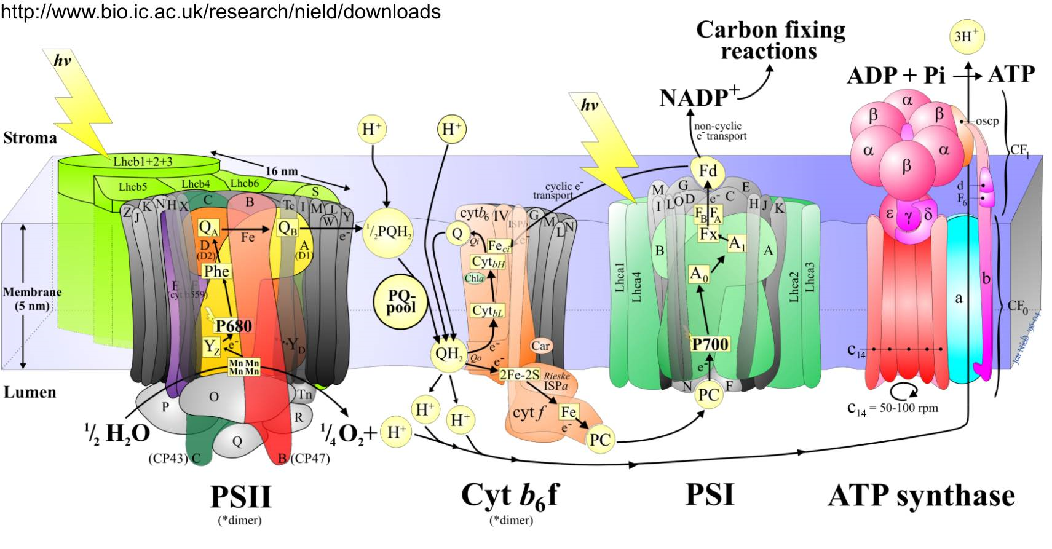
But, during 75% of the day photosynthesis is light saturated Reducing the antennae size increases efficiency at high light

Slide 22
Reduced light harvesting antennae size
Improves growth in deeper ponds
LHC+
Mix (1:1)
LHC-

Slide 23

Feeding sugars to algae Algae efficiently convert sugar to biomass and oil (90% energy conversion efficiency, 35% carbon conversion efficiency)
Relative total lipid yield
Growth Lipid content Dry weight Lipid yield
No addition 5 NRU* 0.4 g/L (1X) 2 (1X)
Glycerol
[20 mM] 18 (4X) 1.7 g/L (4X) 30 (15X)
Glucose
[15 mM] 55 (11X) 1.9 g/L (5X) 105 (52X)
*NRU = Nile red units/cell

Slide 24

Next generation systems
Metabolic engineering
Algae
Photosynthesis
Increased PAR
Enhanced catalytic complexes Metabolic channeling
Metabolic shunts
Pyruvate
Lipid Synthesis
Novel products

Slide 25
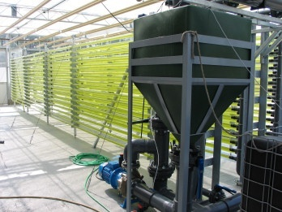
Reducing the costs of harvesting oils Milking oil from algae
Harvesting and extracting oil from algae accounts for 40-60% of the total production cost .

Slide 26
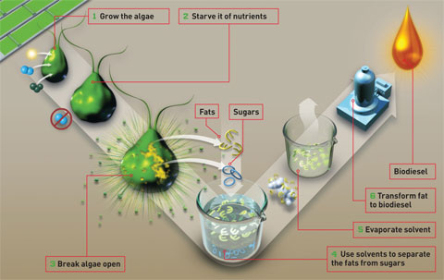
Current algal biodiesel production Room for improvement

Slide 27

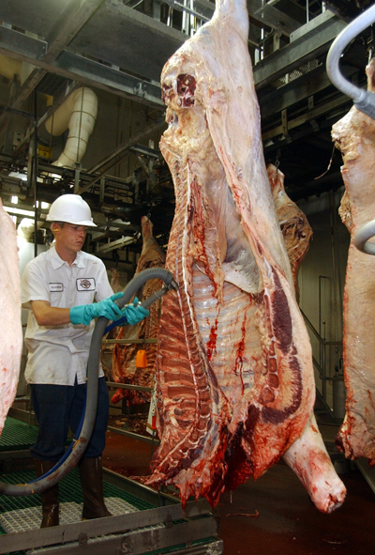
Milking oil from algae
“The compassionate alternative”
milking
No harvesting necessary
Slaughterhouse

Slide 28
Milking with biocompatible solvents
100% cell survival
Cont. C10 C11 C12 C13 C14 C15 C16
Solvents
Total cells/mL x 10⁻⁵.
Richard Sayre and Suzette Pereira, patent pending

Slide 29
Milking oil from algae
2.4-fold more biomass and 1.4-fold more oil
Trait | Milking cultures | Destructively extracted cultures
Biomass harvested | 208 mg/L 2.4X | 85 mg/L 1X
Total lipids produced | 175 mg/gdw 1.14 X | 154 mg/gdw 1X
Solvent extracted oils | 71 mg 1.39X | 51 mg 1X

Slide 30
Algal growth is not impaired by multiple milkings
Pond residence time is reduced three fold
1.2
0
Extracted
TAG fatty acids
C16:0 = 40%
C18:0 = 36%
C18:2 = 16%
C20:0 = 4.4%

Slide 31
A new systems approach
Milking Oil
Distillation
Nutrients
CO₂
Algae
Pond
Heterotrophic
Boost
Oil
Water Treatment
Destructive harvest
Delipidated Biomass
$35/gal → $2/gal
Milking oil
Co-product offsets
GMO algae
Pyrolysis
Anaerobic Digestion
VHC
Charcoal, Ash
Fuel
Methane
Biomass
Electricity
Sequestered carbon
Feed

Slide 32
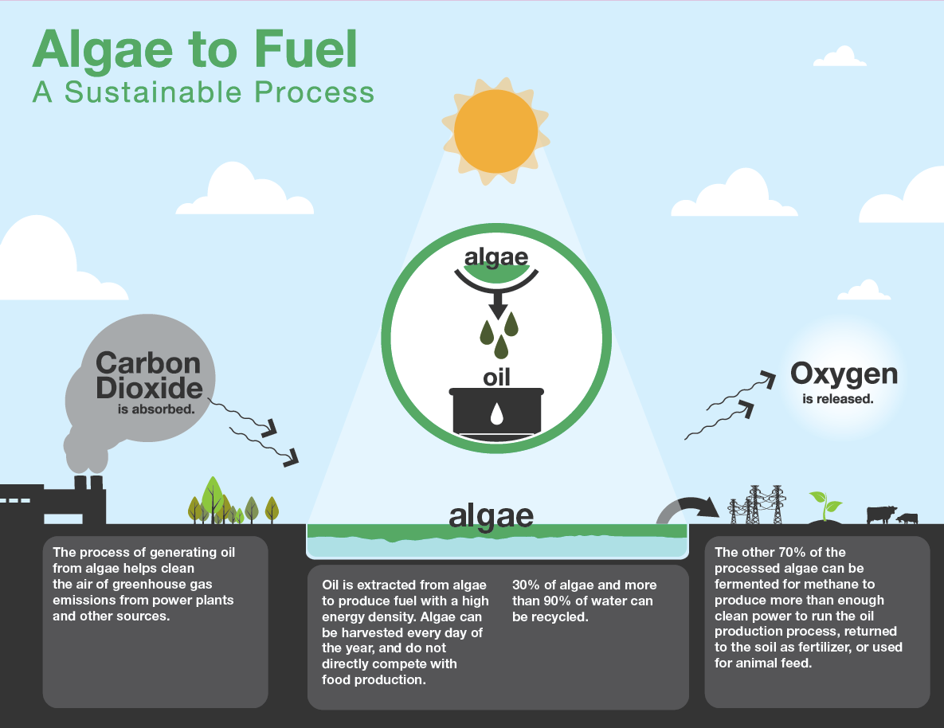

Slide 33
Collaborators
Danforth Center
Dr. Peizheng Yang
Dr. Shayani Pieris
Dr. Oliver Yu
Zoee Gokhale
Ohio State University
Dr. Robert Tabita
Dr. Linda Weavers
Dr. Patrice Hamel
Phycal LLC
Dr. Brad Postier
Dr. Dan Coury
Dr. Andrew Swanson
Clay Stroff
General Atomics

