Slide 1
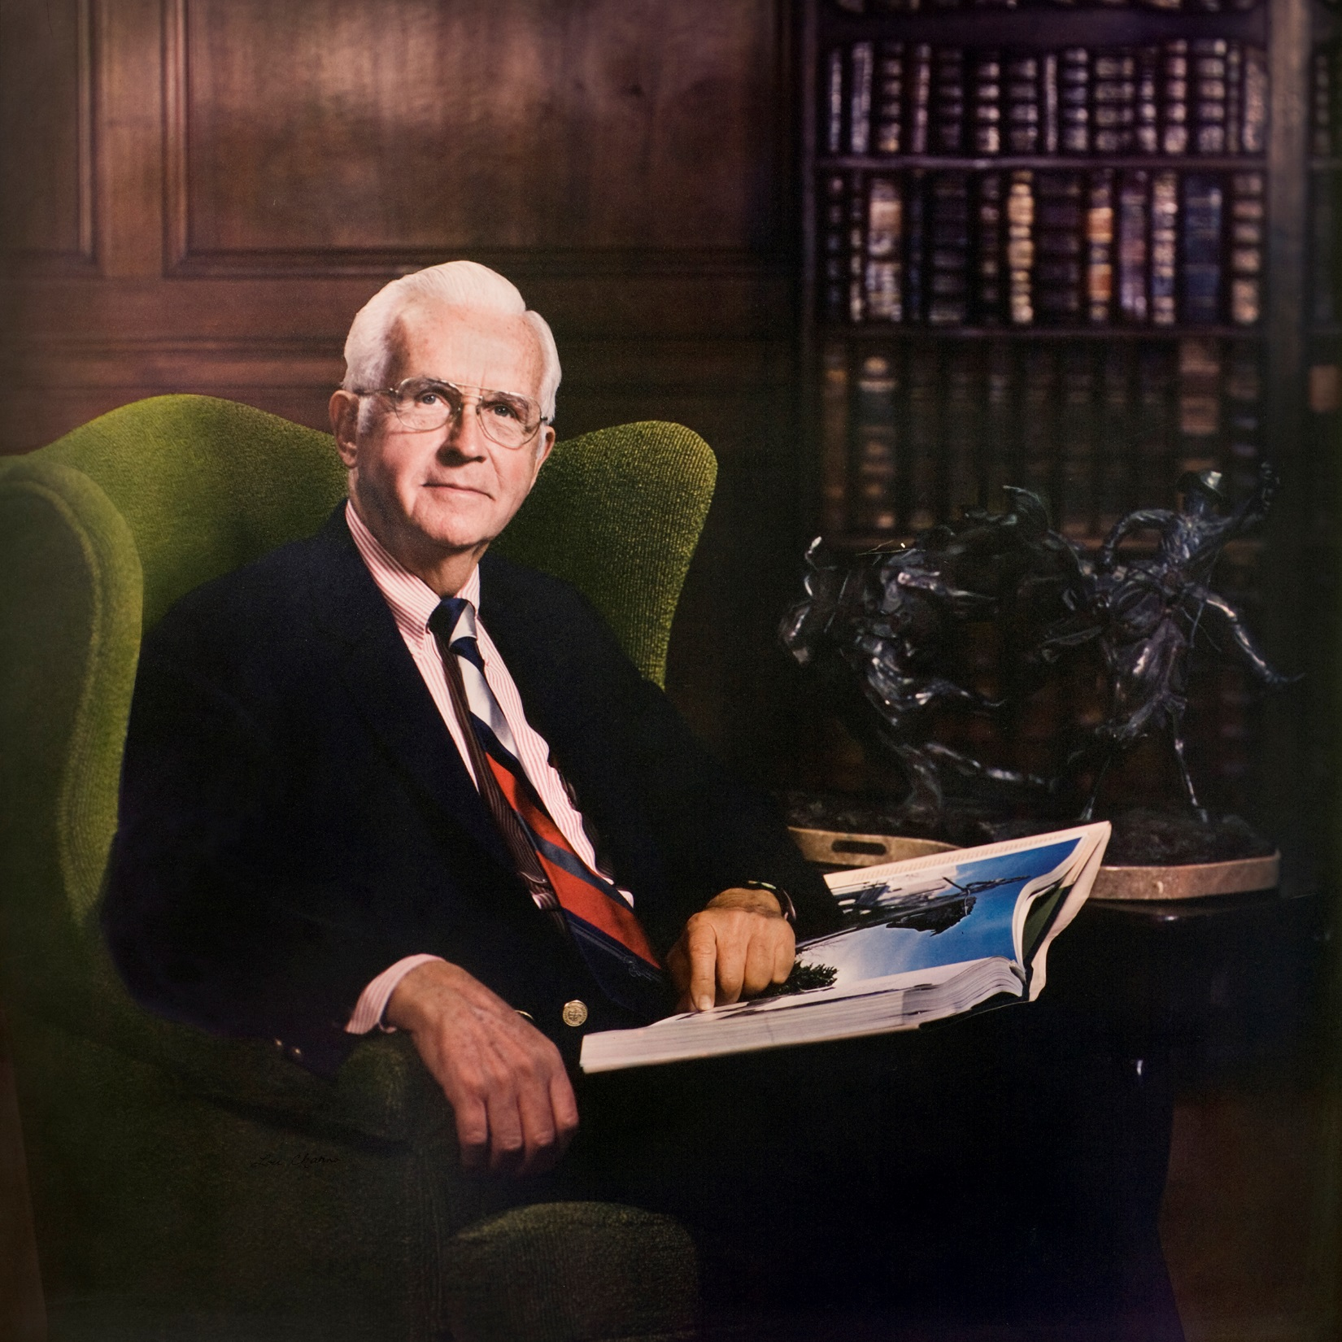
A TRIBUTE TO MILLER NICHOLS
Biography

Slide 2
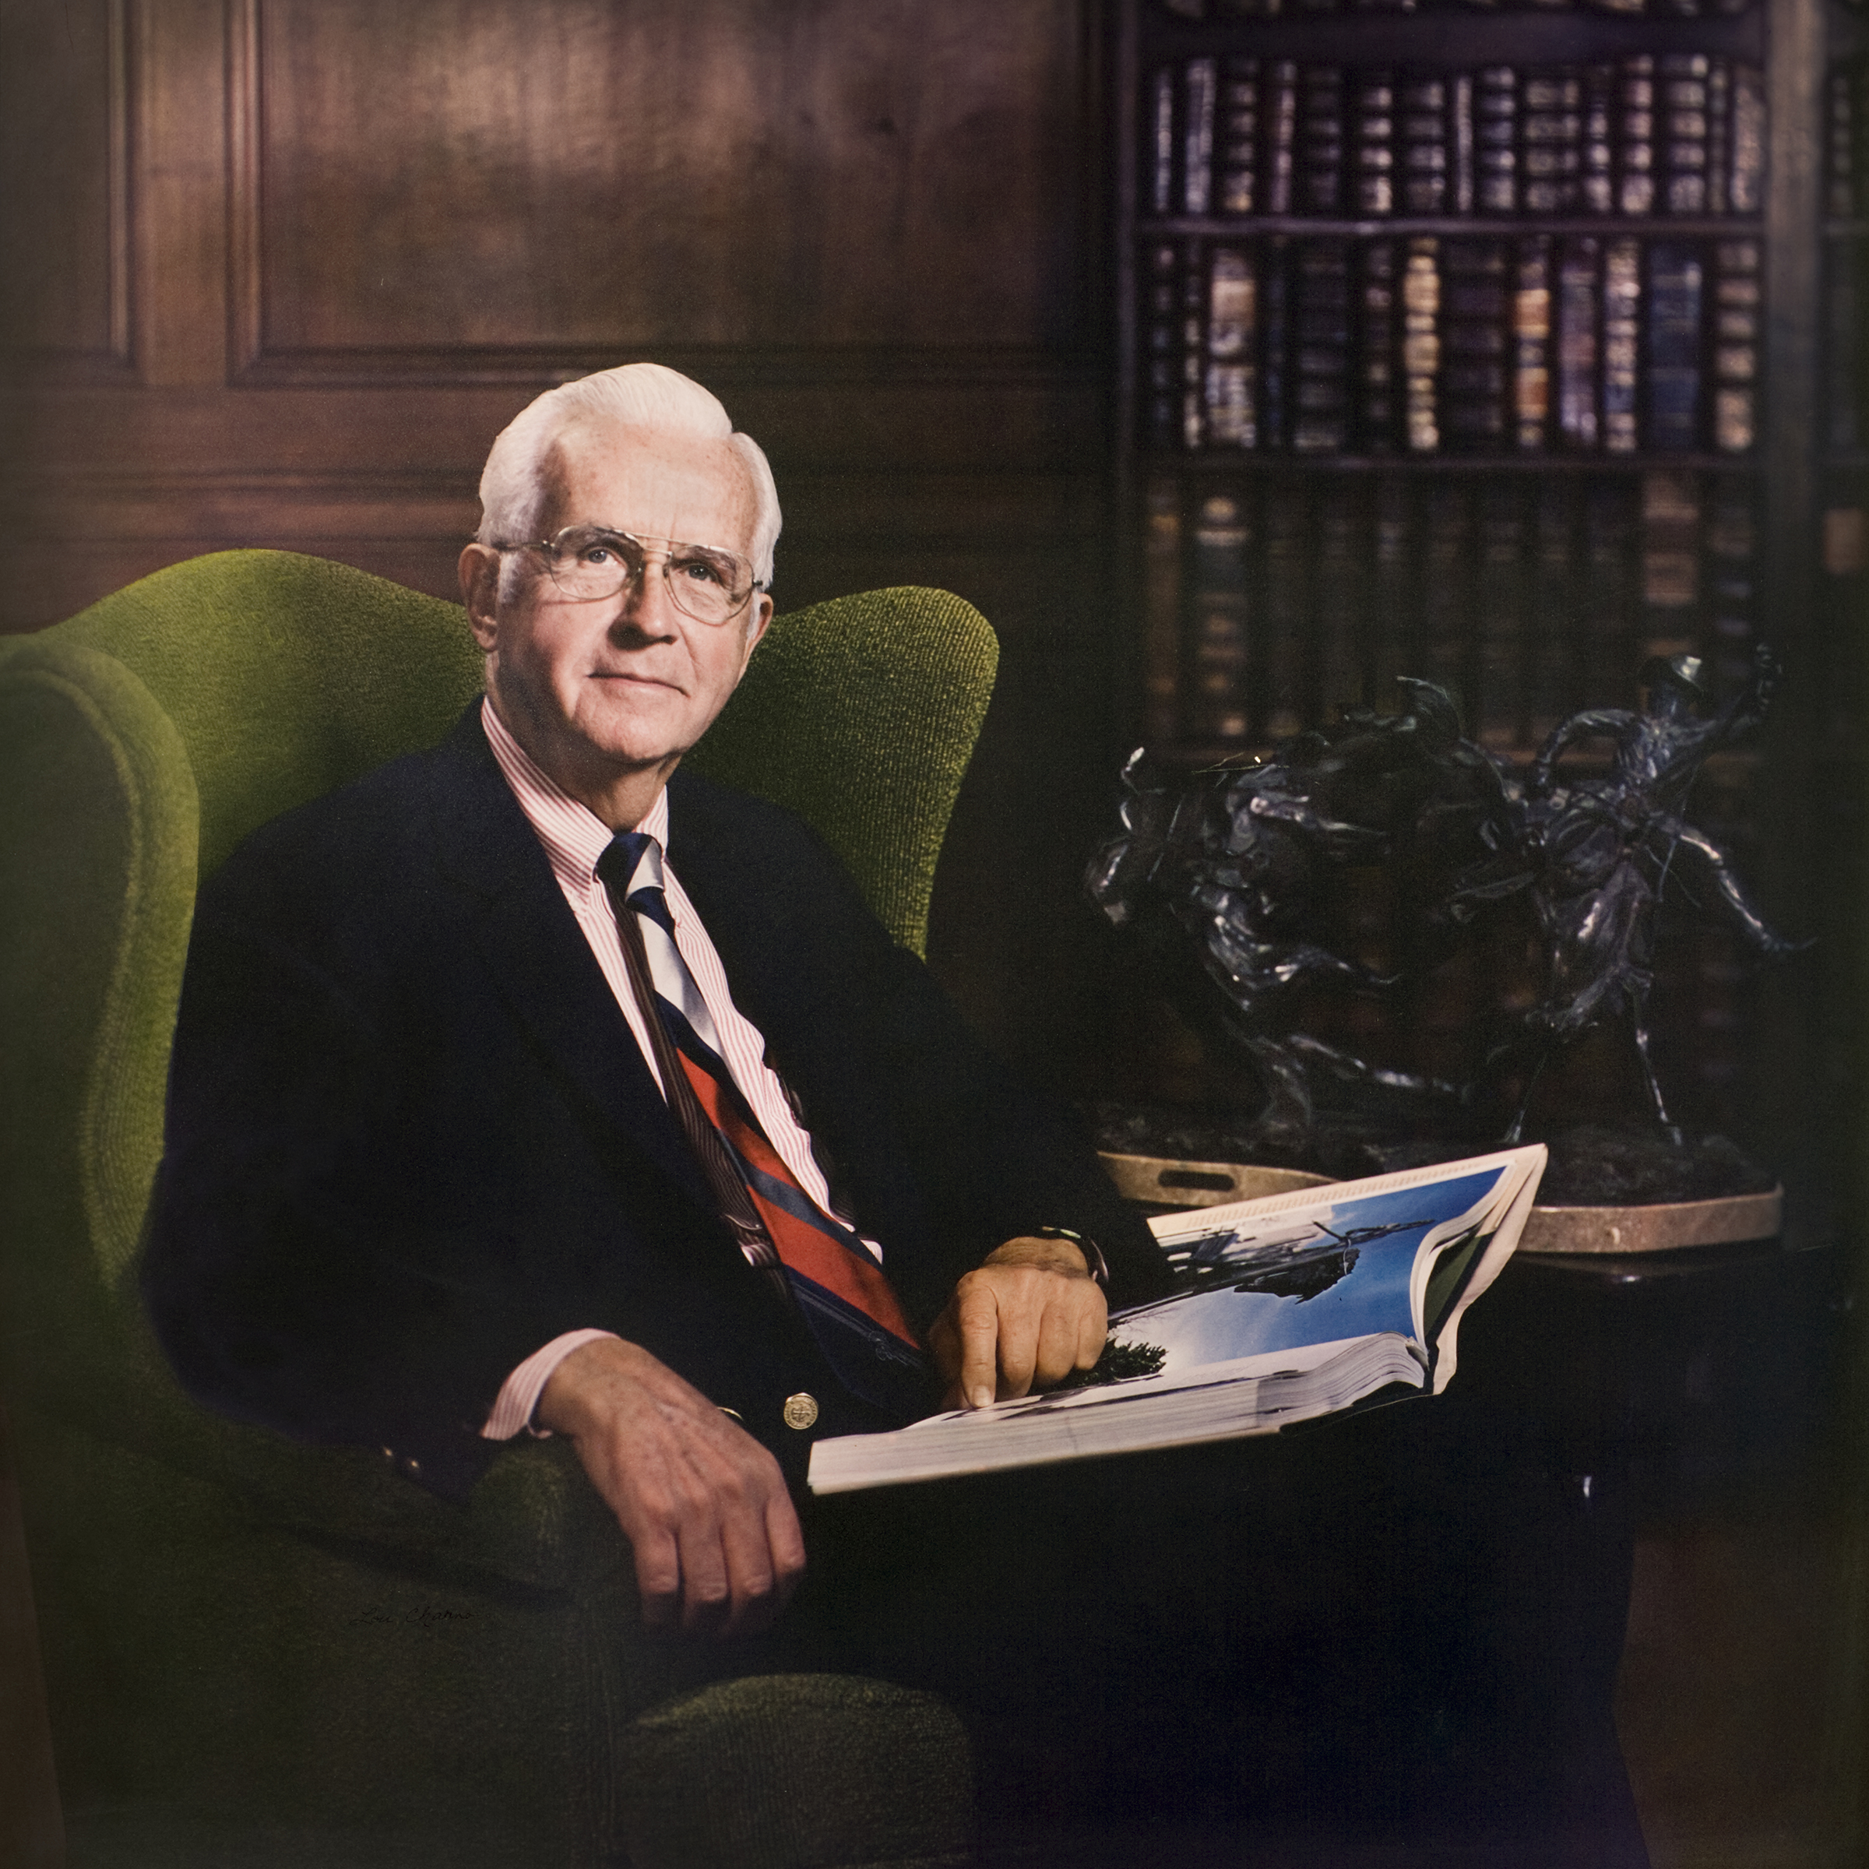
A TRIBUTE TO MILLER NICHOLS
Miller Nichols was the son of pioneer and visionary Jesse Clyde Nichols, better known as J.C. Nichols, prominent land owner and, real estate developer.
Miller Nichols graduated from Country Day School (now the Pembroke Hill School) and the University of Kansas where he was a member of the Beta Theta Pi Fraternity.
Biography

Slide 3
A TRIBUTE TO MILLER NICHOLS
J.C. Nichols’ developments include:
The Country Club Plaza, the first suburban shopping center in the world designed to accommodate shoppers arriving by automobile.
The Country Club District, the largest contiguous planned residential community in the U.S.
Miller Nichols built upon J.C. Nichols’ legacy and work.
Biography

Slide 4
A TRIBUTE TO MILLER NICHOLS
During World War II he enlisted in the Navy and spent time in Washington, D.C., and San Francisco, and was discharged as a Lt. Commander in 1945.
Prior to Pearl Harbor, Nichols served in the Hawaiian Department of the U.S. Army.
Biography

Slide 5
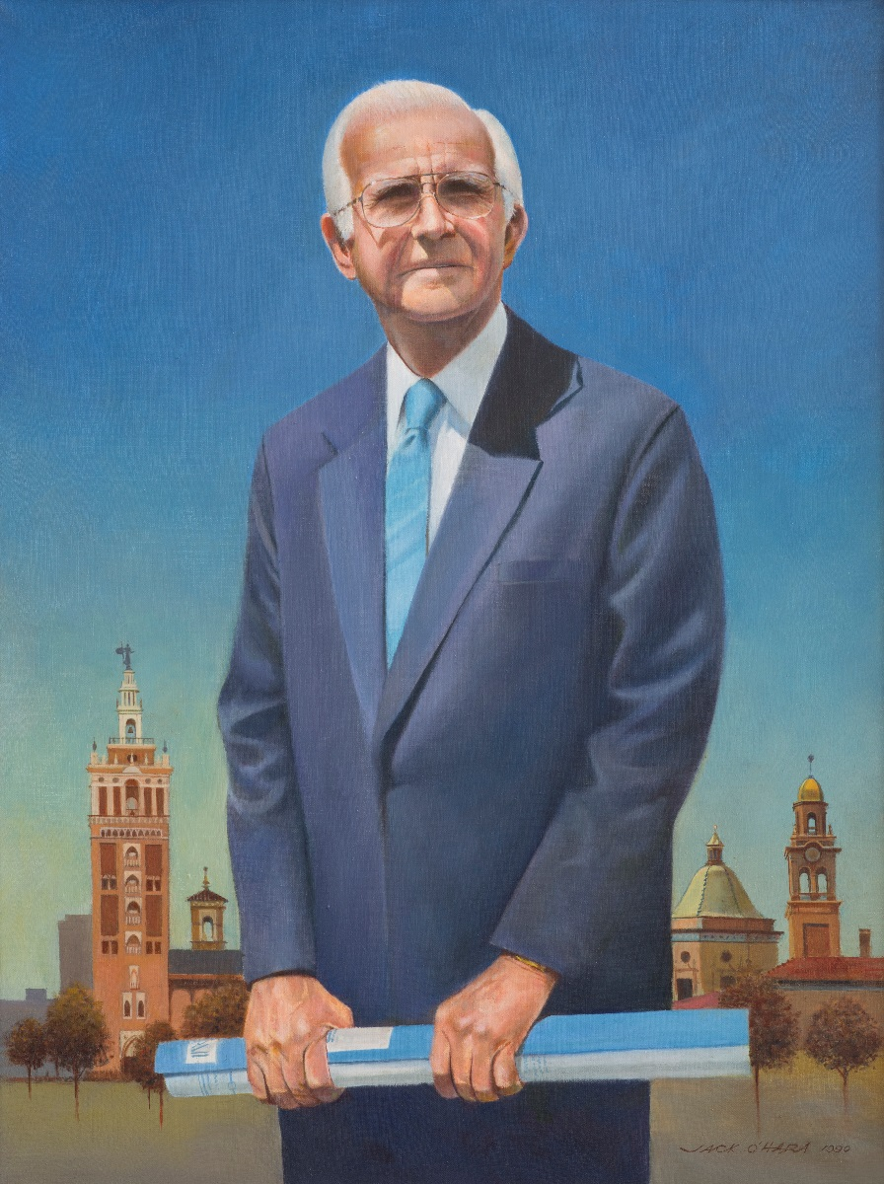
A TRIBUTE TO MILLER NICHOLS
For Nichols, the most important aspects of his life were his family, the Kansas City community and the J.C. Nichols Company.
In 1941, Nichols married Catherine (Katie) Caldwell in Kansas City, Missouri, and raised four daughters: Kay, Nance, Ann and Lynn. Katie passed away in 1977.
In 1979, Nichols married Jeannette Terrell Deweese and they remained together until his passing in 2000.
Biography

Slide 6
A TRIBUTE TO MILLER NICHOLS
Nichols’ focus on Kansas City emanated from his desire to make Kansas City “a better place to live,” a goal he promoted his entire life. He enjoyed the challenges and opportunities he saw in Kansas City.
He focused much of his efforts on fundraising, earning the nickname “White Heat.”
Later in life, he gave himself a middle name as his parents did not: “Persistence” personified his approach to projects and improvements in Kansas City.
Biography

Slide 7
A TRIBUTE TO MILLER NICHOLS
Mr. Nichols and the J.C. Nichols Company

Slide 8
A TRIBUTE TO MILLER NICHOLS
After military service, Nichols worked full time at the J. C. Nichols Company.
Upon his father’s death in 1950, he became President of the J. C. Nichols Company, which he headed until his retirement in 1988 .
Mr. Nichols and the J.C. Nichols Company

Slide 9
A TRIBUTE TO MILLER NICHOLS
Nichols shared his father’s vision for livable neighborhoods and, building on his father’s dreams, created his own legacy that focused primarily on Kansas City.
He was known for having an open-door policy—no matter the position they held in the J.C. Nichols Company, he welcomed talking with employees.
Mr. Nichols and the J.C. Nichols Company

Slide 10
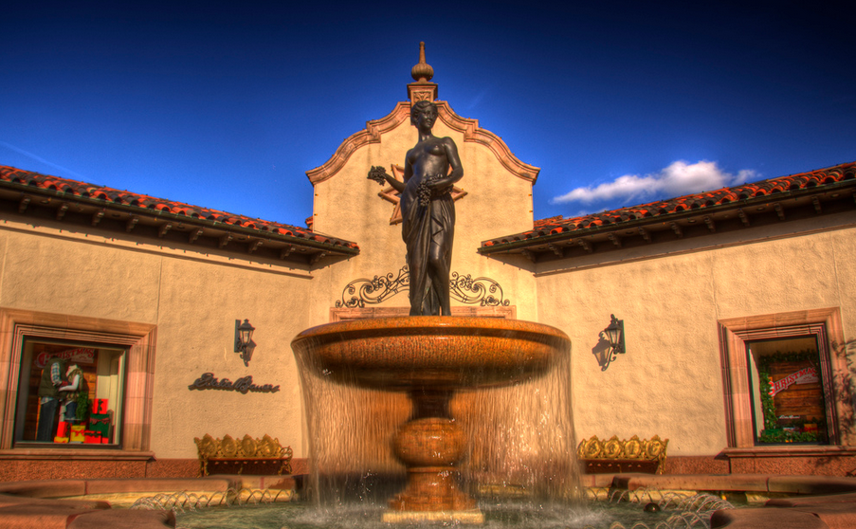
A TRIBUTE TO MILLER NICHOLS
Nichols concentrated much of his efforts on the company’s crown jewel – the Country Club Plaza. He oversaw the renovation of nine courtyards’, which the company reclaimed from former filling station sites; continued the free parking policy; upgraded and replaced buildings; installed statuary, fountains and art; and improved landscaping, all enhancing the Plaza experience.
Mr. Nichols and the J.C. Nichols Company

Slide 11
A TRIBUTE TO MILLER NICHOLS
Building on his father’s dream of always making the Plaza better, Nichols took the company to new heights, adding hotels and apartments to the Plaza’s landscape.
Mr. Nichols and the J.C. Nichols Company

Slide 12
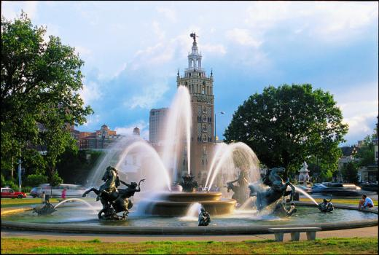
A TRIBUTE TO MILLER NICHOLS
Keeping in mind his father’s philosophy that people want a nice place they can take pride in, Nichols personally sought out the finest works of art from around the world to adorn the Plaza. The purchase and installation of the J.C. Nichols Memorial Fountain, a tribute to his father, was a project initiated in the late 1950s by the Nichols family and was funded by the family, the city and private donors, including Kansas City area school children.
The J.C. Nichols Memorial Fountain, one of the City’s most loved fountains, is a principal reason that Kansas City is known as “The City of Fountains.”
Mr. Nichols and the J.C. Nichols Company

Slide 13
A TRIBUTE TO MILLER NICHOLS
The J.C. Nichols Company also acquired the “Wild Boar” fountain, located at 47th Street and Wornall Road. This bronze is one of three replicas of the famous Wild Boar of Florence, Italy. The fountain features an area where visitors may drop coins for the children at Children’s Mercy Hospital, then rub the Wild Boar’s nose for good luck.
Mr. Nichols and the J.C. Nichols Company

Slide 14
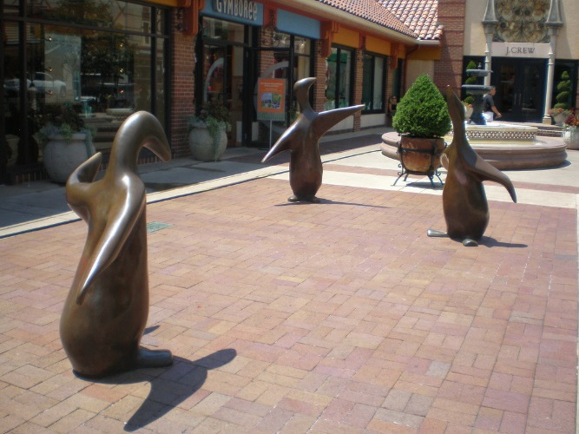
A TRIBUTE TO MILLER NICHOLS
Another beautification project of the early 1980s was the “Court of the Penguins.” While re-purposing the adjacent retail shops, Nichols saw an opportunity to complement and beautify the Plaza image. The answer came to Nichols when he saw three eight-inch bronze penguins on a friend’s desk. The trio of bronze penguins face one another in a semi-circle where children and adults can enjoy these contemporary and playful sculptures.
Mr. Nichols and the J.C. Nichols Company

Slide 15
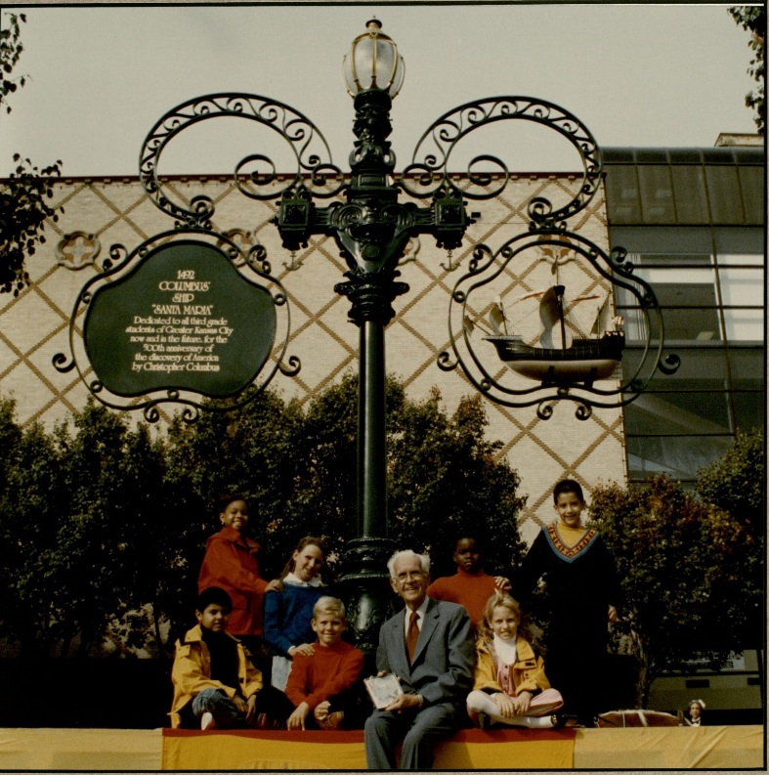
A TRIBUTE TO MILLER NICHOLS
Near the Court of Penguins is the Santa Maria Light on Nichols Road. The light, which features a replica of the Santa Maria, is “dedicated to all third grade students of Greater Kansas City now and in the future, for the 500th anniversary of the discovery of America by Christopher Columbus.”
Mr. Nichols and the J.C. Nichols Company

Slide 16
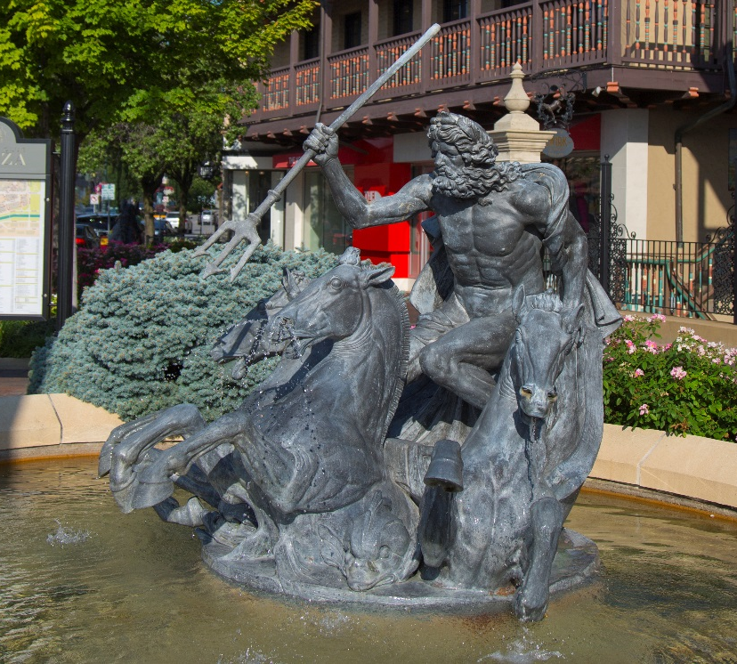
A TRIBUTE TO MILLER NICHOLS
The Nichols Company purchased the Neptune Fountain in 1952, a piece originally commissioned in 1911 by the president of the Baldwin Locomotive Company for his estate.
Mr. Nichols and the J.C. Nichols Company

Slide 17
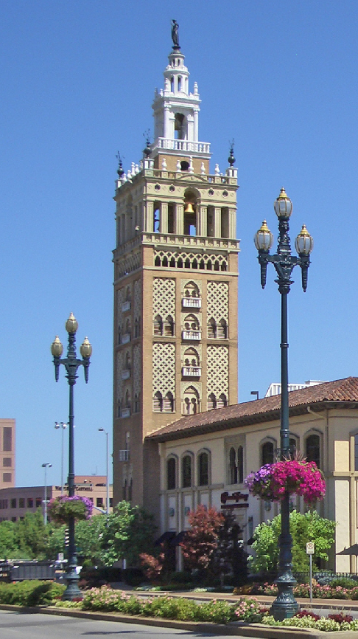
A TRIBUTE TO MILLER NICHOLS
There are more than 30 statues, murals and tile mosaics on display in the Plaza area, as well as major architectural reproductions, such as the Giralda Tower and the Seville Light, both completed in 1967. Along with the J.C. Nichols Memorial Fountain, they form an impressive east entrance to the Plaza.
Mr. Nichols and the J.C. Nichols Company

Slide 18
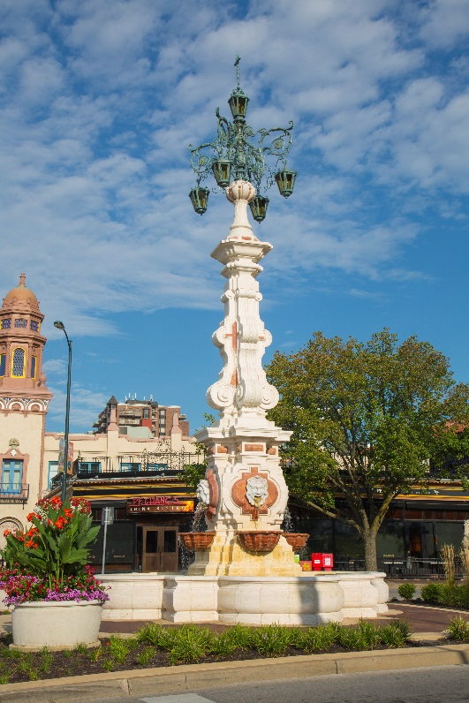
A TRIBUTE TO MILLER NICHOLS
Commissioned by Nichols in 1967, the Seville Light Fountain at 47th Street and J.C. Nichols Parkway is an exact replica of the Plaza de Los Reyes fountain in Seville, Spain. The fountain, which had not worked for years, was restored in 2015.
Mr. Nichols and the J.C. Nichols Company

Slide 19
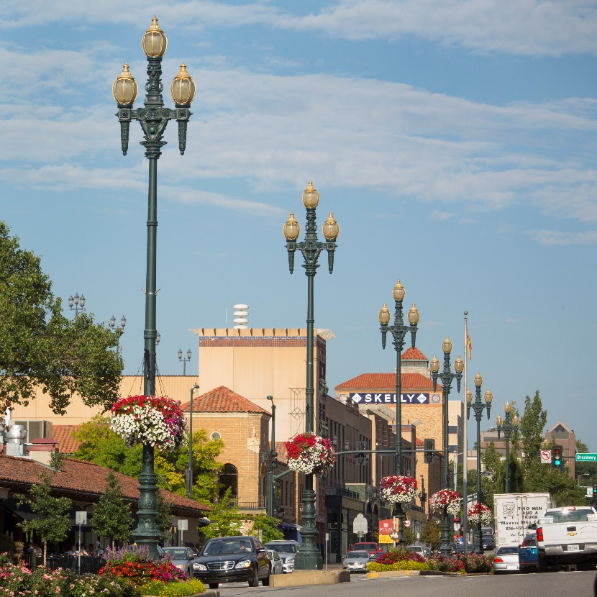
A TRIBUTE TO MILLER NICHOLS
The Plaza also includes reproductions of San Francisco's Path of Gold streetlights on West 47th Street. These ornamental street lights were a favorite of Nichols and add to the Plaza’s ambiance.
Mr. Nichols and the J.C. Nichols Company

Slide 20
A TRIBUTE TO MILLER NICHOLS
In May 1960, Nichols, his family, friends and business associates and the City of Kansas City, dedicated the J.C. Nichols Memorial Fountain in Mill Creek Park. Nichols had a key role in finding the location, fundraising and installing one of Kansas City’s most visited fountains.
Mr. Nichols and the J.C. Nichols Company

Slide 21
A TRIBUTE TO MILLER NICHOLS
Extensive restoration of this fountain and ten sculptures was completed in April 2015. When the Nichols Fountain was originally installed, one of the dolphins was missing, so a replica was made. In 2008, a Florida resident realized he had the missing dolphin and sold it to the Kansas City Parks and Recreation department. The original dolphin returned “home” as part of the 2015 restoration and now has its own pedestal alongside the fountain.
Mr. Nichols and the J.C. Nichols Company

Slide 22
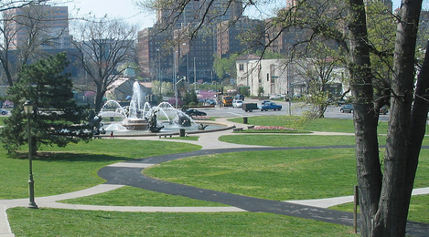
A TRIBUTE TO MILLER NICHOLS
Working alongside his friend, Ben McCallister, a cardiologist at St. Luke’s Hospital and co-founder of the Mid-America Heart Institute (the first heart hospital built in the United States), Nichols began restoration of Mill Creek Park near the Plaza and St. Luke’s Hospital.
Mr. Nichols and the J.C. Nichols Company

Slide 23
A TRIBUTE TO MILLER NICHOLS
Restoration and improvement continue through the Mill Creek Park Association, an organization Nichols and McCallister founded with the Kansas City Department of Parks and Recreation.
Mr. Nichols and the J.C. Nichols Company

Slide 24
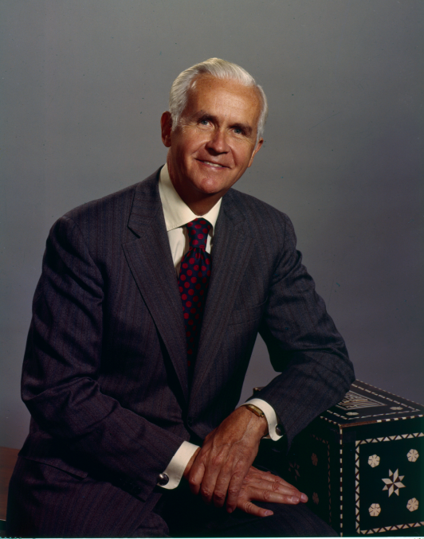
A TRIBUTE TO MILLER NICHOLS
Contributions to umkc

Slide 25
A TRIBUTE TO MILLER NICHOLS
An active participant in the suburban growth of Kansas City, Nichols understood the importance of preserving and enhancing the cultural core of the city, particularly around the Nelson-Atkins Museum, UMKC and the Midwest Research Institute (MRI).
Because he believed that every great city should have a great university, Nichols served as a UMKC Trustee for more than 30 years.
Contributions to umkc

Slide 26
A TRIBUTE TO MILLER NICHOLS
Nichols, like his father, took the long view, creating neighborhoods with community assets, such as schools, churches, parks and shopping areas that could evolve and succeed through time. He knew that the university would need additional land to grow both in offerings and excellence.
Contributions to umkc

Slide 27
A TRIBUTE TO MILLER NICHOLS
Rather than build vertically, a more expensive method and one incompatible with the neighborhood, Nichols led the effort to acquire land for UMKC’s future, increasing the campus from a 75-acre site to approximately 225 acres.
Contributions to umkc

Slide 28
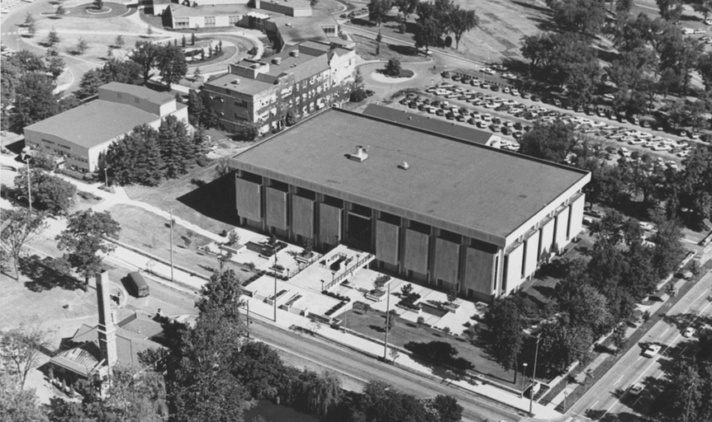
A TRIBUTE TO MILLER NICHOLS
During the 1980s, Nichols was responsible for more than $3 million in personal and company gifts to UMKC, including a donation to help fund the expansion of the library. In 1989, the University of Missouri Board of Curators voted to change the name of the UMKC General Library to the Miller Nichols Library.
Contributions to umkc

Slide 29
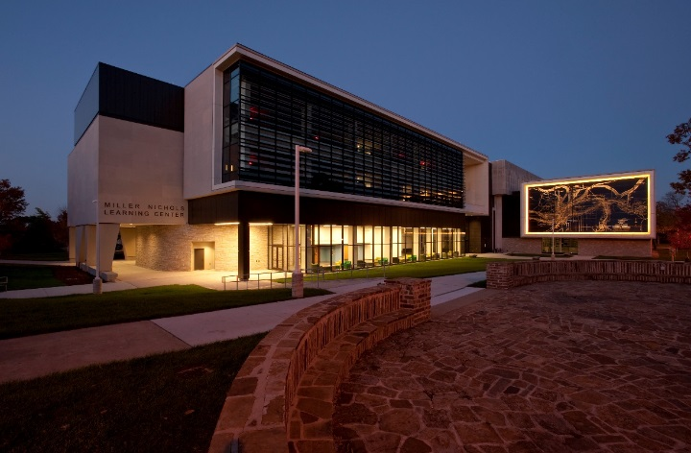
A TRIBUTE TO MILLER NICHOLS
Nichols’ legacy continued with the addition of the Robot, a book retrieval system, to the Miller Nichols Library. It became a “change agent” for the Library’s transformation. The most recent addition, the Miller Nichols Learning Center, was completed in August 2013. Ongoing renovations at the Library will improve the learning spaces and provide additional resources.
Contributions to umkc

Slide 30
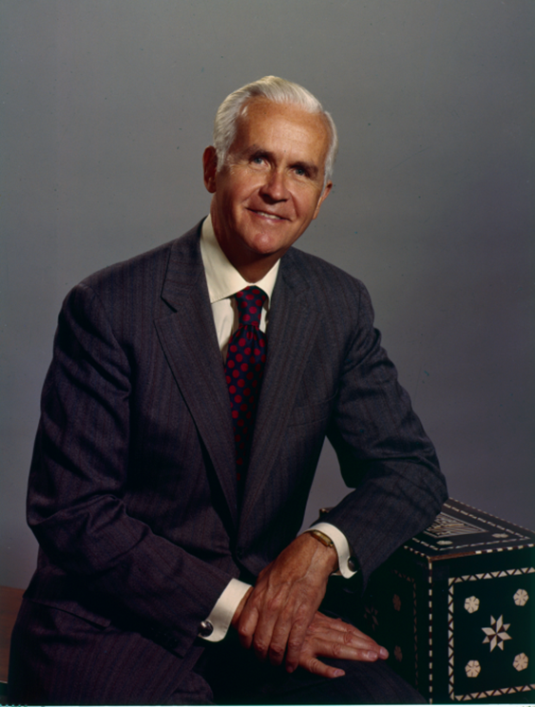
A TRIBUTE TO MILLER NICHOLS
Contributions to Kansas city

Slide 31
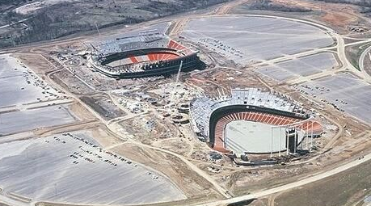
A TRIBUTE TO MILLER NICHOLS
Nichols raised qualifying money for bonds to build the Kansas City Sports Complex and Kansas City International Airport (KCI).
Contributions to Kansas city

Slide 32
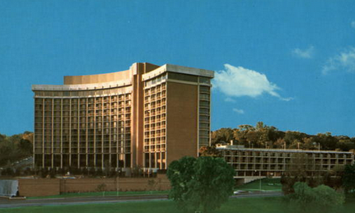
A TRIBUTE TO MILLER NICHOLS
For many years, Nichols spearheaded the effort to build the Alameda Hotel (now the Intercontinental Hotel) on the Plaza. This was the first deluxe hotel south of Downtown Kansas City.
Contributions to Kansas city

Slide 33
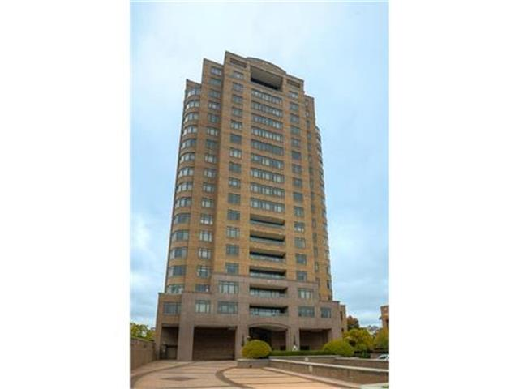
A TRIBUTE TO MILLER NICHOLS
The Nichols Company also introduced the first residential deluxe high-rise condominiums to the Kansas City area, building the Alameda Tower south of the Hotel.
In addition to UMKC, Nichols helped acquire land for Rockhurst University and for St. Luke’s Hospital’s main facility north of the Plaza.
Contributions to Kansas city

Slide 34
A TRIBUTE TO MILLER NICHOLS
Nichols served on many executive civic committees, among them:
The Chamber of Commerce
The Civic Council, (charter member), where he continued to serve as honorary director
Midwest Research Institute (MRI), Vice Chairman of the board, chair of the building committee, and a member of the executive committee from 1953-1982
Heart of America United Fund Campaign, general chairman
Contributions to Kansas city

Slide 35
A TRIBUTE TO MILLER NICHOLS
Nichols served many local groups in an executive role, including:
Chairman of the Kansas City Crime Commission (two terms) , 1953-54
President of the Kansas City Philharmonic Association in 1963; Chair of the Trustees of the Philharmonic Foundation, 1964
Director of the Performing Arts Foundation
Contributions to Kansas city

Slide 36
A TRIBUTE TO MILLER NICHOLS
Civic honors

Slide 37
A TRIBUTE TO MILLER NICHOLS
Among his many awards were the following:
Beta of the Year Award, 1963
“Mr. Kansas City,” Kansas City Chamber of Commerce, 1969
UMKC Chancellor’s Medal, 1970
Junior Achievement – Free Enterpriser of the Year, 1975
Civic honors

Slide 38
A TRIBUTE TO MILLER NICHOLS
William Booth Award for Community Service, Salvation Army, 1979
Distinguished Service Citation, University of Kansas, 1979
William F. Yates Medallion for Distinguished Service, William Jewell College, 1980
Doctor of Business Administration Honoris Causa, University of Missouri, 1989
Civic honors

Slide 39
A TRIBUTE TO MILLER NICHOLS
Spirit of Philanthropy Award from the Mid-America Chapter, National Society of Fund Raising Executives, 2000
Inductee, Junior Achievement of Middle America's 2011 Greater Kansas City Business Hall of Fame
Civic honors

Slide 40
A TRIBUTE TO MILLER NICHOLS
Throughout his life, Miller Nichols remained focused on Kansas City’s growth and accomplishments, beautifying the city and leaving something much greater than it was before.

Slide 41
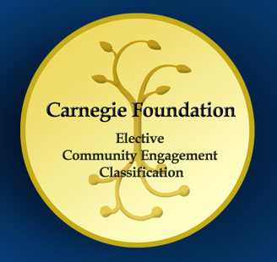
UMKC: An Urban University
Vision Statement
UMKC will become a model urban research university characterized by signature graduate and professional programs, a dynamic undergraduate population, a highly diverse faculty, staff and student body, and active engagement with its city and region.
Mission Statement
UMKC's mission is to lead in life and health sciences; to deepen and expand strength in the visual and performing arts; to develop a professional workforce and collaborate in urban issues and education; and to create a vibrant learning and campus life experience
Goal: Advance Urban Engagement
To become a model urban university by fully engaging with the Kansas City community to enhance education, public health, the arts and economic development.
Mission

